Slide 1

Notes:
Welcome and one-sentence summary: unified GPU-ready differentiable path tracing for reflection and diffraction sequences.

Slide 2
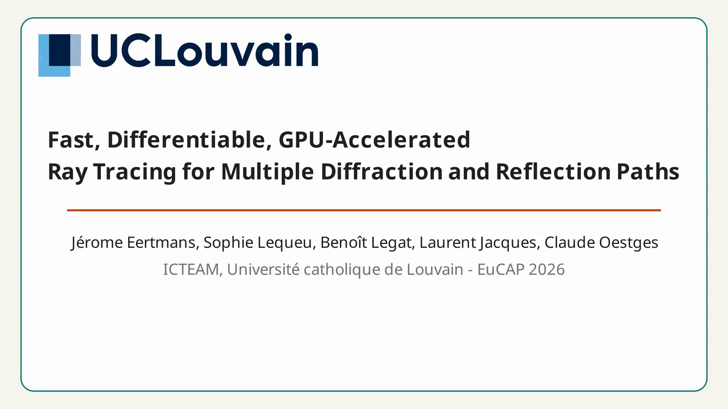
Notes:
Motivate the paradigm shift and stress why differentiability matters for inverse localization and material calibration demos.

Slide 3
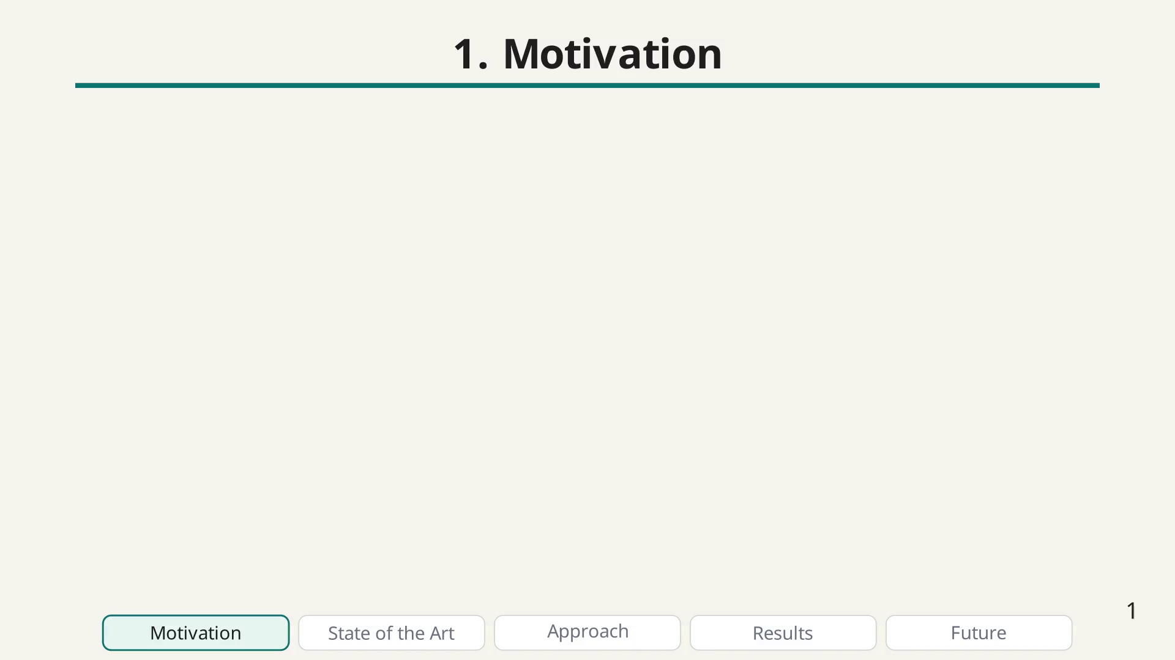
Notes:
Motivation bullet

Slide 4
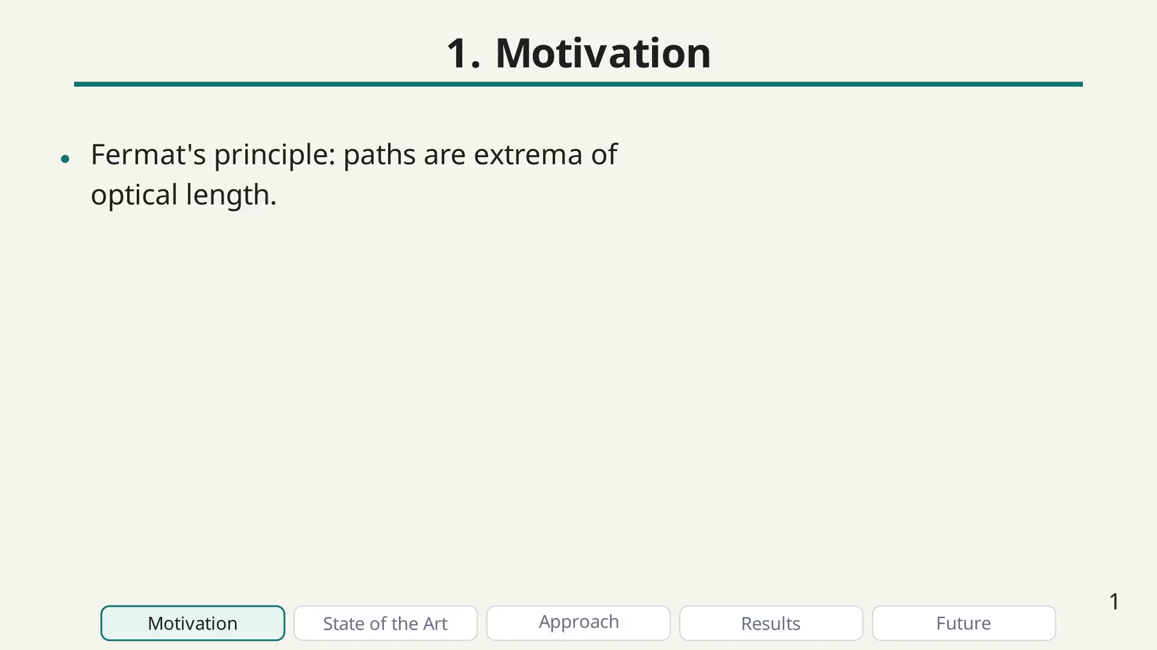
Notes:
Motivation bullet

Slide 5
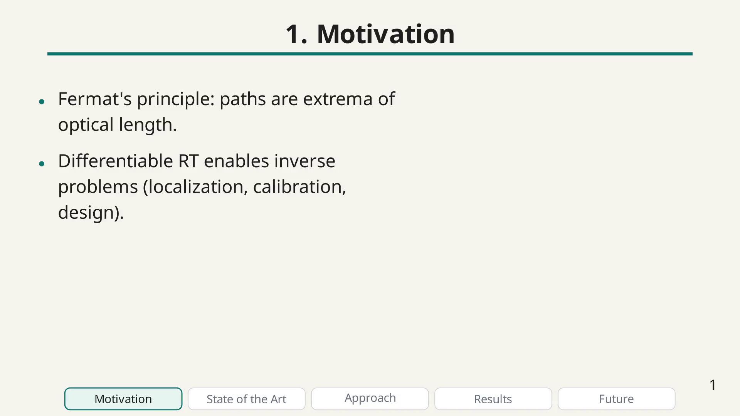
Notes:
Motivation bullet

Slide 6
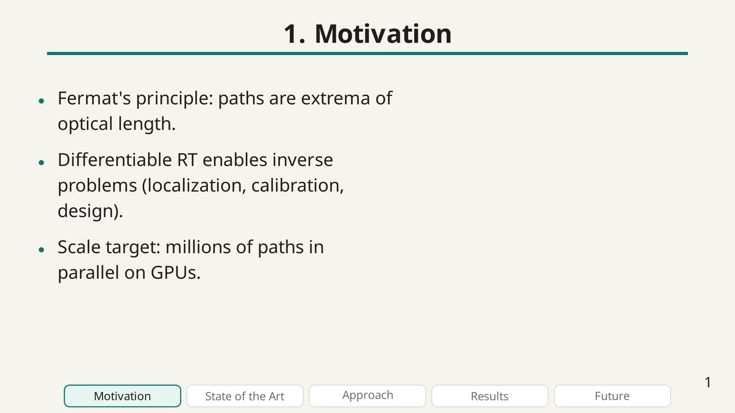
Notes:
Illustrate the motivation on an urban street-canyon scenario where many paths are needed in parallel.

Slide 7
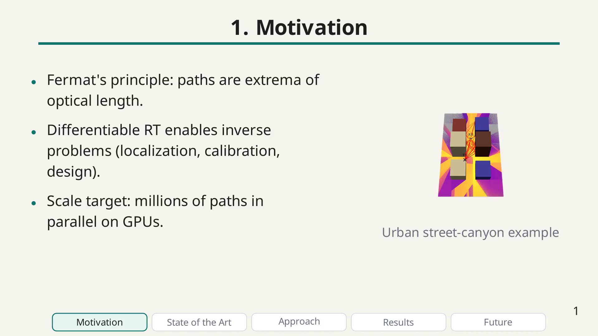
Notes:
Zoom on the image

Slide 8
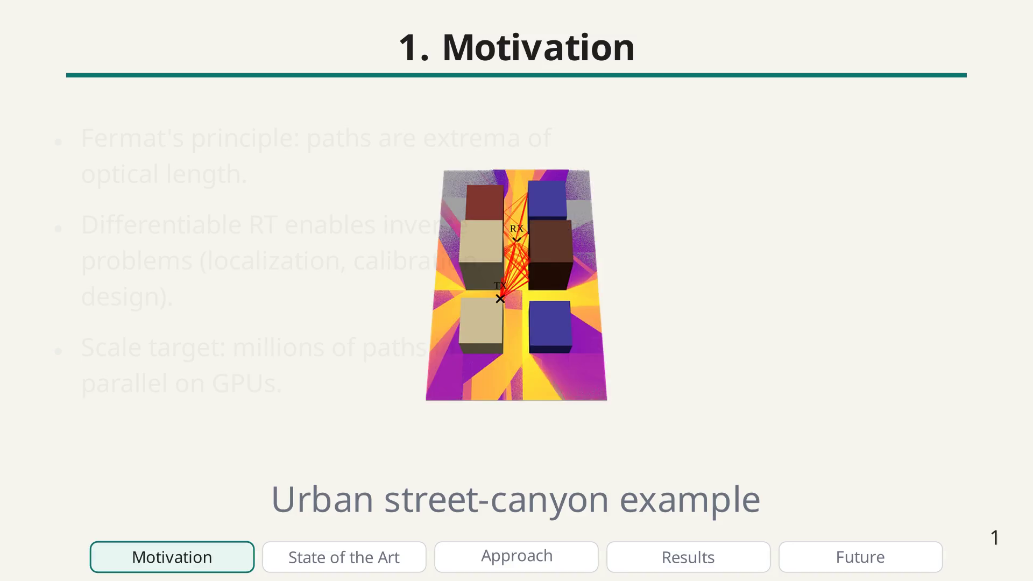
Notes:
Playing video

Slide 9
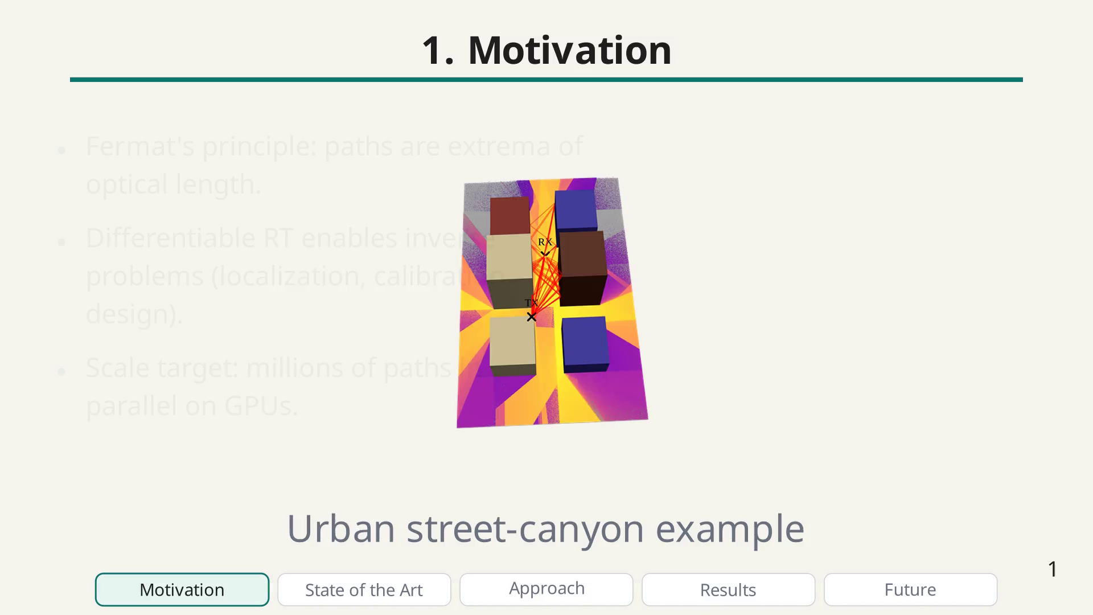
Notes:
We observe a paradigm shift: RT is becoming differentiable and GPU-friendly, unlocking new applications but also requiring new methods.

Slide 10
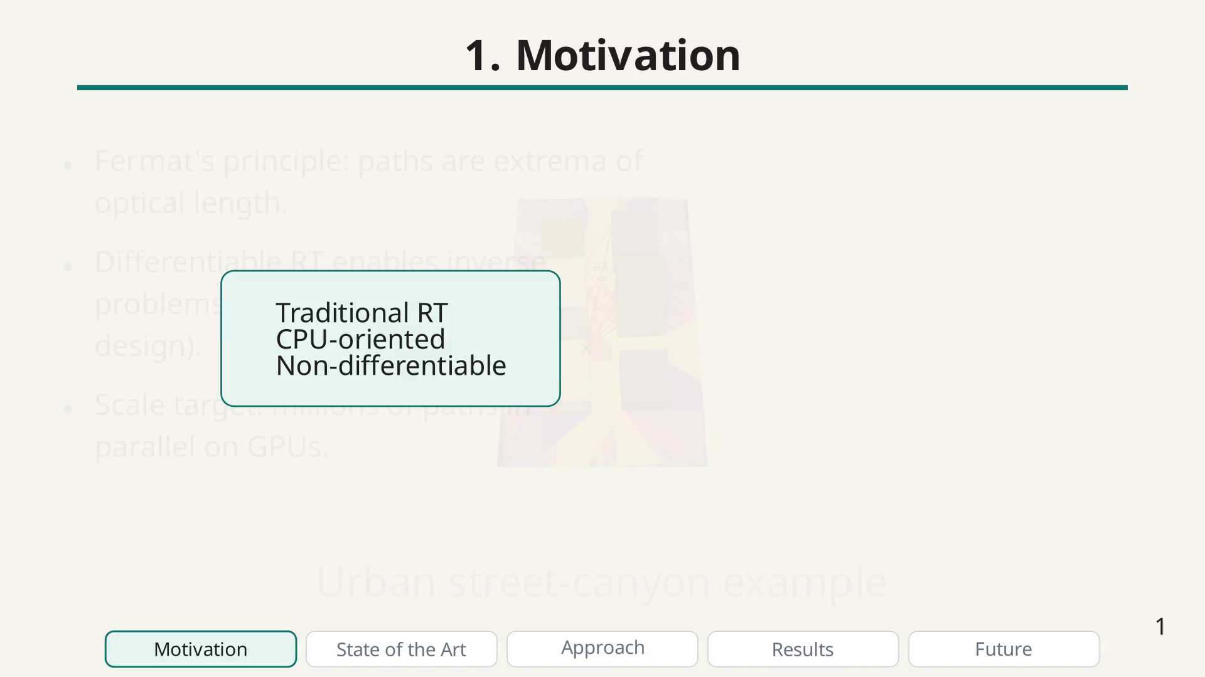
Notes:
to...

Slide 11
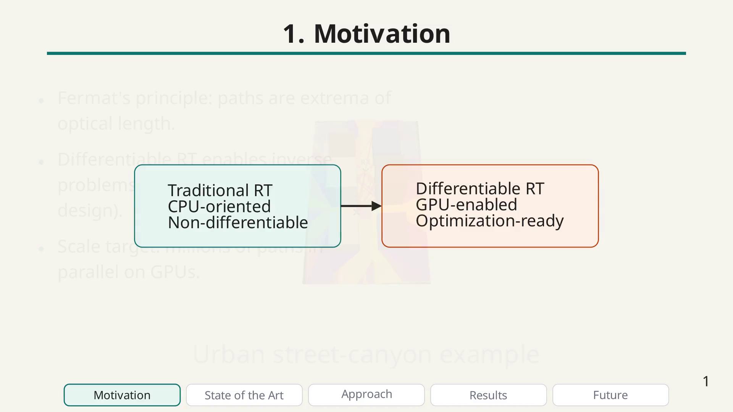
Notes:
In practice, such applications pose some implementation challenges:

Slide 12
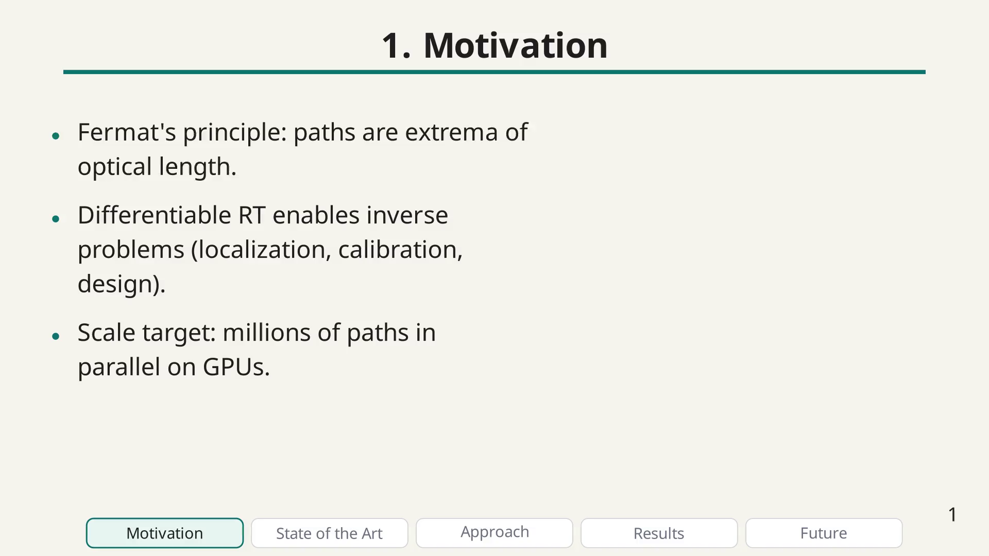
Notes:
Challenge bullet

Slide 13
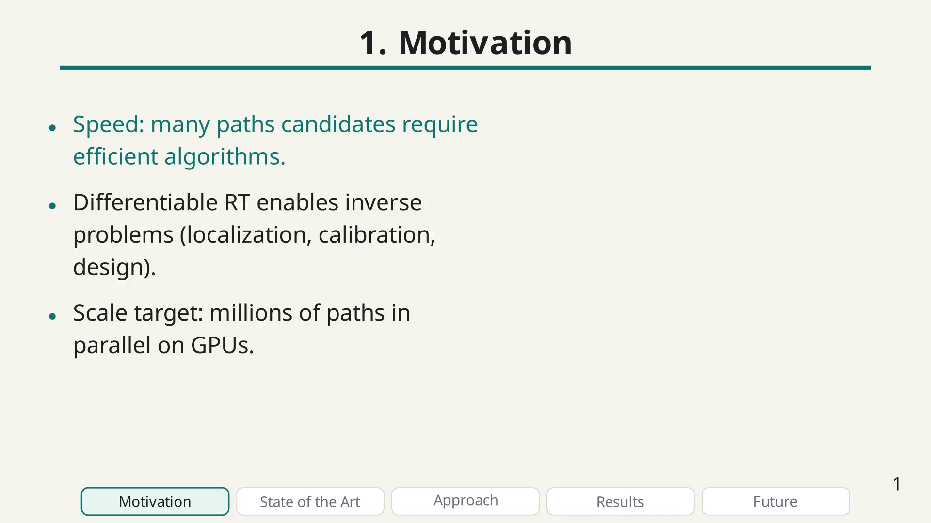
Notes:
Challenge bullet

Slide 14
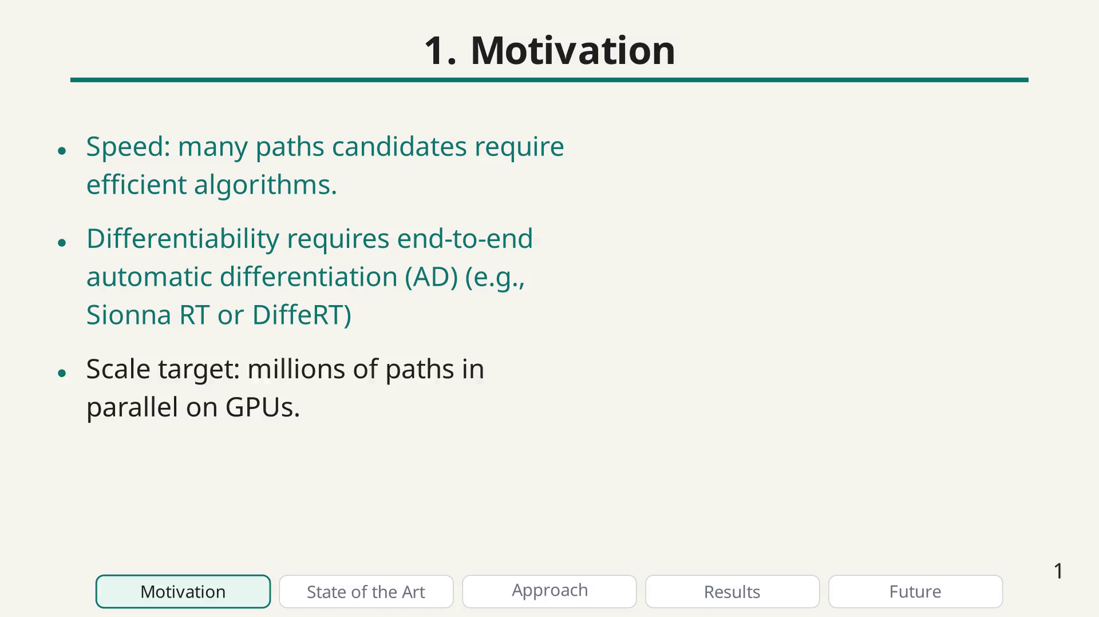
Notes:
Challenge bullet

Slide 15
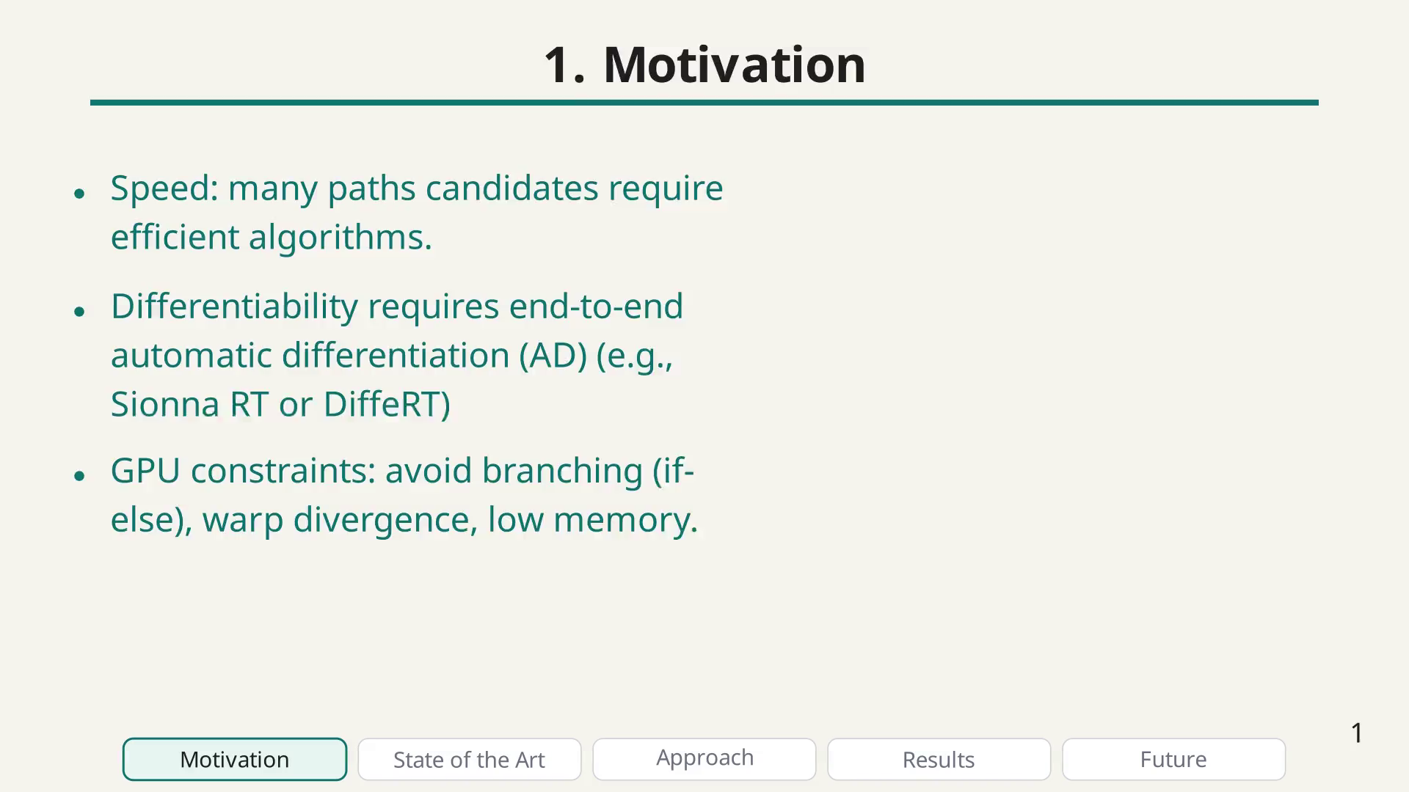
Notes:
Quick map of the presentation and pacing.

Slide 16
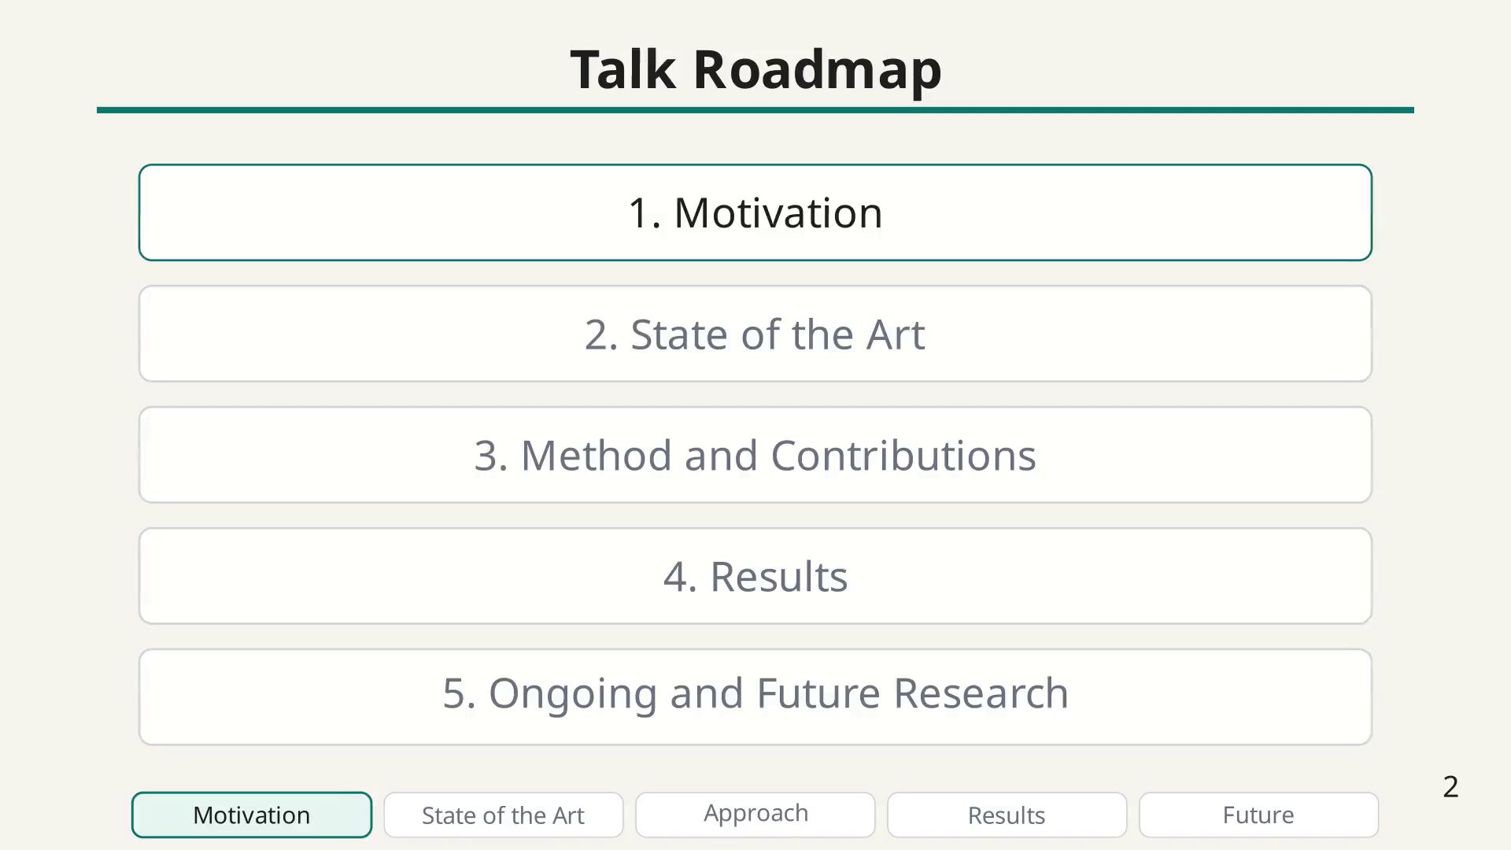
Notes:
Recall prior work from the paper and highlight Fermat-based path formulation as the unifying physical principle.

Slide 17

Notes:
Geometry: problem formulation

Slide 18
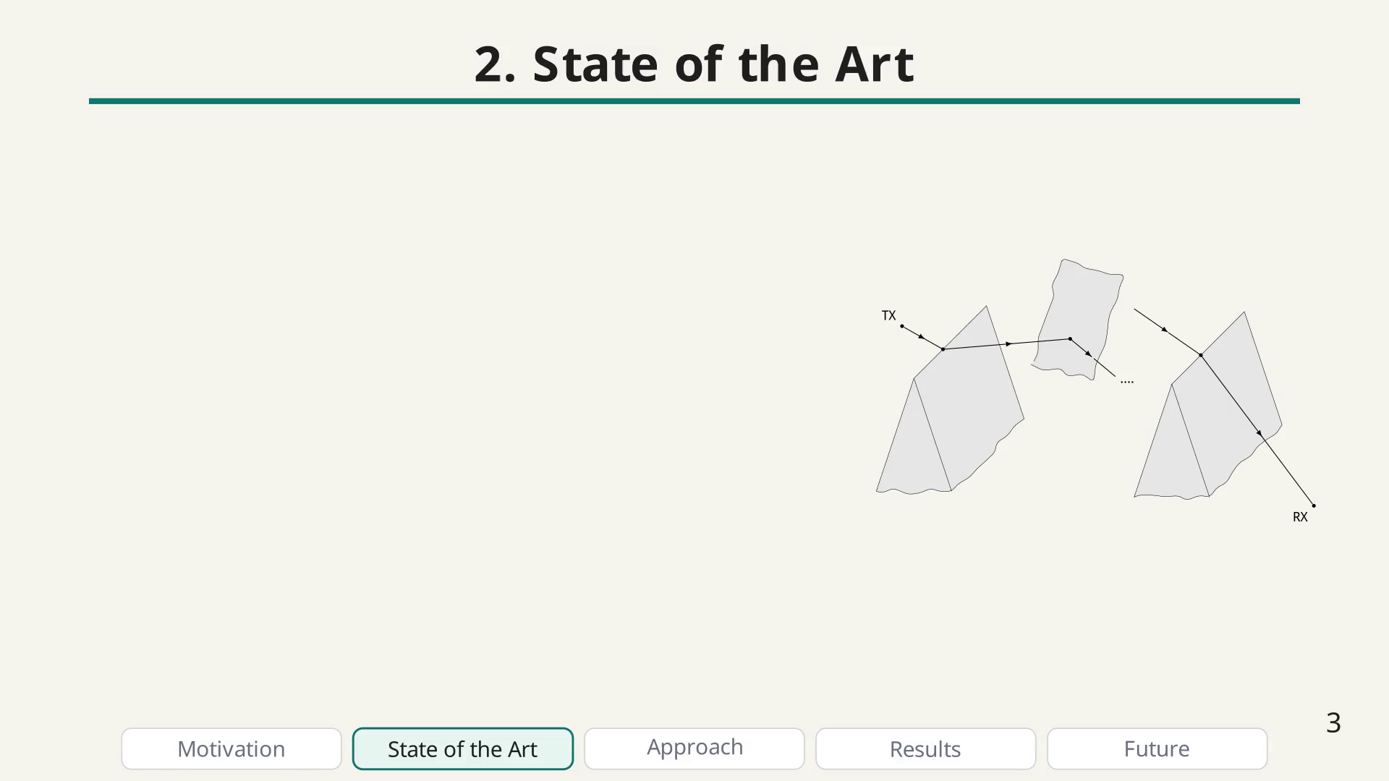
Notes:
State of the art bullet

Slide 19
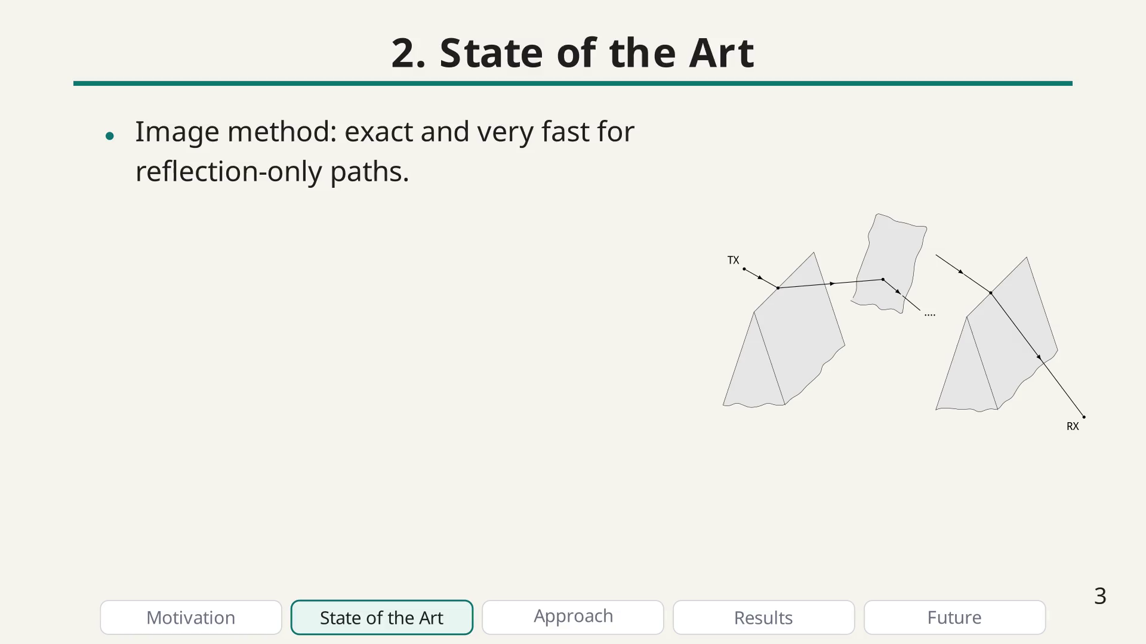
Notes:
State of the art bullet

Slide 20
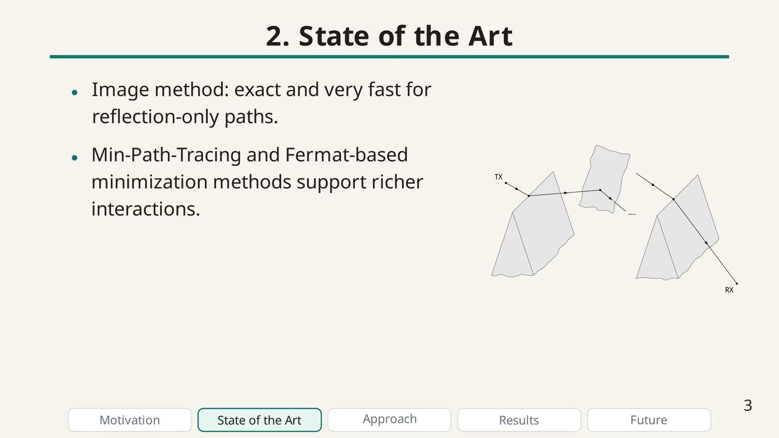
Notes:
State of the art bullet

Slide 21
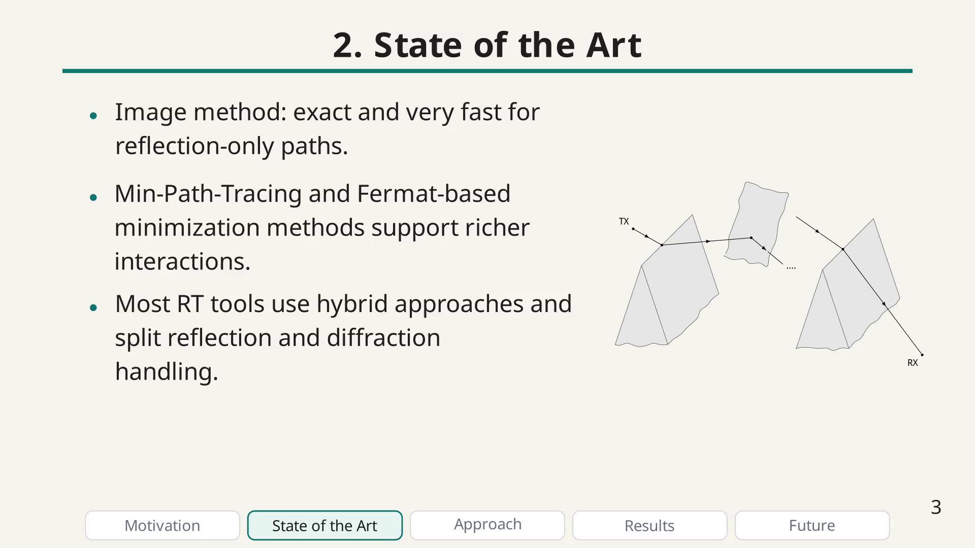
Notes:
State of the art bullet

Slide 22
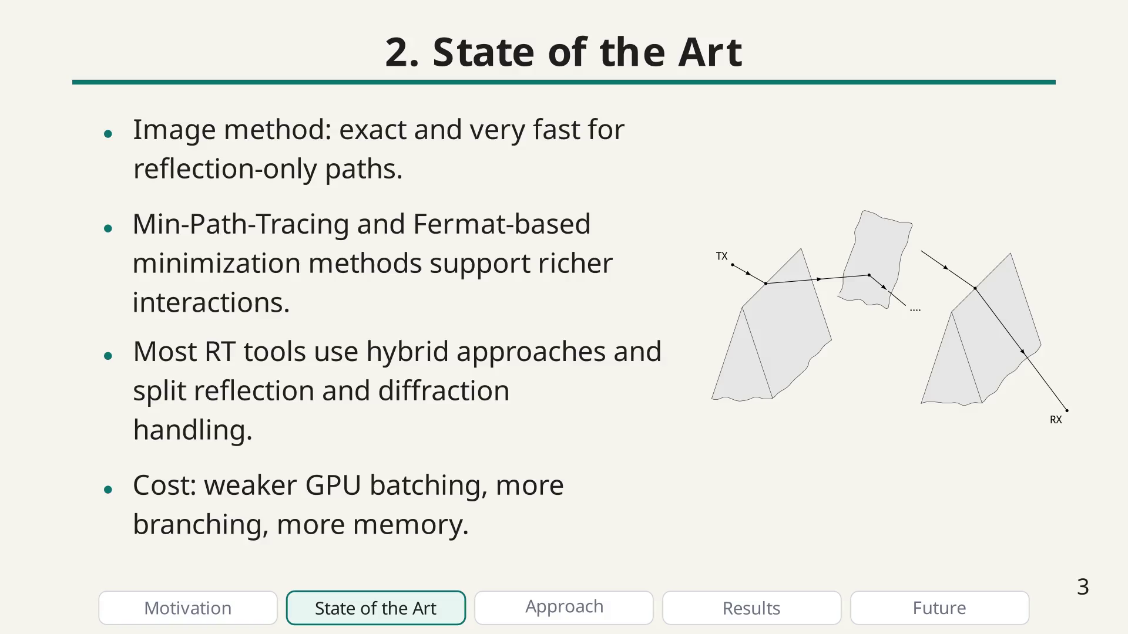
Notes:
Qualitative comparison of the different methods in terms of generality and speed.

Slide 23
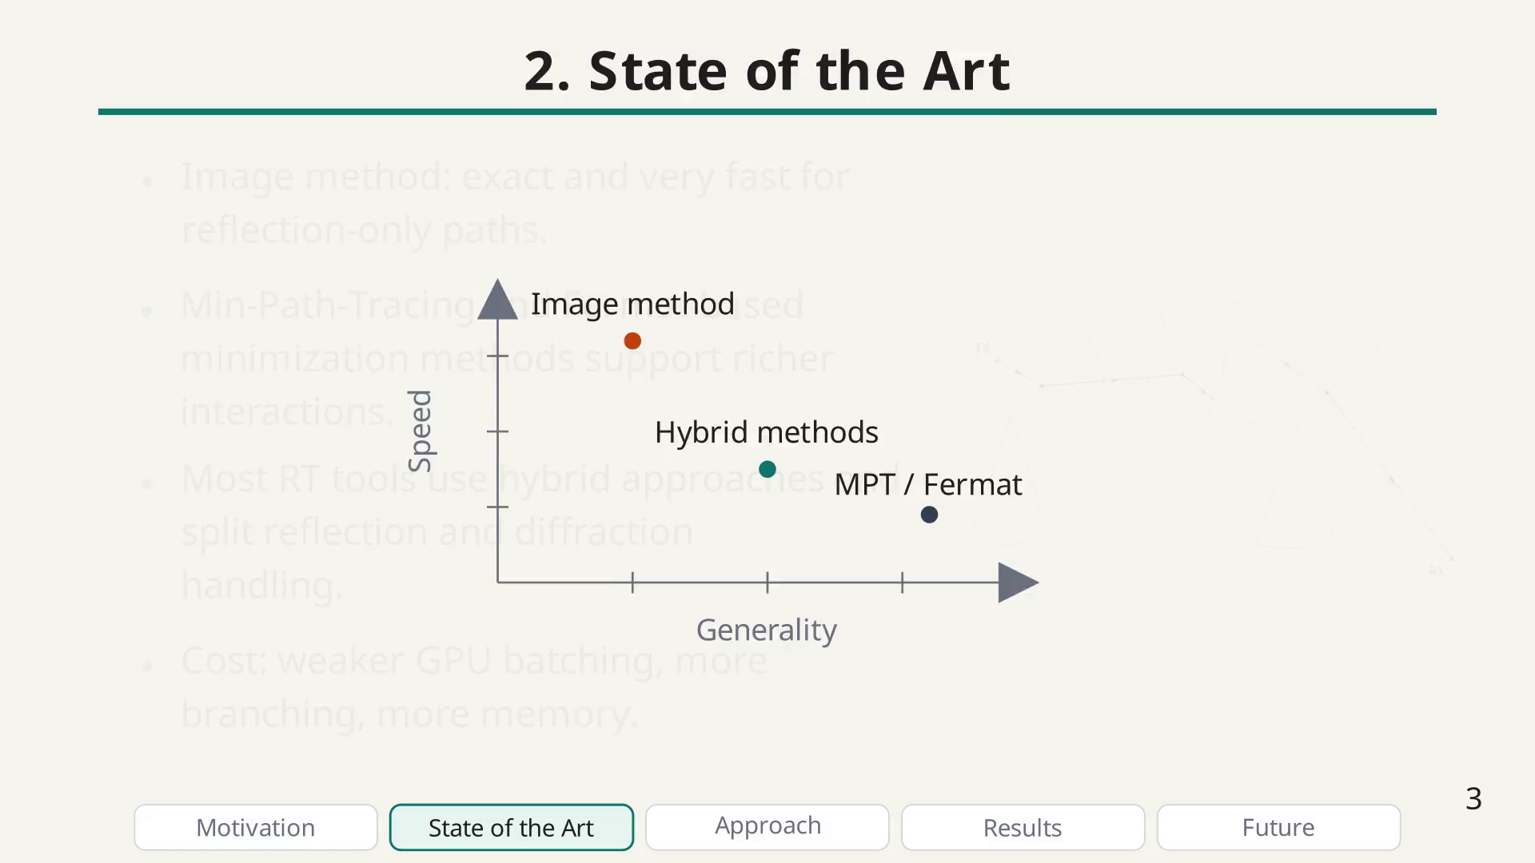
Notes:
First method slide: focus on the optimization problem and the unified parameterization.

Slide 24
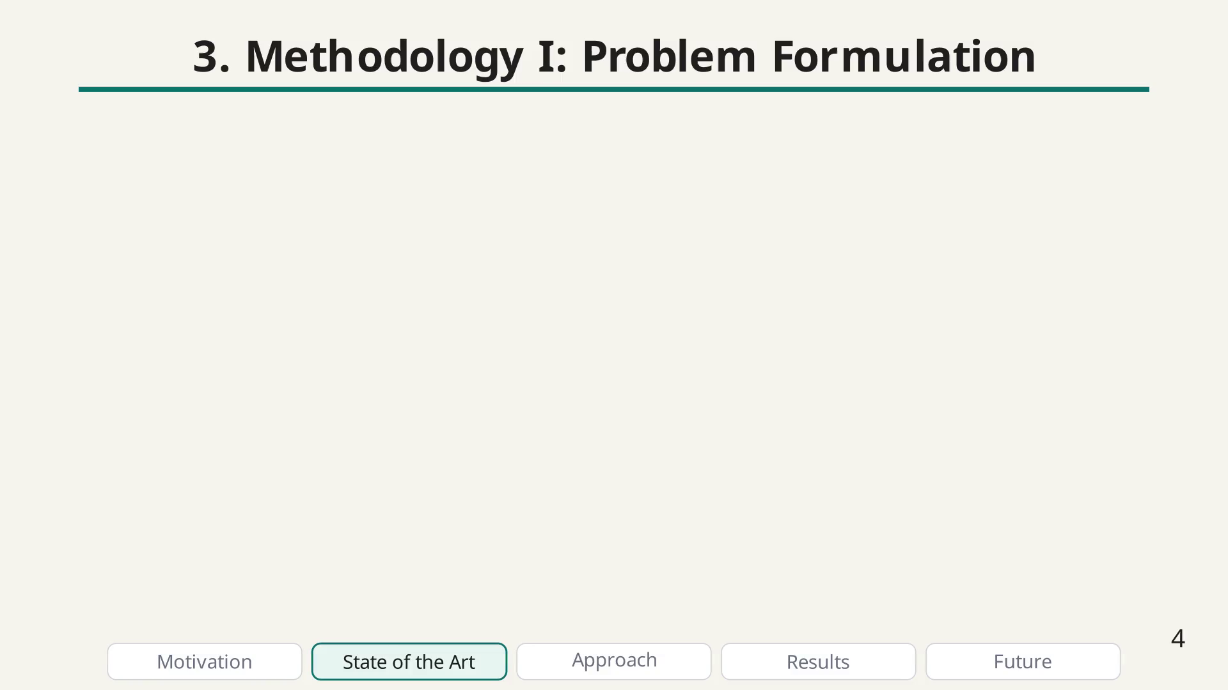
Notes:
Methodology (1) bullet

Slide 25
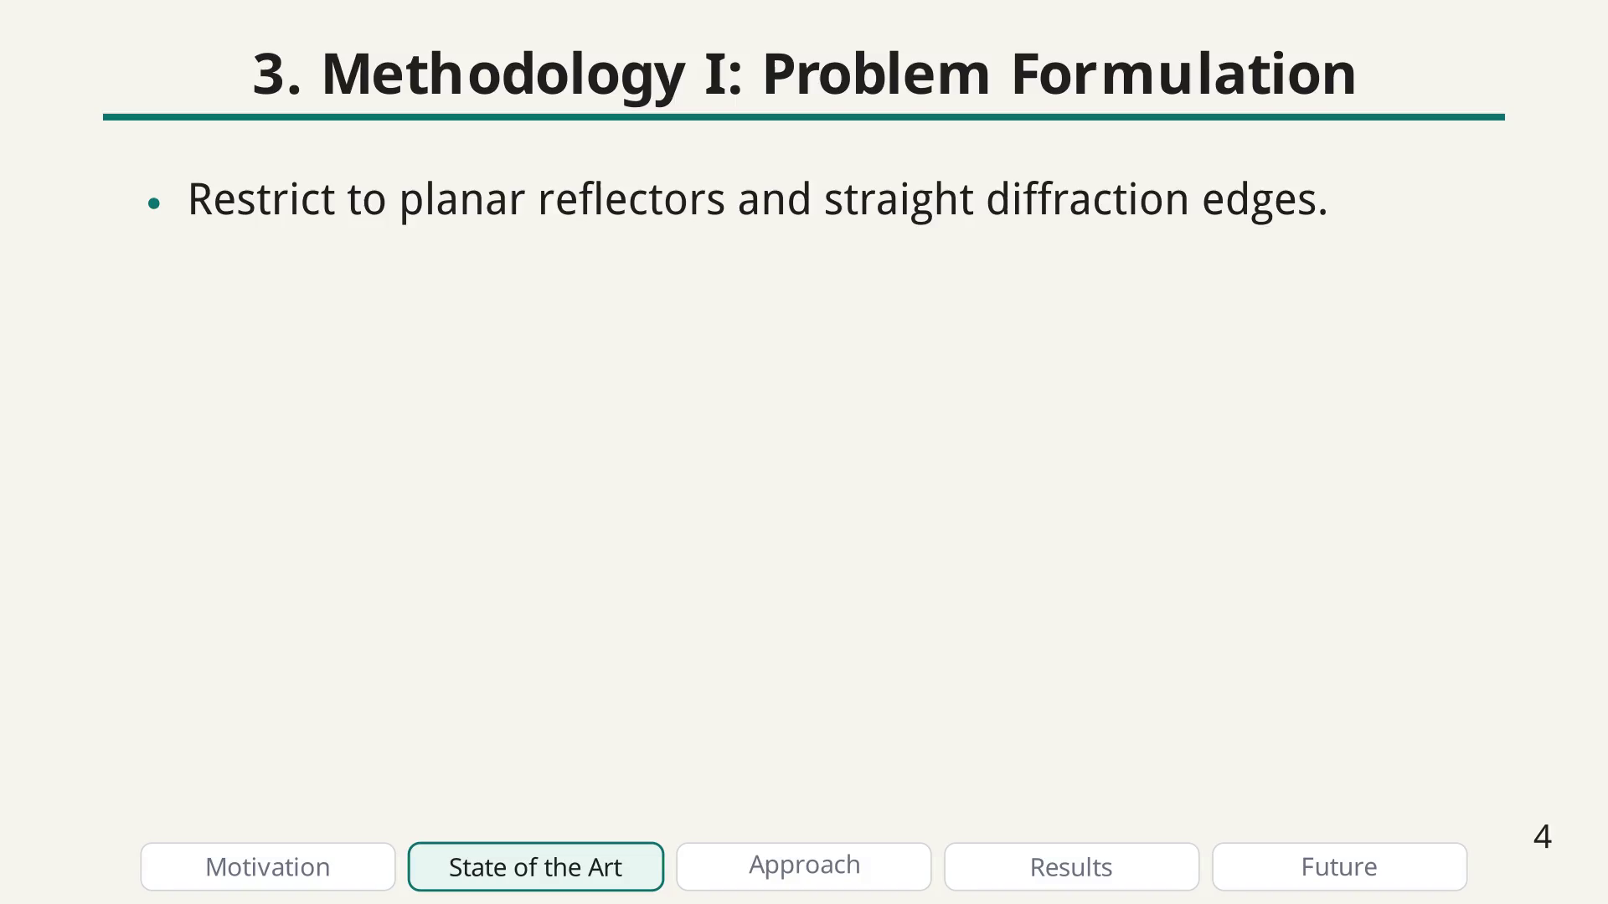
Notes:
Methodology (1) bullet

Slide 26
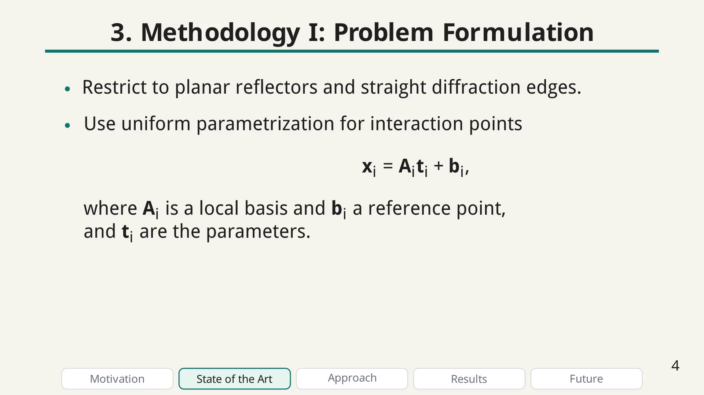
Notes:
Methodology (1) bullet

Slide 27
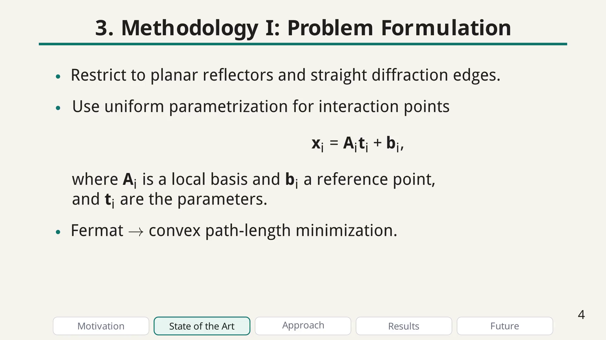
Notes:
Methodology (1) bullet

Slide 28
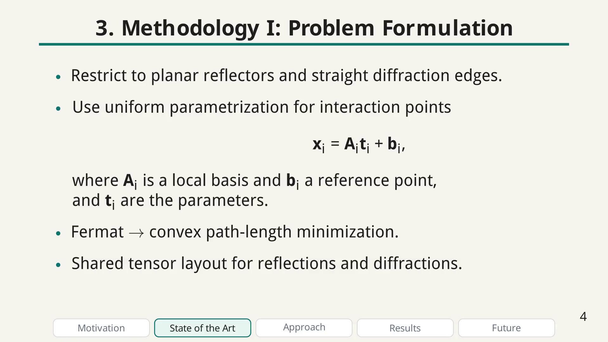
Notes:
Methodology (1) bullet

Slide 29
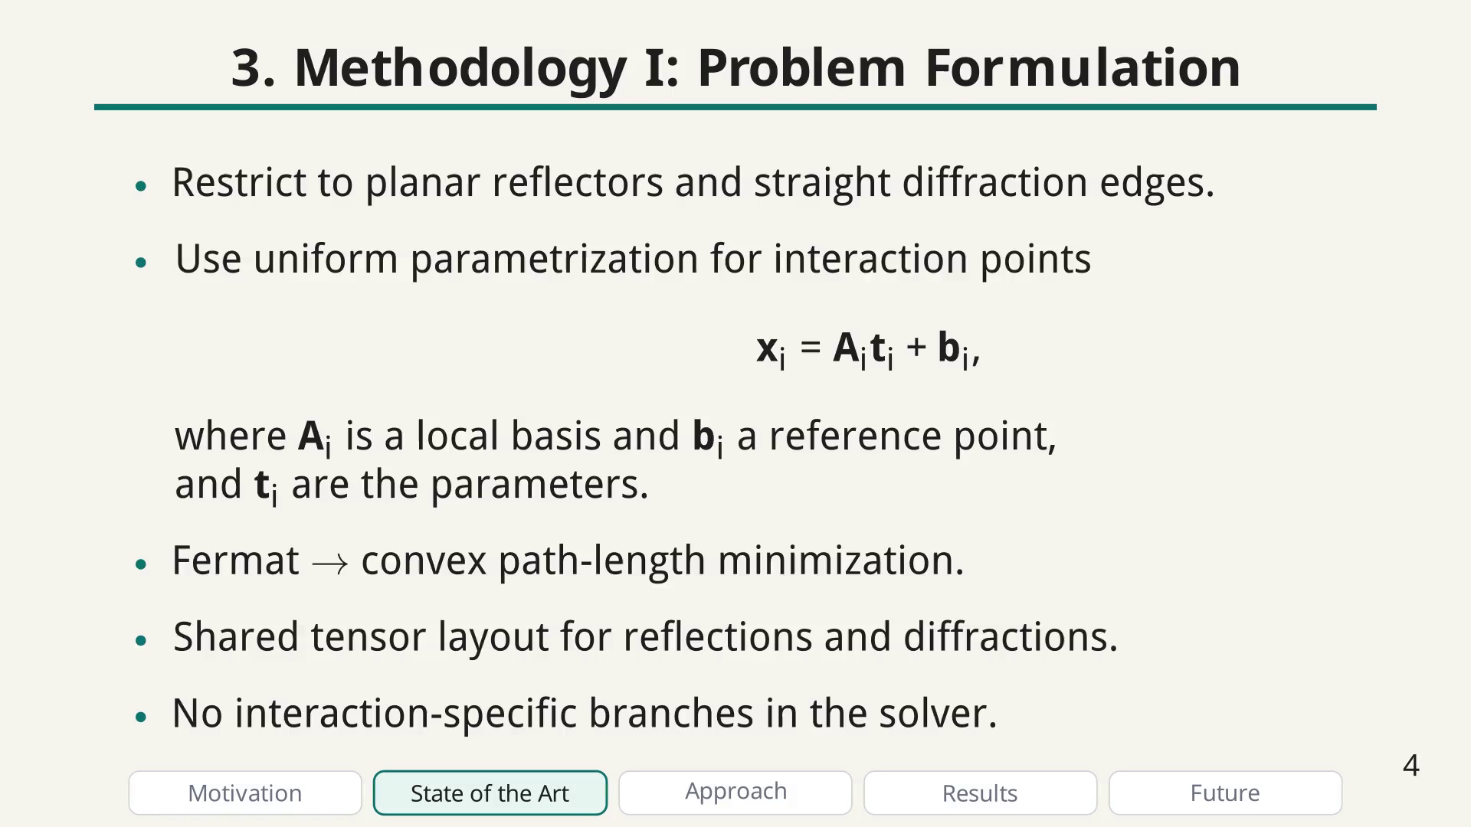
Notes:
Key equation: path as the solution of a convex optimization problem. Emphasize the unified formulation and how it enables batching.

Slide 30
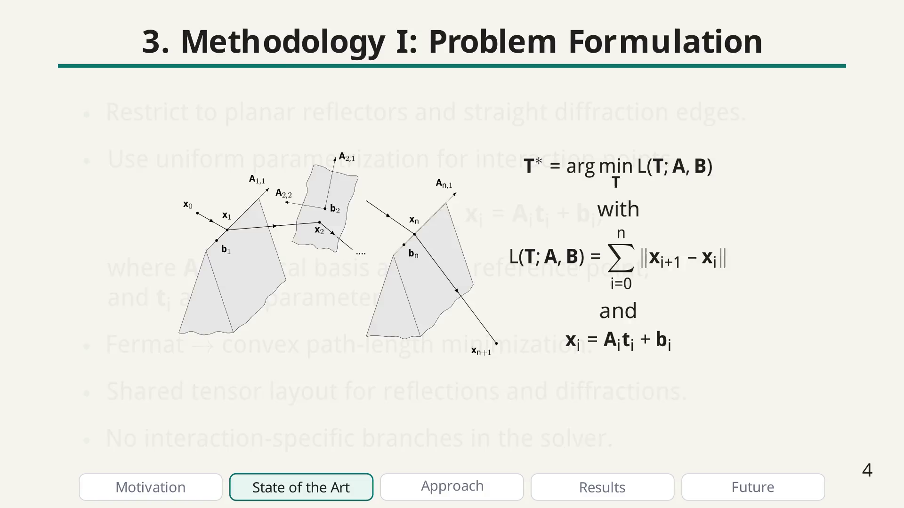
Notes:
Short parenthesis: mention this extension as a strong direction without overloading details.

Slide 31
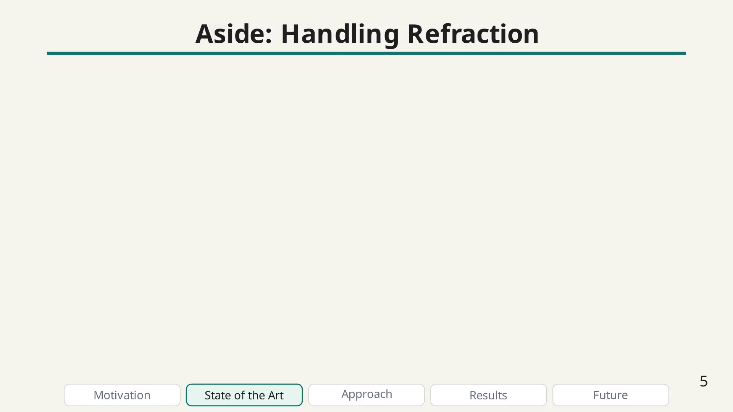
Notes:
Apart bullet

Slide 32
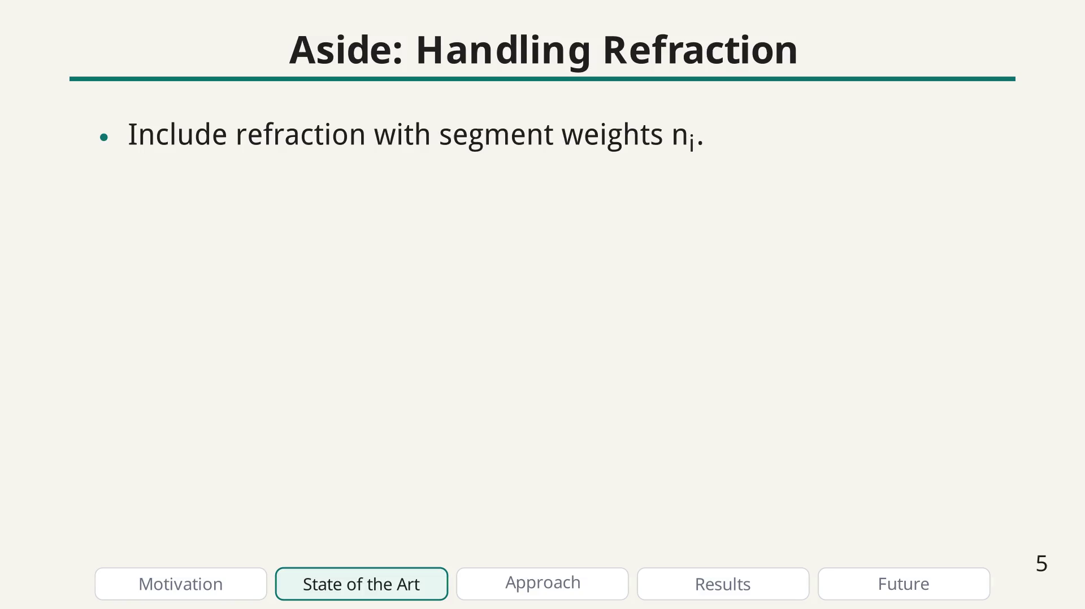
Notes:
Apart bullet

Slide 33
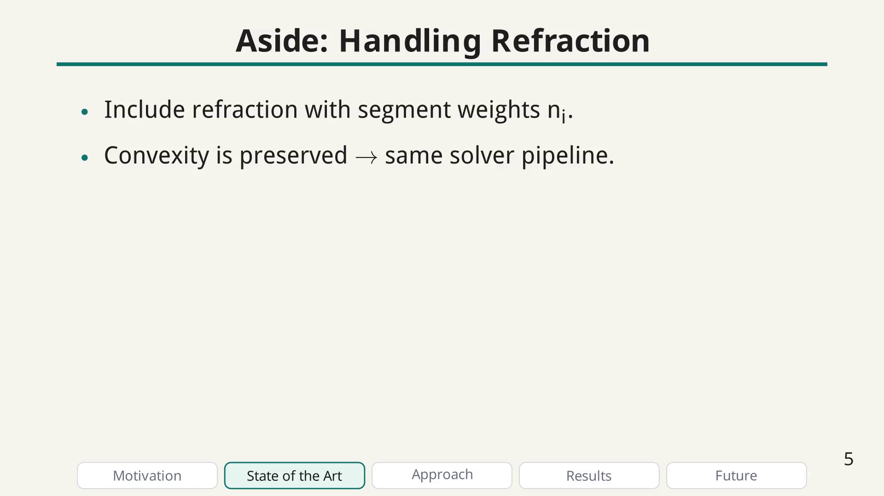
Notes:
Equations: the same formulation holds with a weighted sum of segment lengths, where weights are the refractive indices.

Slide 34
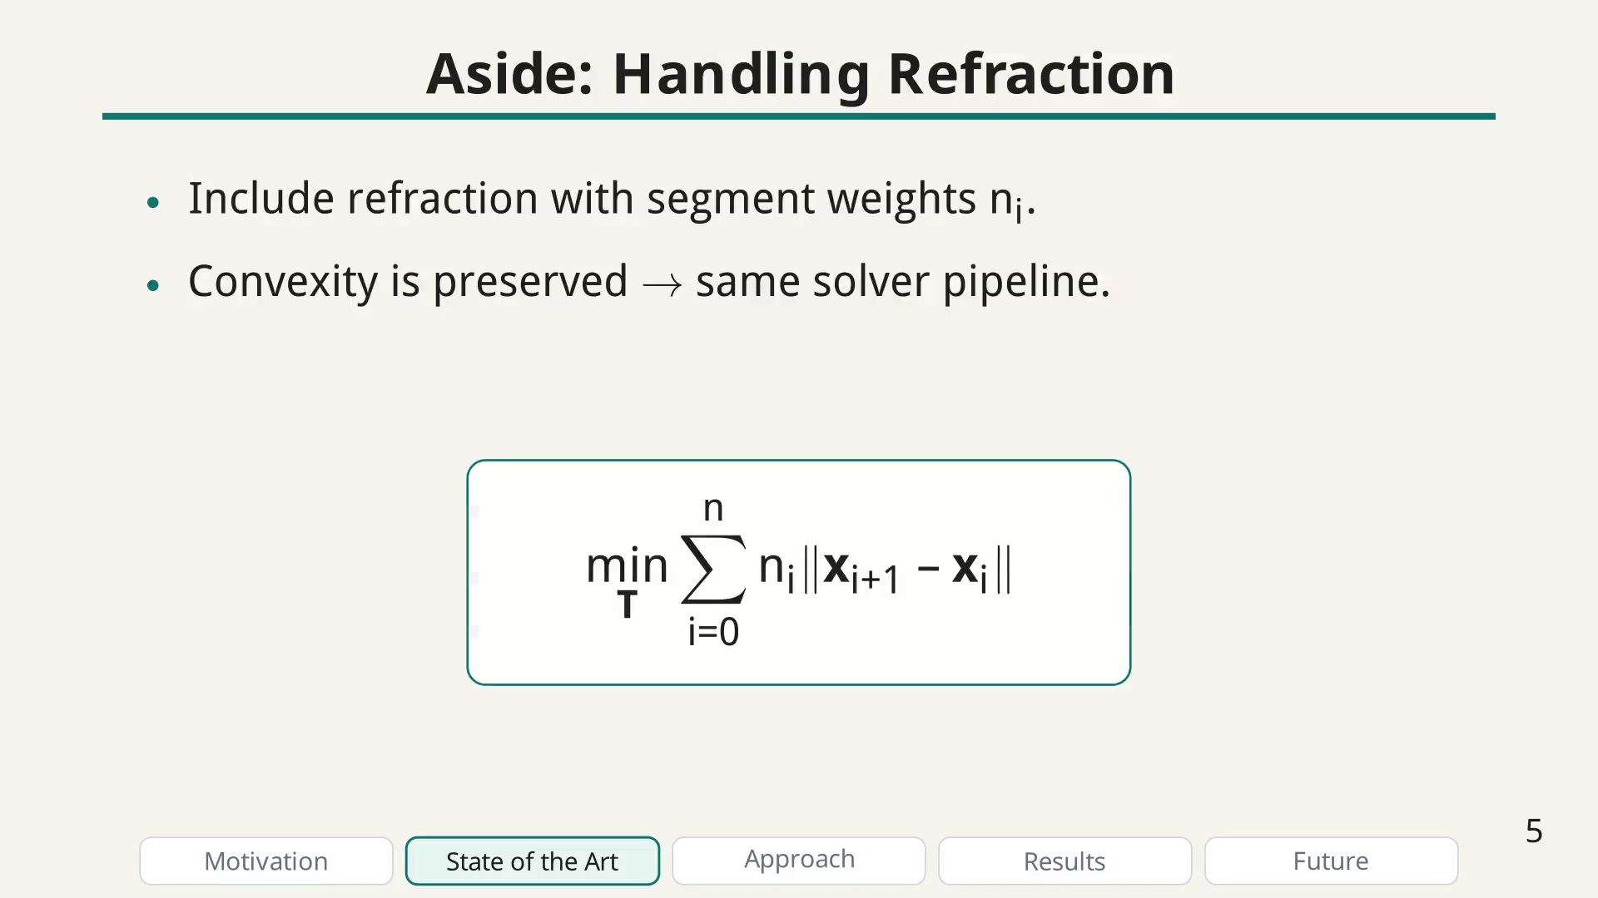
Notes:
Second method slide: summarize the BFGS solver and why it is more robust than mixed Newton/GD when Hessians are ill-conditioned.

Slide 35
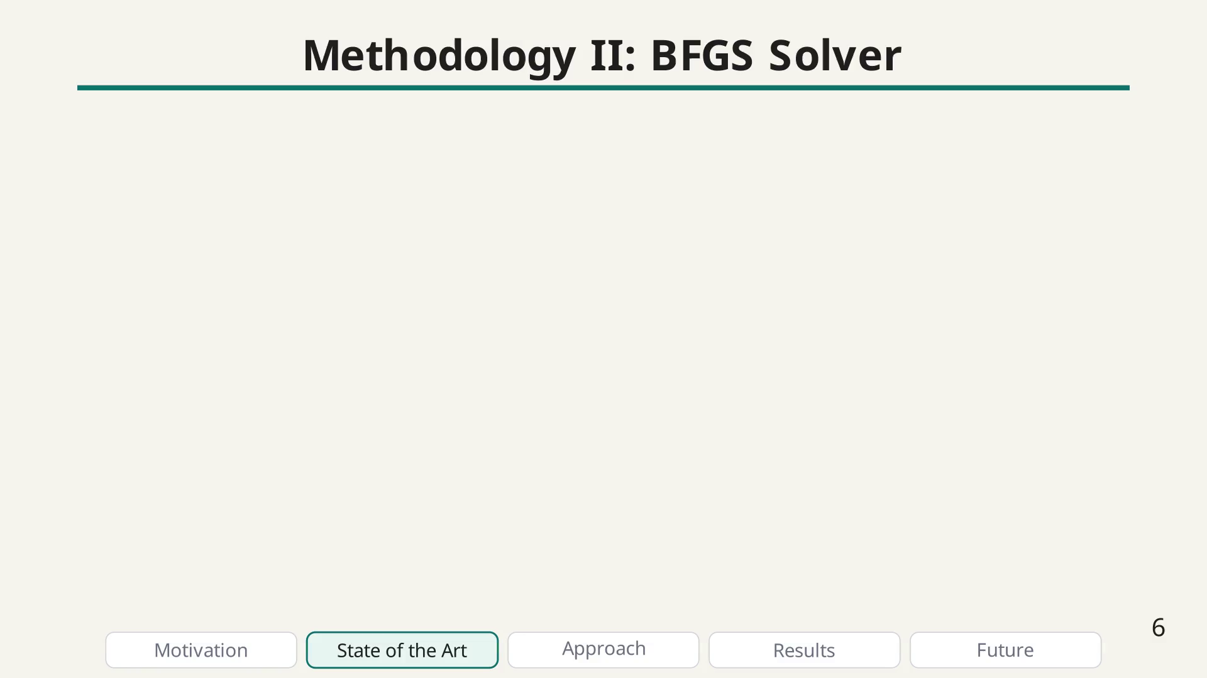
Notes:
Methodology (2) bullet

Slide 36
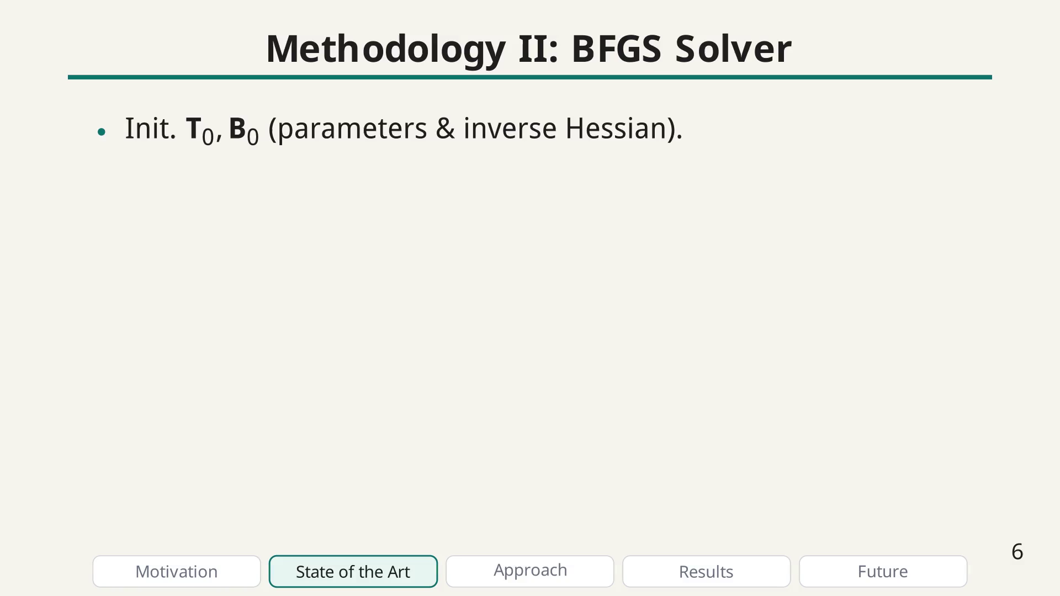
Notes:
Methodology (2) bullet

Slide 37
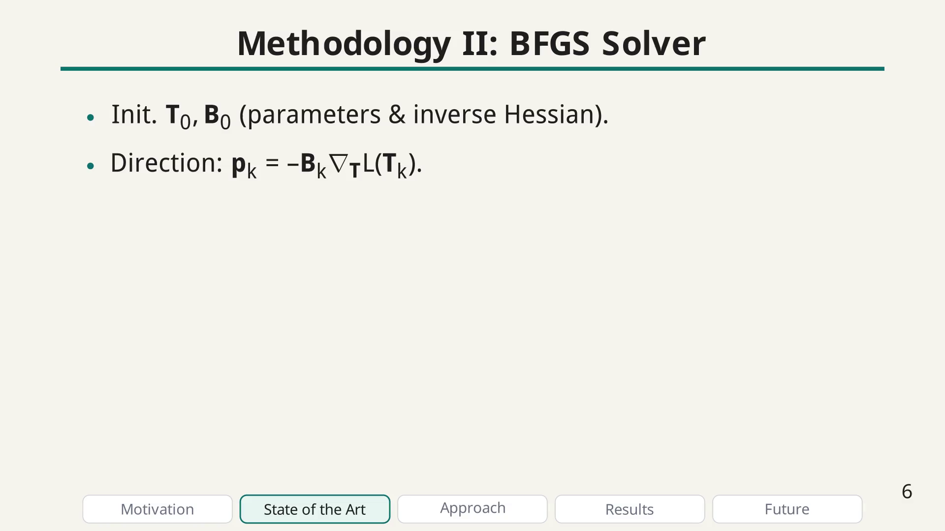
Notes:
Methodology (2) bullet

Slide 38
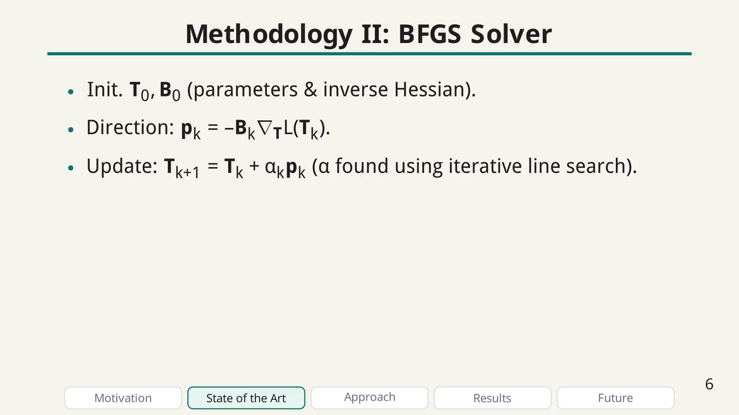
Notes:
Methodology (2) bullet

Slide 39
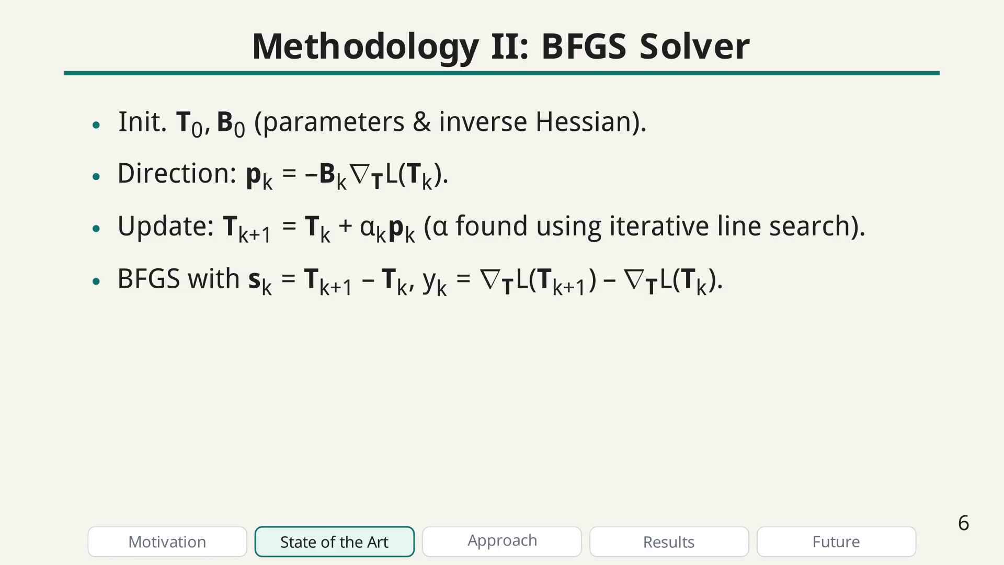
Notes:
Methodology (2) bullet

Slide 40
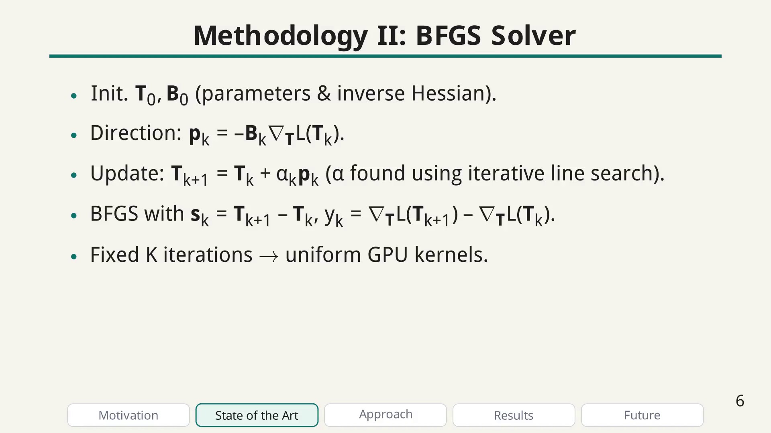
Notes:
Right panel: explain CA sensitivity to ill-conditioning from zero padding, and emphasize BFGS avoids Hessian inversion while enabling better line-search.

Slide 41
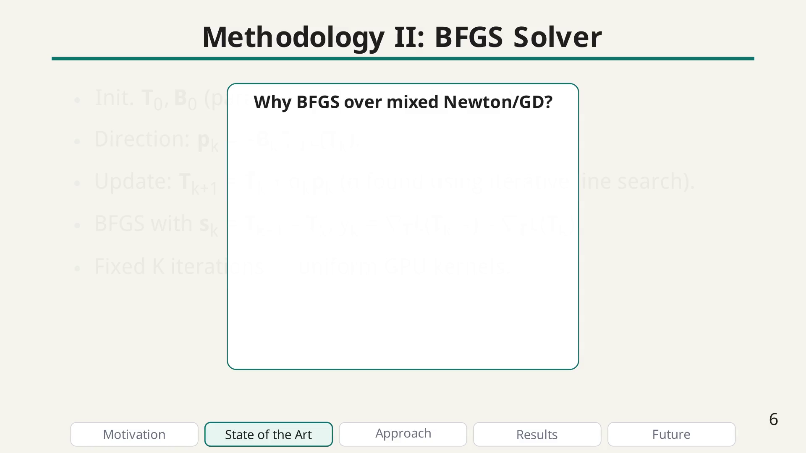
Notes:
BFGS bullet

Slide 42
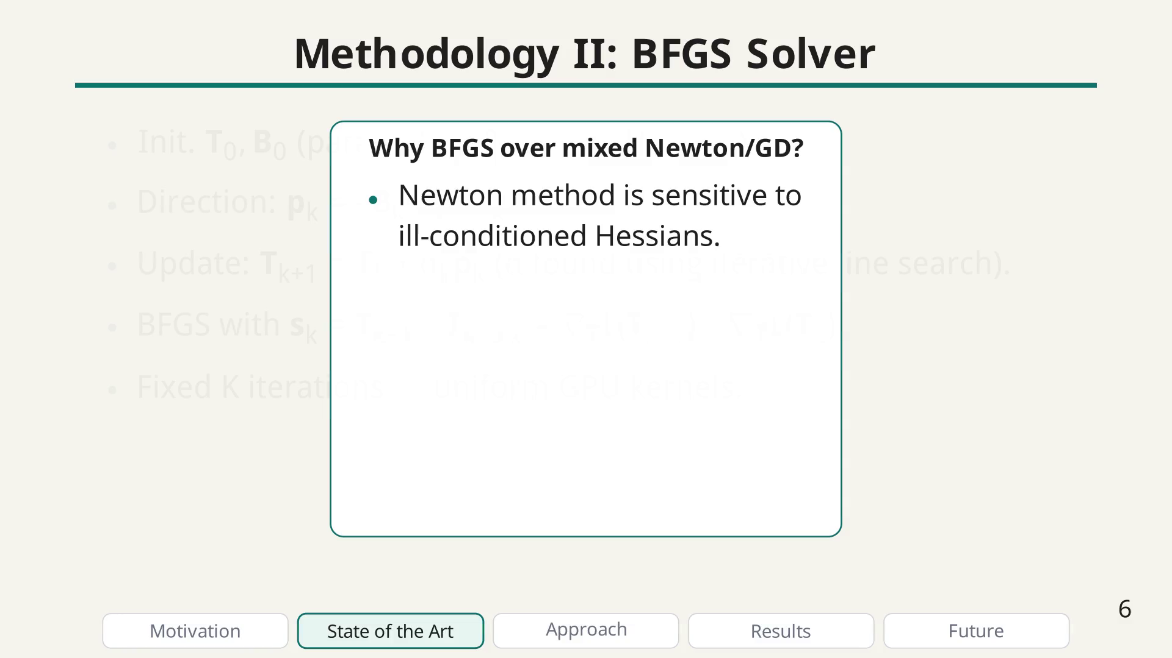
Notes:
BFGS bullet

Slide 43
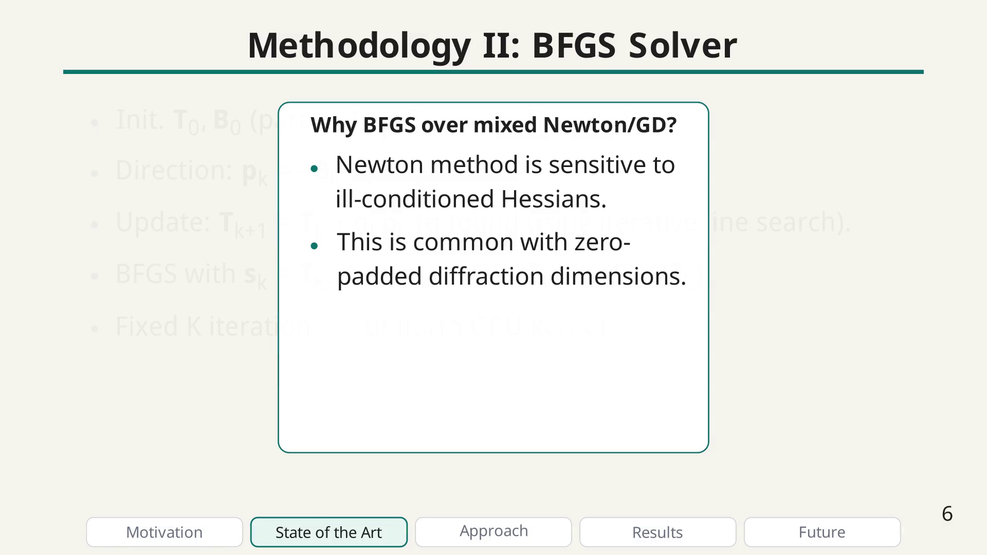
Notes:
BFGS bullet

Slide 44
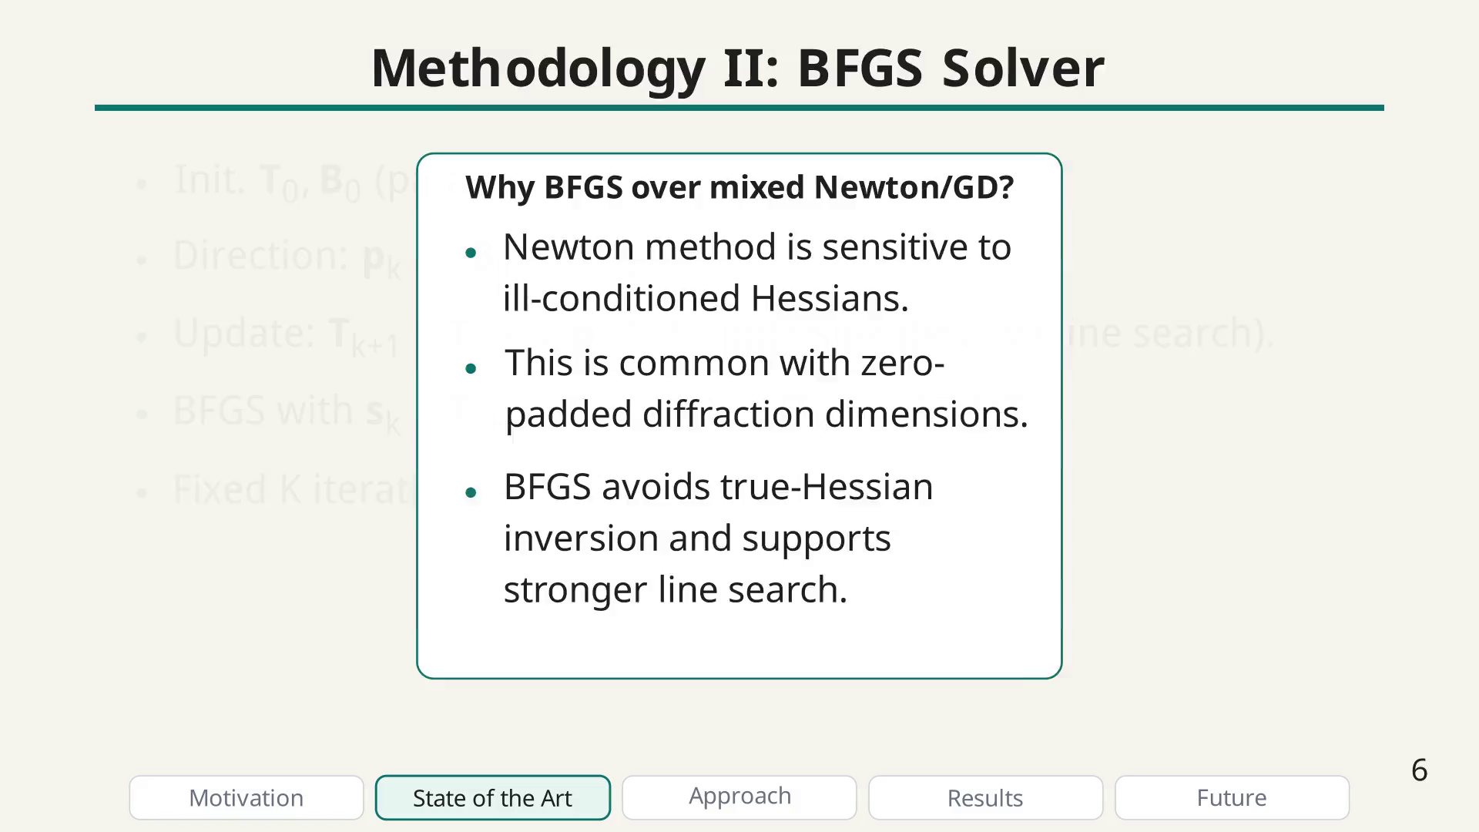
Notes:
Introduce reverse-mode AD on this toy graph and display the two-output function definition.

Slide 45
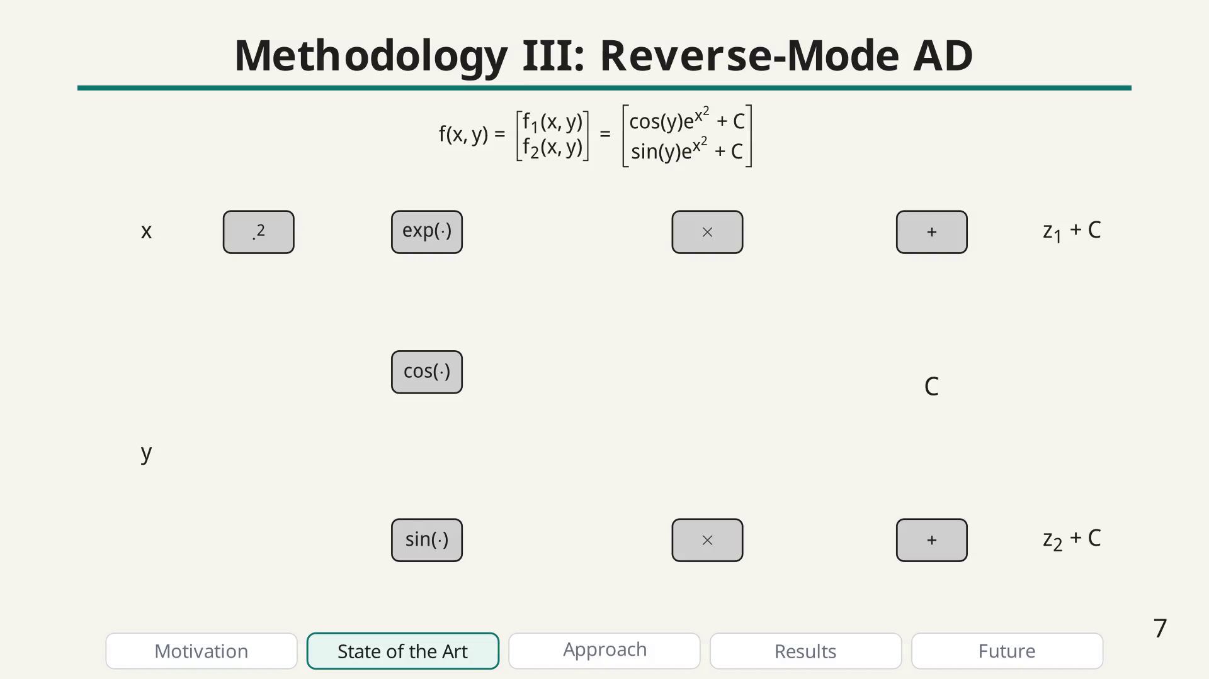
Notes:
Forward pass stage.

Slide 46
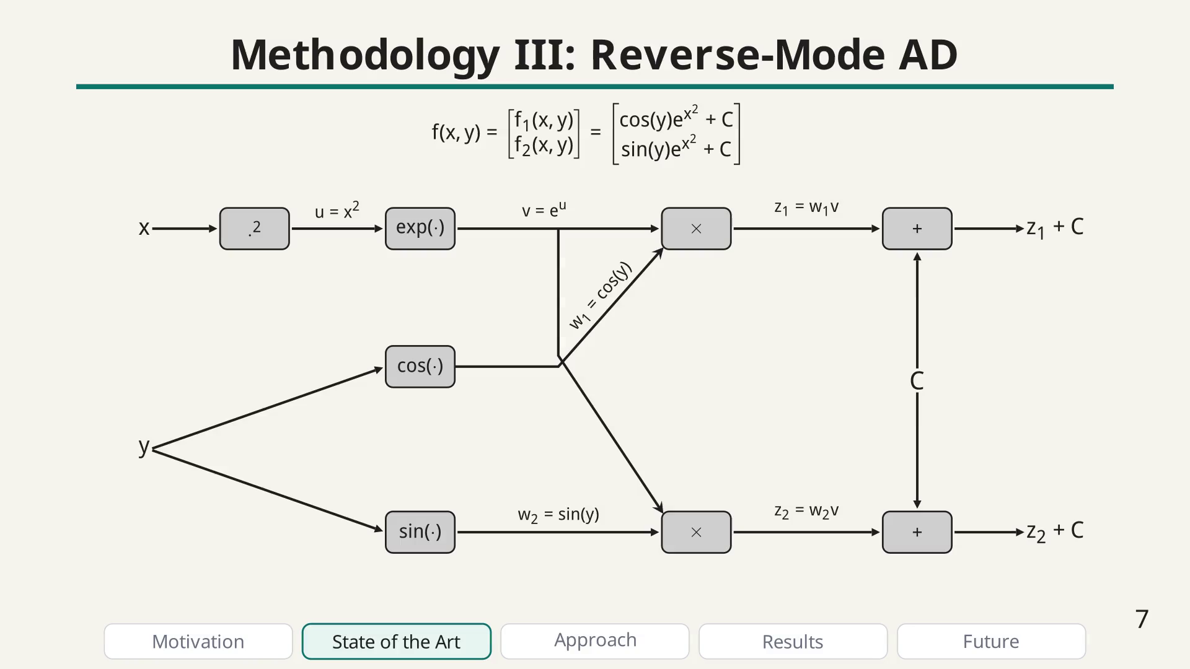
Notes:
Reverse pass stage.

Slide 47
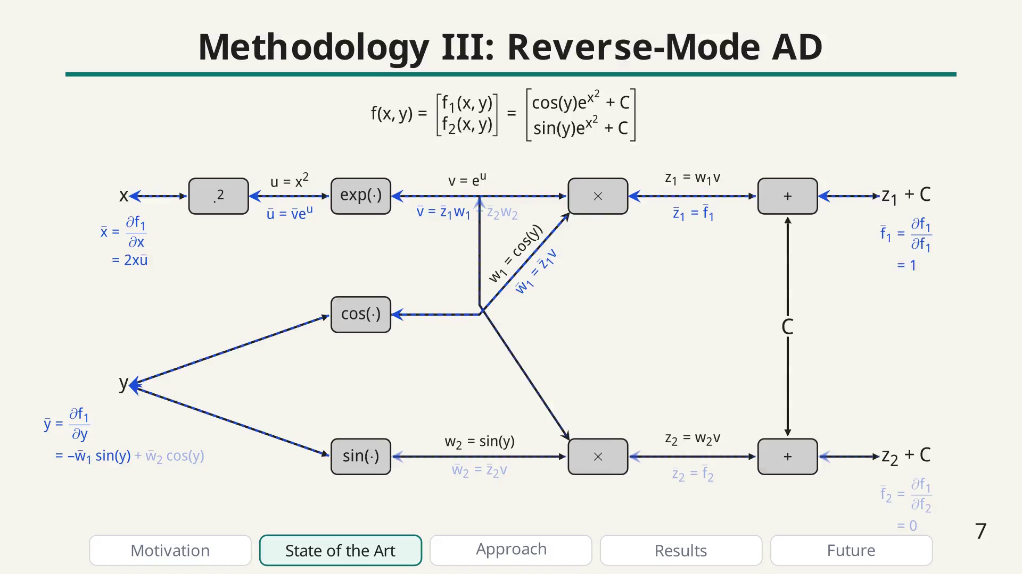
Notes:
After reverse-mode AD, explain why unrolling iterative solvers is expensive in memory and backward-time.

Slide 48
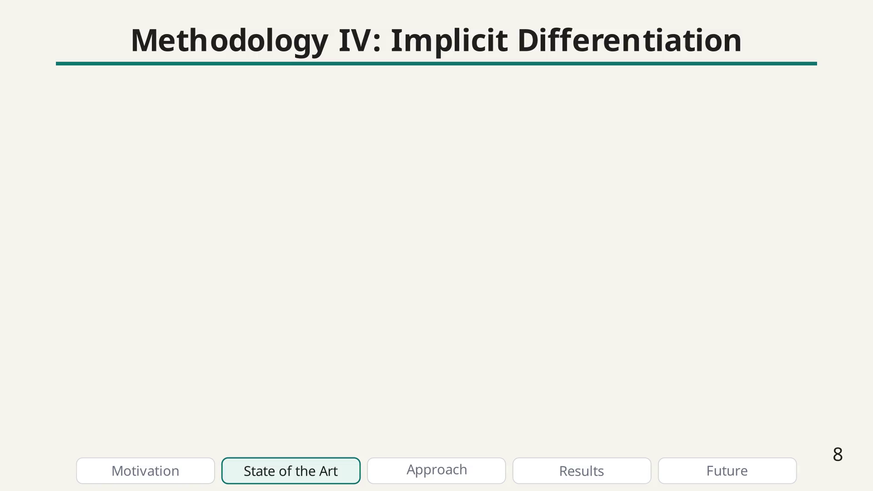
Notes:
Implicit differentiation motivation bullet

Slide 49
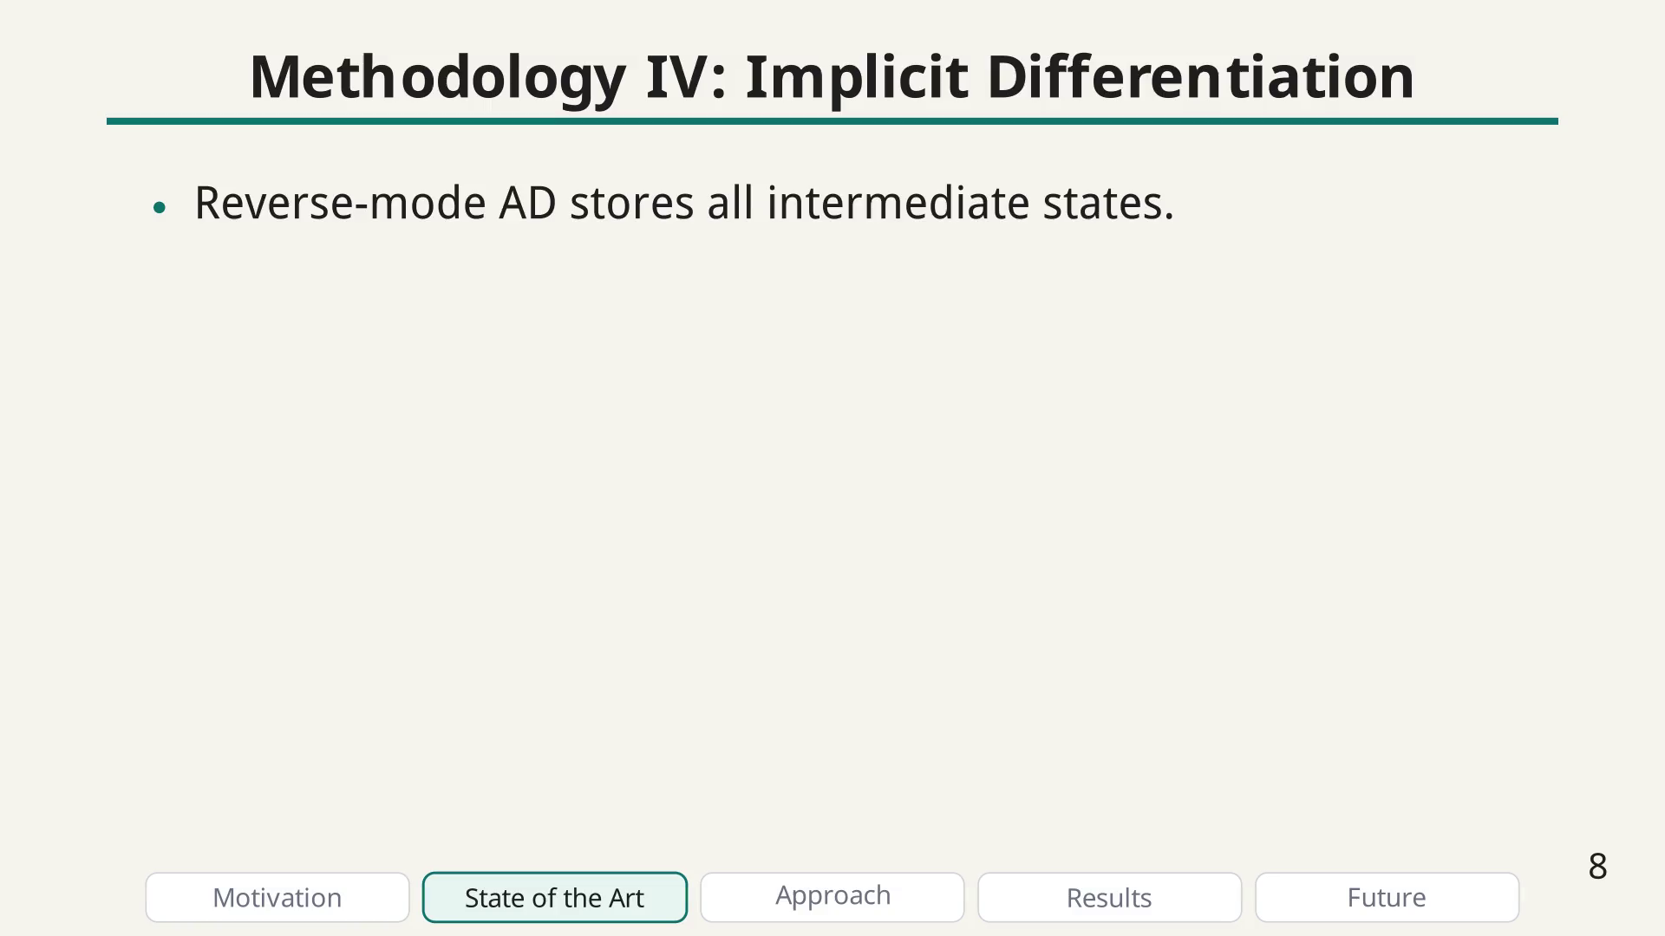
Notes:
Implicit differentiation motivation bullet

Slide 50
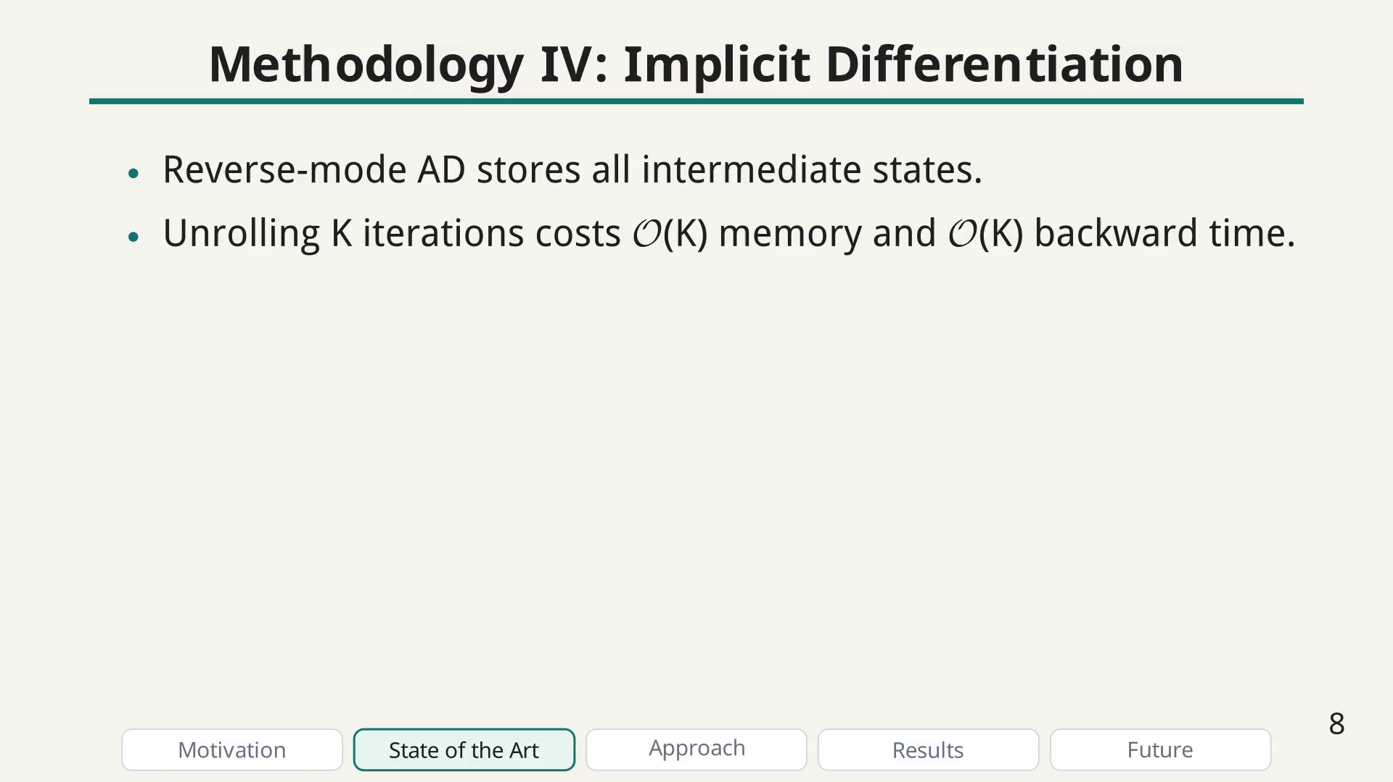
Notes:
Implicit differentiation motivation bullet

Slide 51
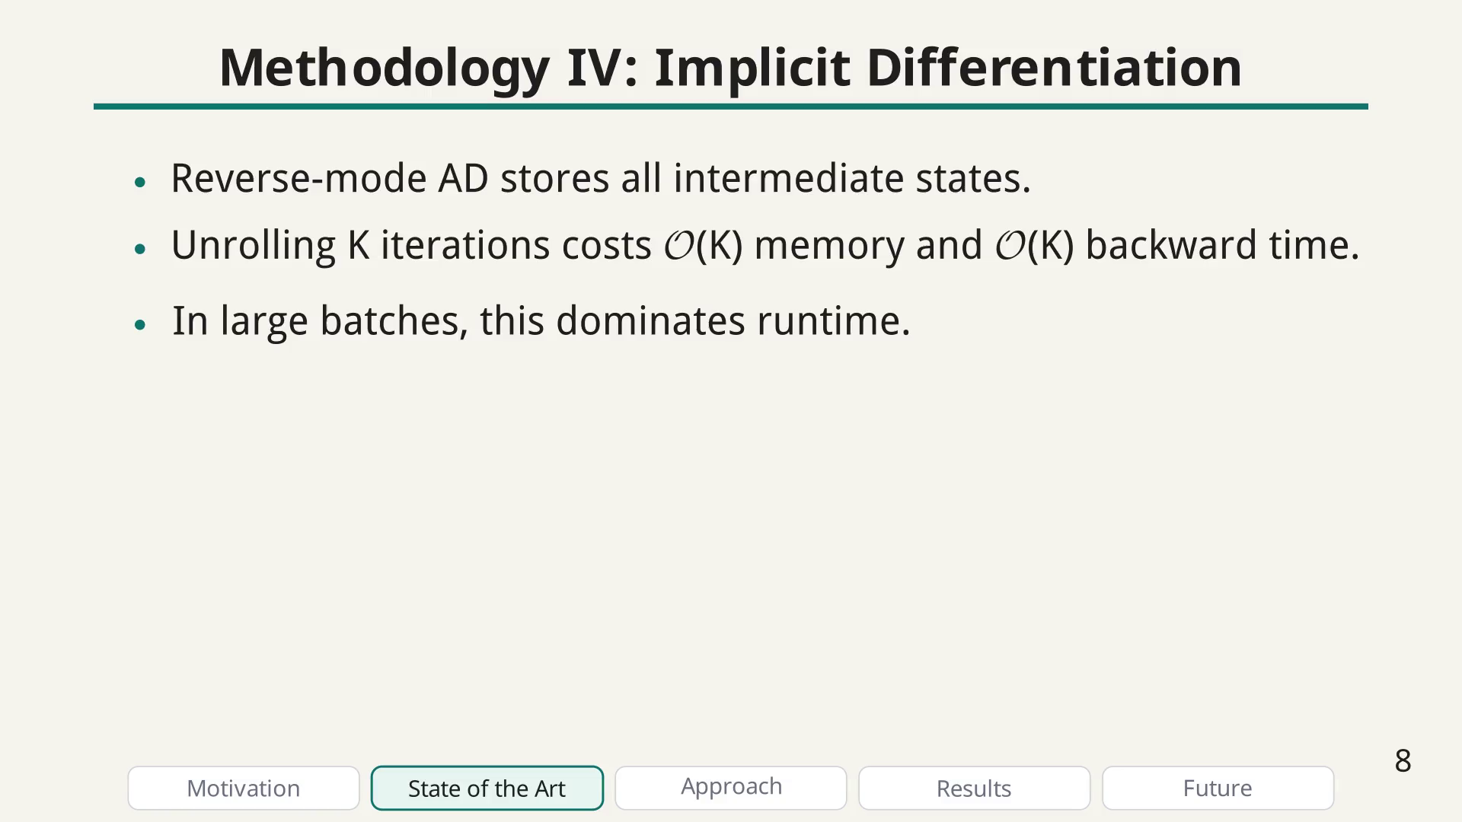
Notes:
Implicit differentiation motivation bullet

Slide 52
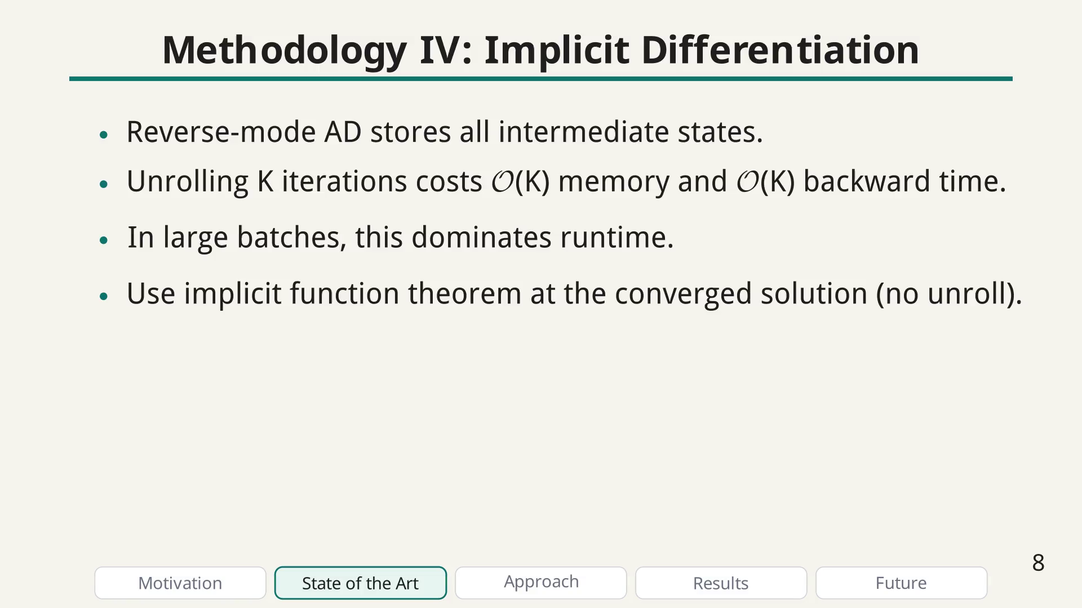
Notes:
Implicit differentiation motivation bullet

Slide 53

Notes:
Use the optimality condition and implicit function theorem to compute gradients without storing all iterations.

Slide 54

Notes:
Key equations: the optimality condition states the gradient at the solution is zero

Slide 55

Notes:
Key equations: from the optimality condition, we can derive the implicit gradient formula that only depends on the converged solution, not the entire trajectory.

Slide 56

Notes:
Explain why a general formulation removes branching and mention this is where your contribution starts.

Slide 57

Notes:
Contributions bullet

Slide 58

Notes:
Contributions bullet

Slide 59

Notes:
Contributions bullet

Slide 60

Notes:
Contributions bullet

Slide 61

Notes:
Contributions bullet

Slide 62

Notes:
Results setup slide to make the benchmark conditions explicit before the plots.

Slide 63

Notes:
Setup bullet

Slide 64

Notes:
Setup bullet

Slide 65

Notes:
Setup bullet

Slide 66

Notes:
Setup bullet

Slide 67

Notes:
Setup bullet

Slide 68

Notes:
Main benchmark figure, split into two panels: reflection-only on the left and diffraction-only on the right.

Slide 69

Notes:
Draw GD for n=1 on both panels.

Slide 70

Notes:
Draw CA for n=1 on both panels.

Slide 71

Notes:
Draw L-BFGS for n=1 on both panels.

Slide 72

Notes:
Draw ours for n=1 on both panels.

Slide 73

Notes:
Draw ours-64 for n=1 on both panels.

Slide 74

Notes:
Update both panels to n=2 while preserving solver ordering and style.

Slide 75

Notes:
Update both panels to n=3 while preserving solver ordering and style.

Slide 76

Notes:
Update both panels to n=4 while preserving solver ordering and style.

Slide 77

Notes:
Update both panels to n=5 while preserving solver ordering and style.

Slide 78

Notes:
End with a balanced message: method works now, but solver ecosystem is the next frontier.

Slide 79

Notes:
Future bullet

Slide 80

Notes:
Future bullet

Slide 81

Notes:
Future bullet

Slide 82

Notes:
Future bullet

Slide 83

Notes:
Final note on the solver bottleneck and the need for more open implementations to bridge theory and practice.

Slide 84

Notes:
Closing slide with thanks, and QR codes for the paper and code repository.

