Slide 1

Notes:
Welcome everyone, and thank you for being here today. My name is Jérome Eertmans, and I will present my PhD work on differentiable ray tracing for radio propagation modeling.

Slide 2
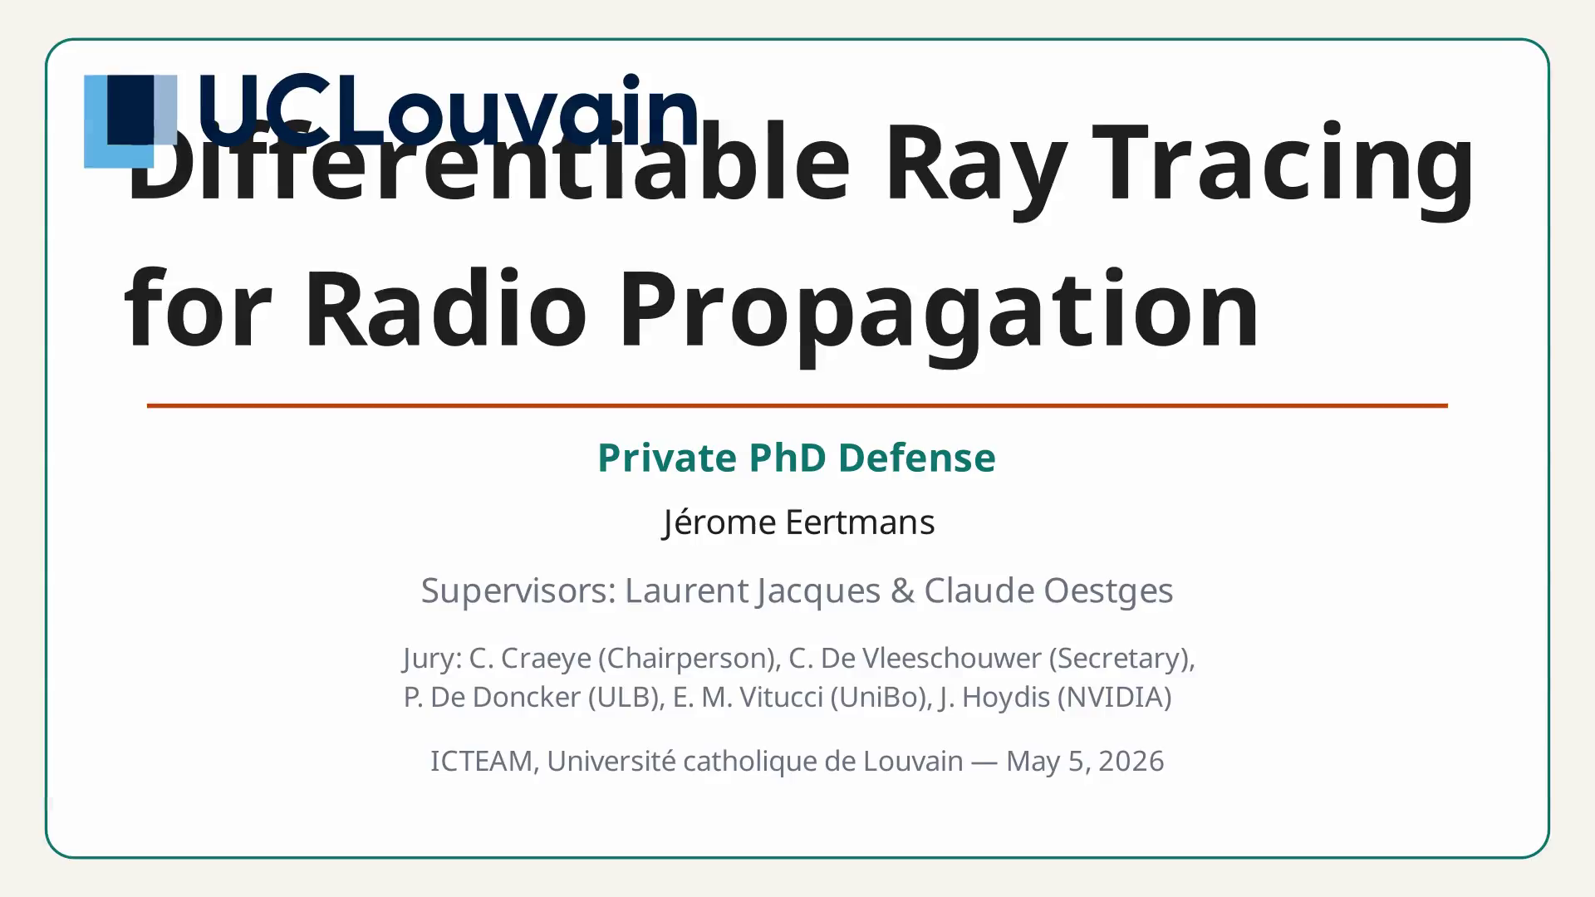
Notes:
Let me start by providing a brief context. In wireless communications, understanding how radio waves propagate through complex environments is essential. Ray tracing is a simulation technique that traces individual ray paths from a transmitter to a receiver.

Slide 3
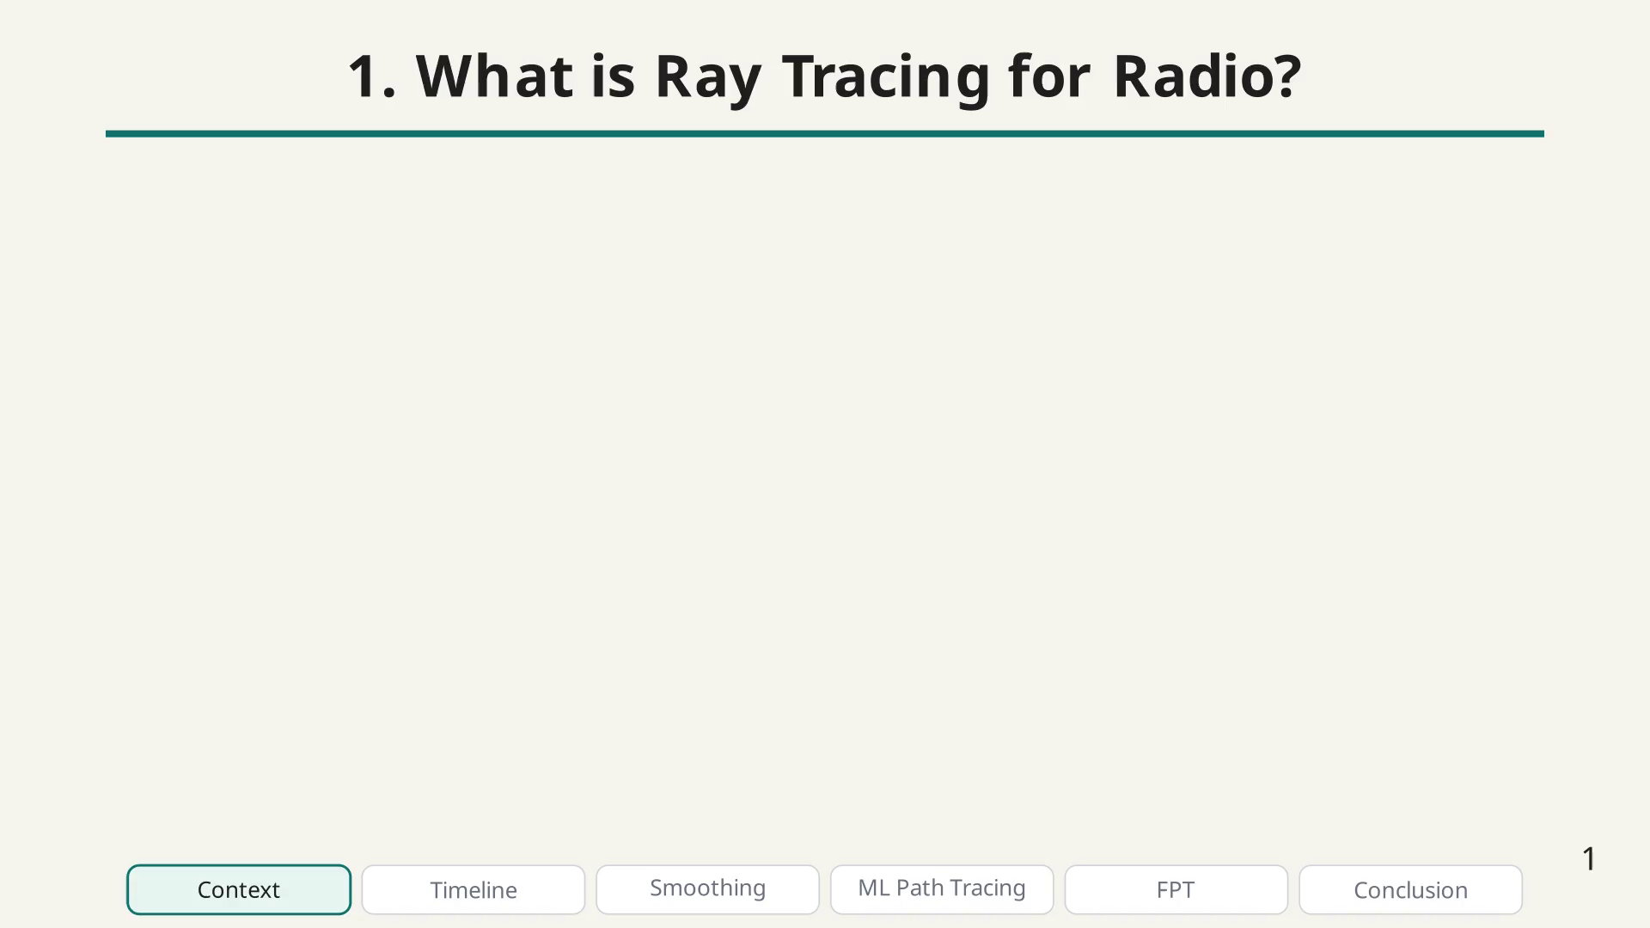
Notes:
RT models the key electromagnetic interactions: reflection off surfaces, diffraction around edges, and scattering from rough surfaces.

Slide 4
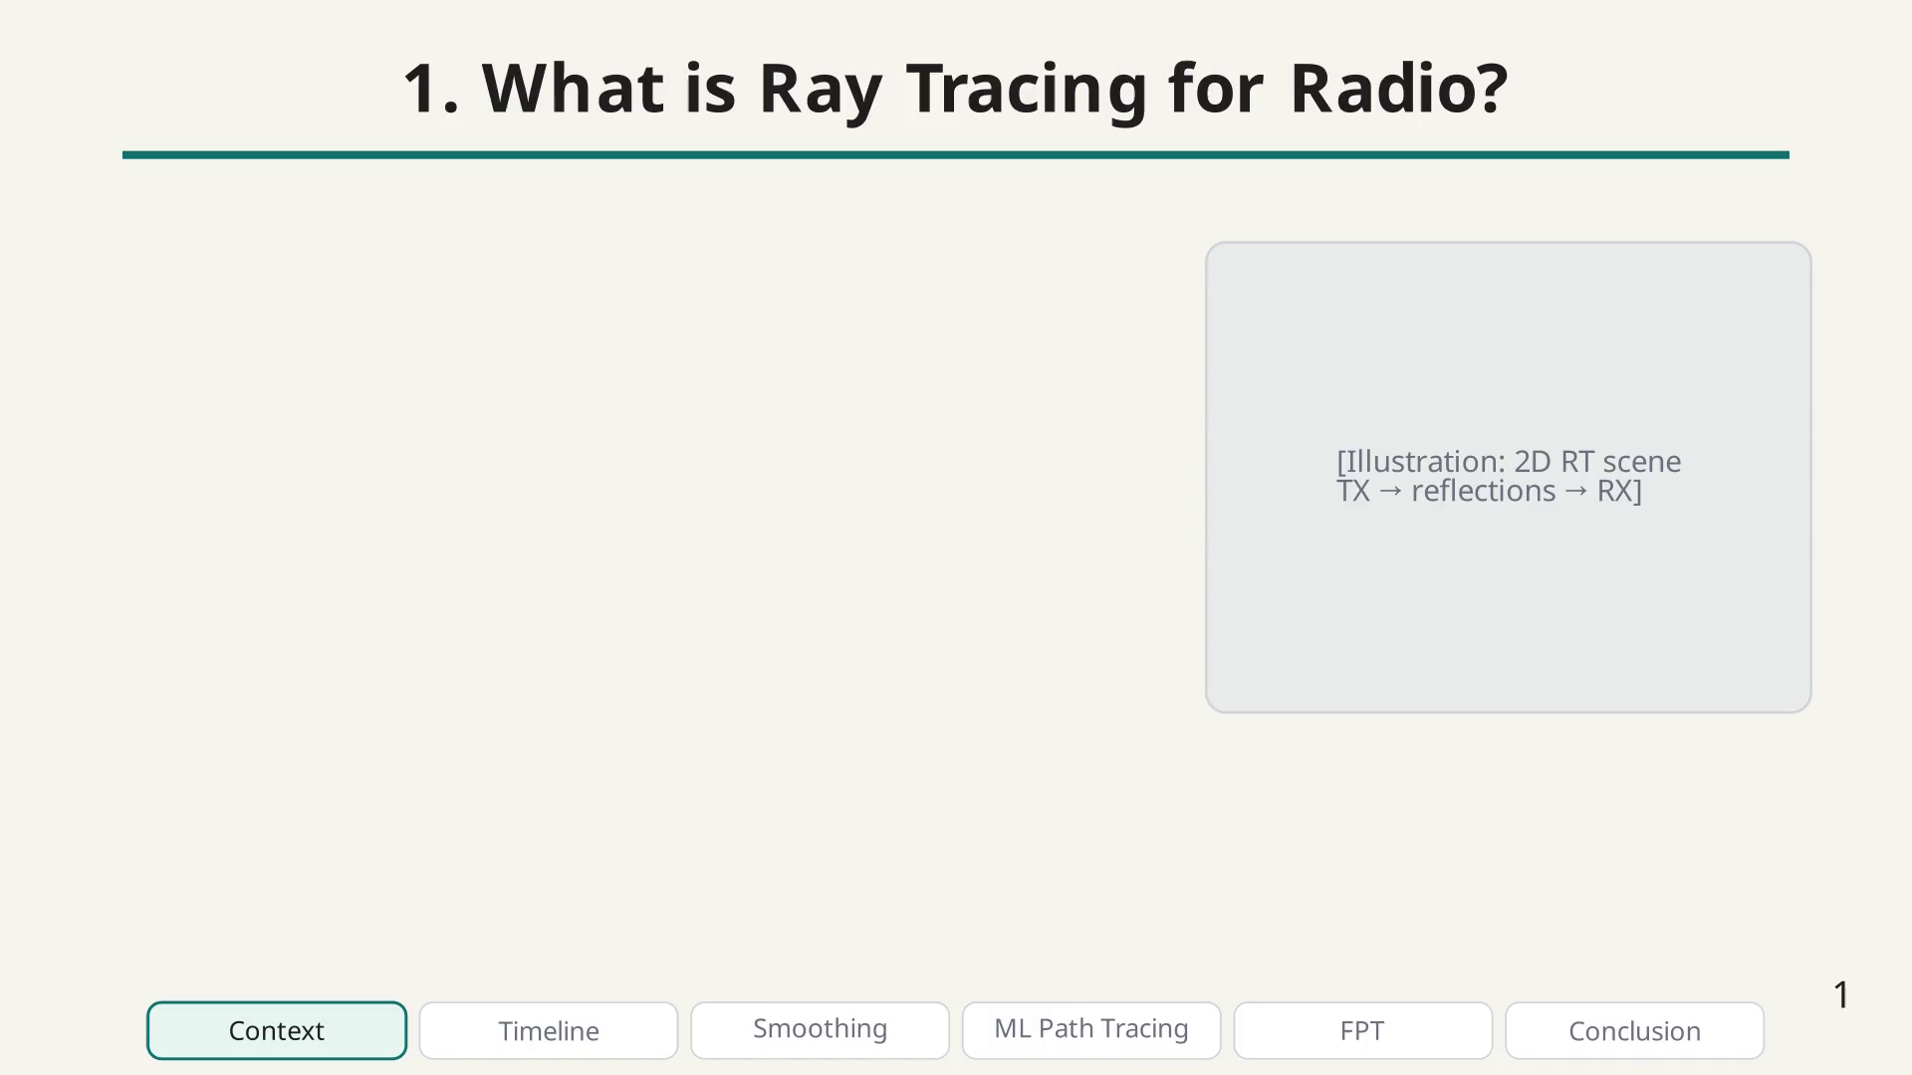
Notes:
Radio waves travel through complex environments like cities.

Slide 5
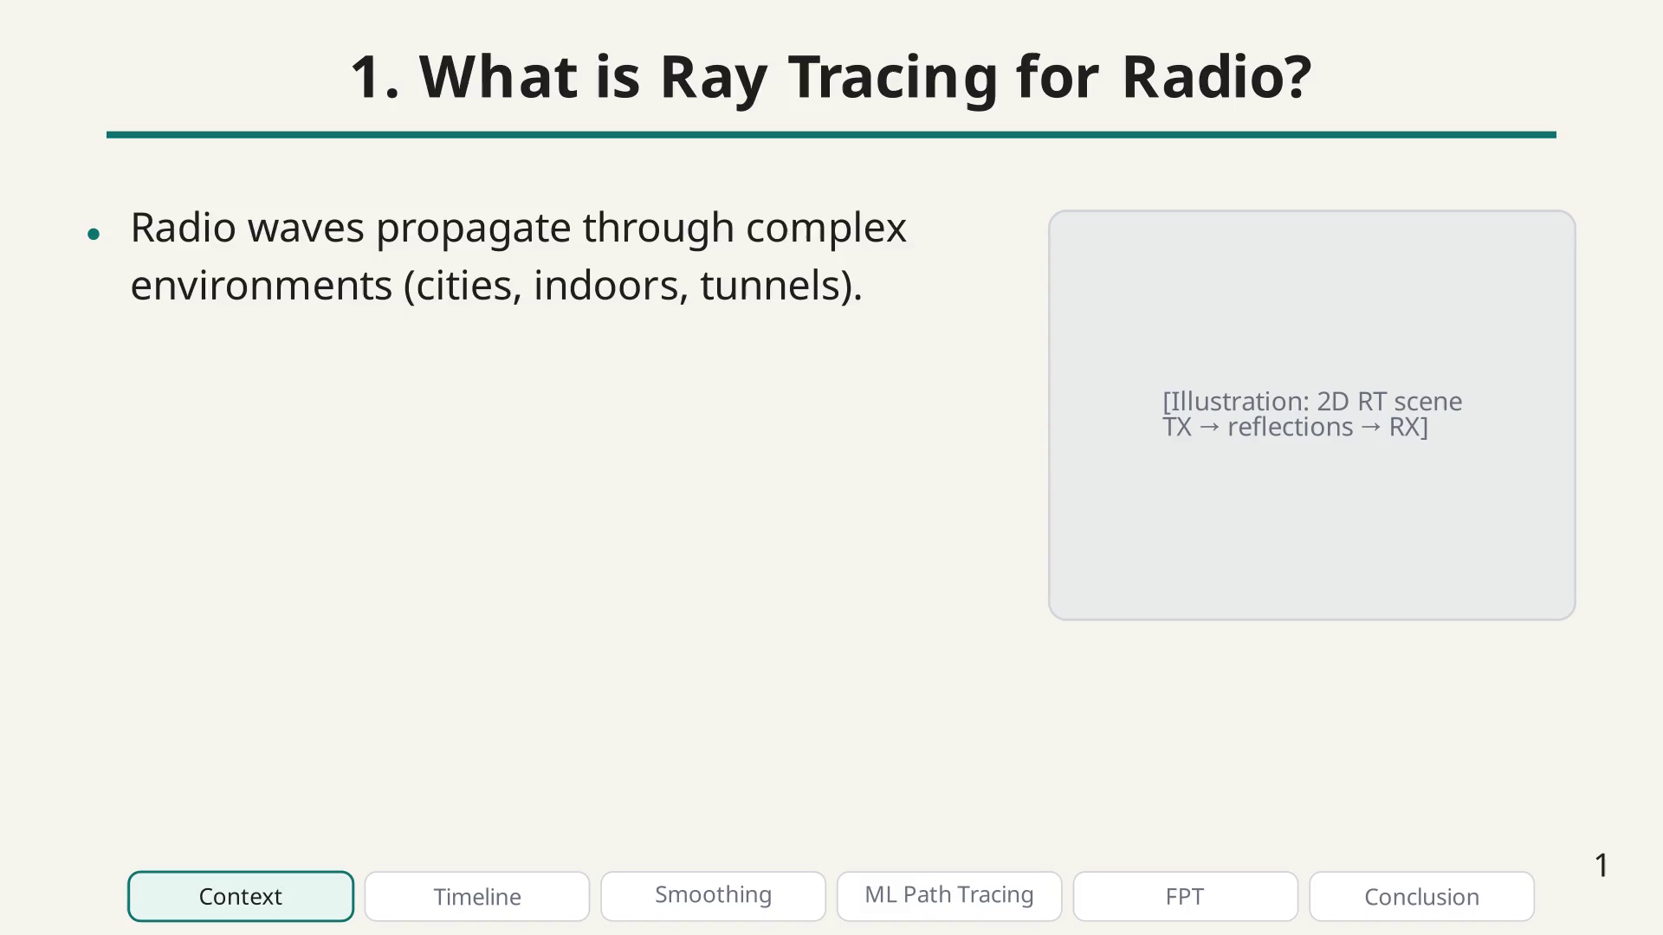
Notes:
RT simulates individual paths between TX and RX.

Slide 6
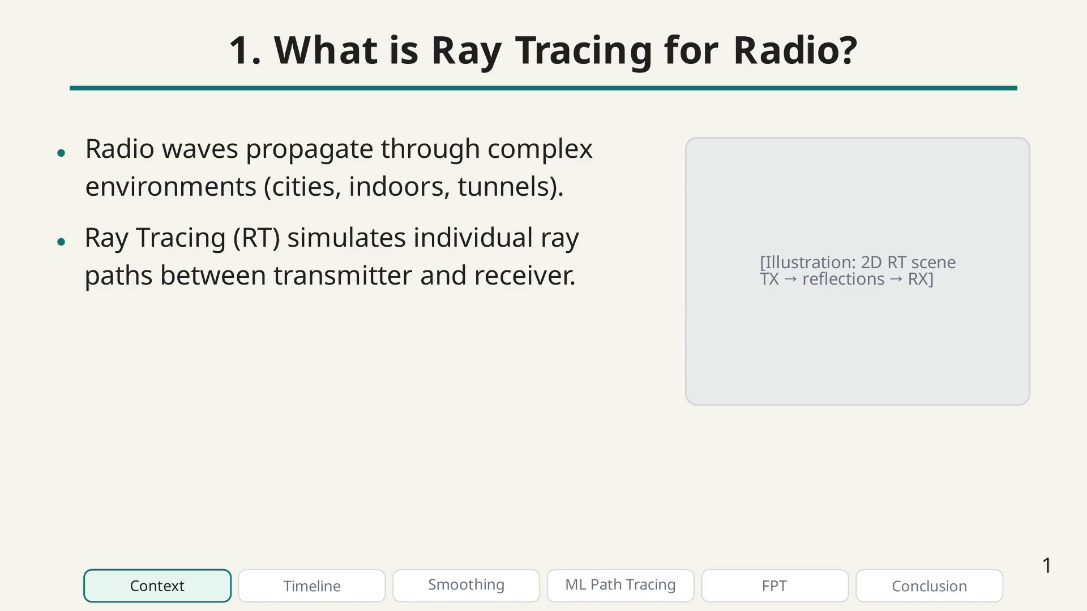
Notes:
Each path can undergo multiple interactions.

Slide 7
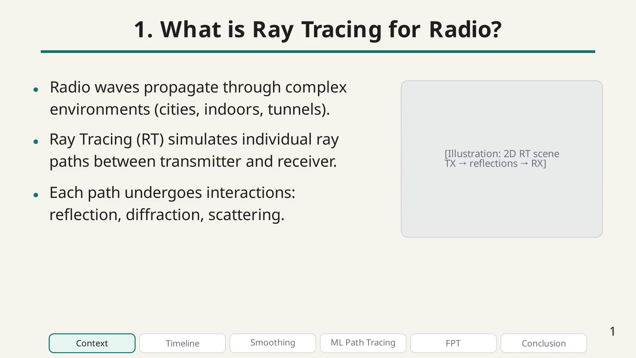
Notes:
This enables site-specific channel modeling.

Slide 8
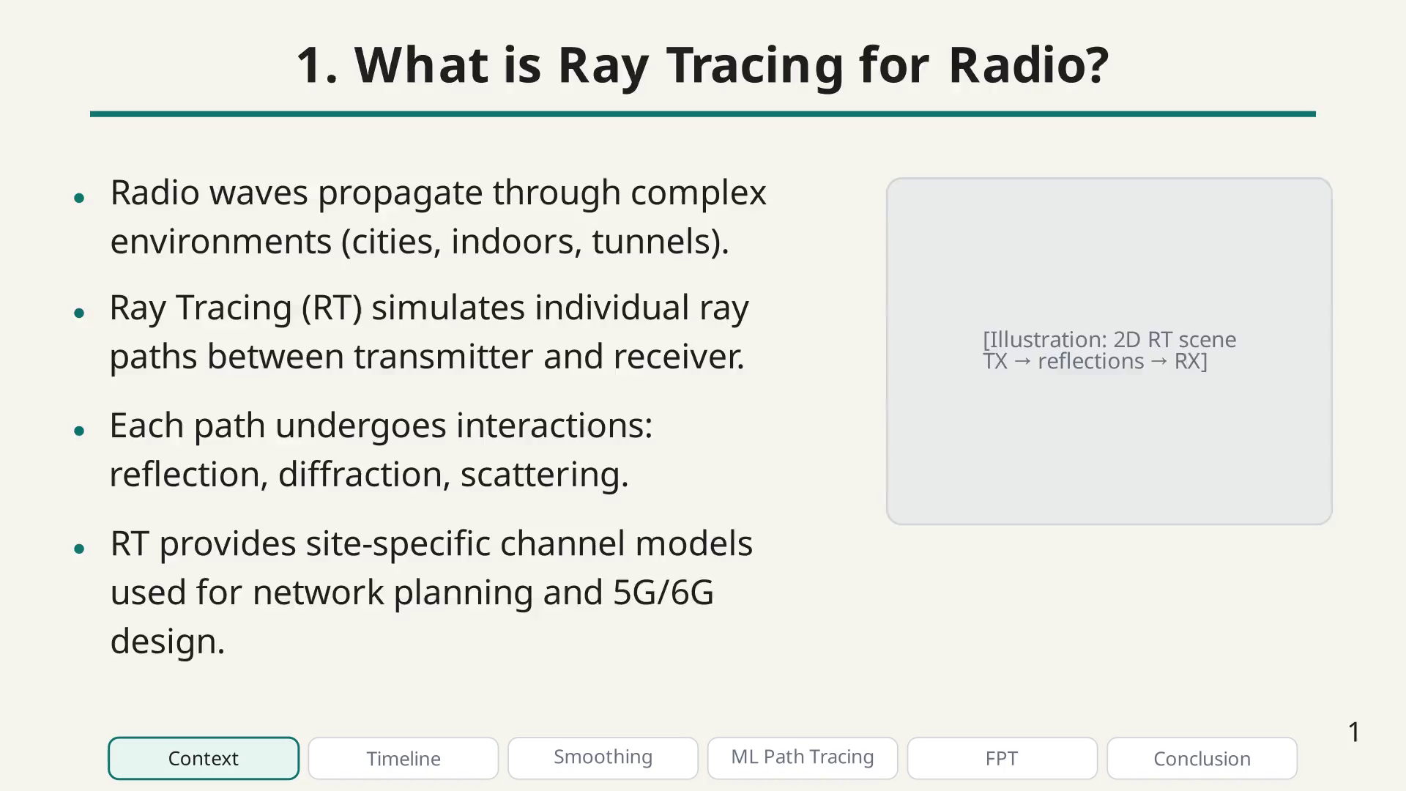
Notes:
So why differentiable ray tracing? The key idea is to make the entire RT simulation pipeline differentiable, meaning we can compute gradients of any output with respect to any input.

Slide 9
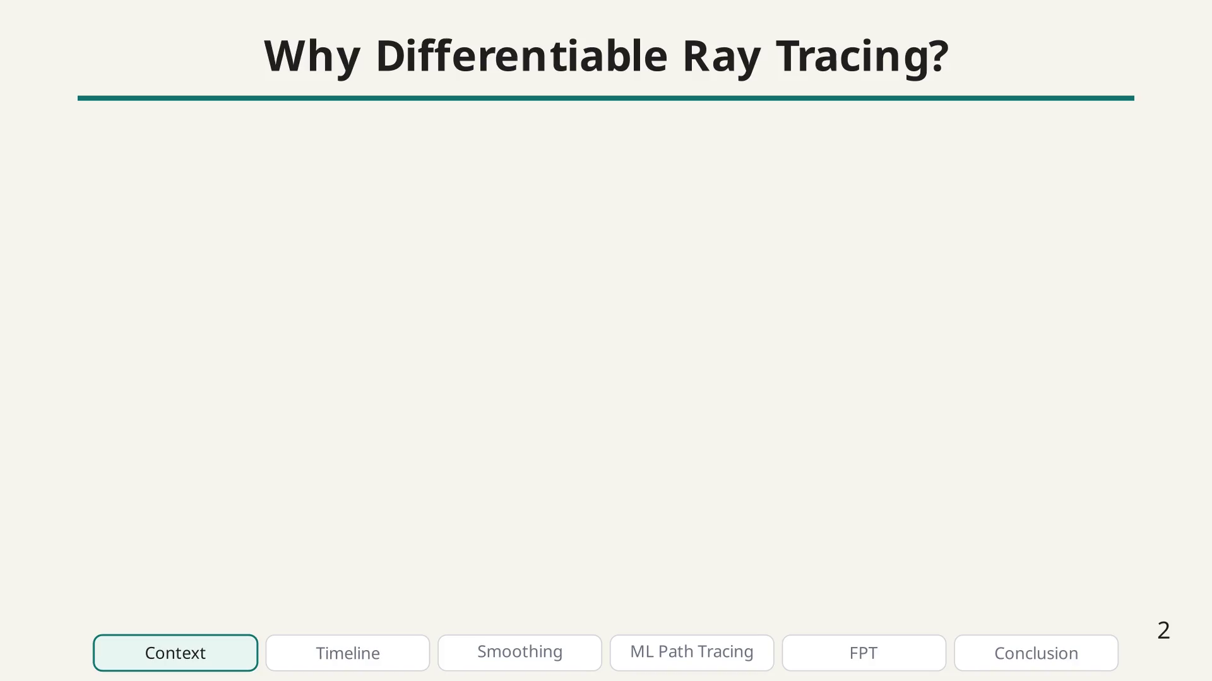
Notes:
Differentiable RT motivation bullet.

Slide 10
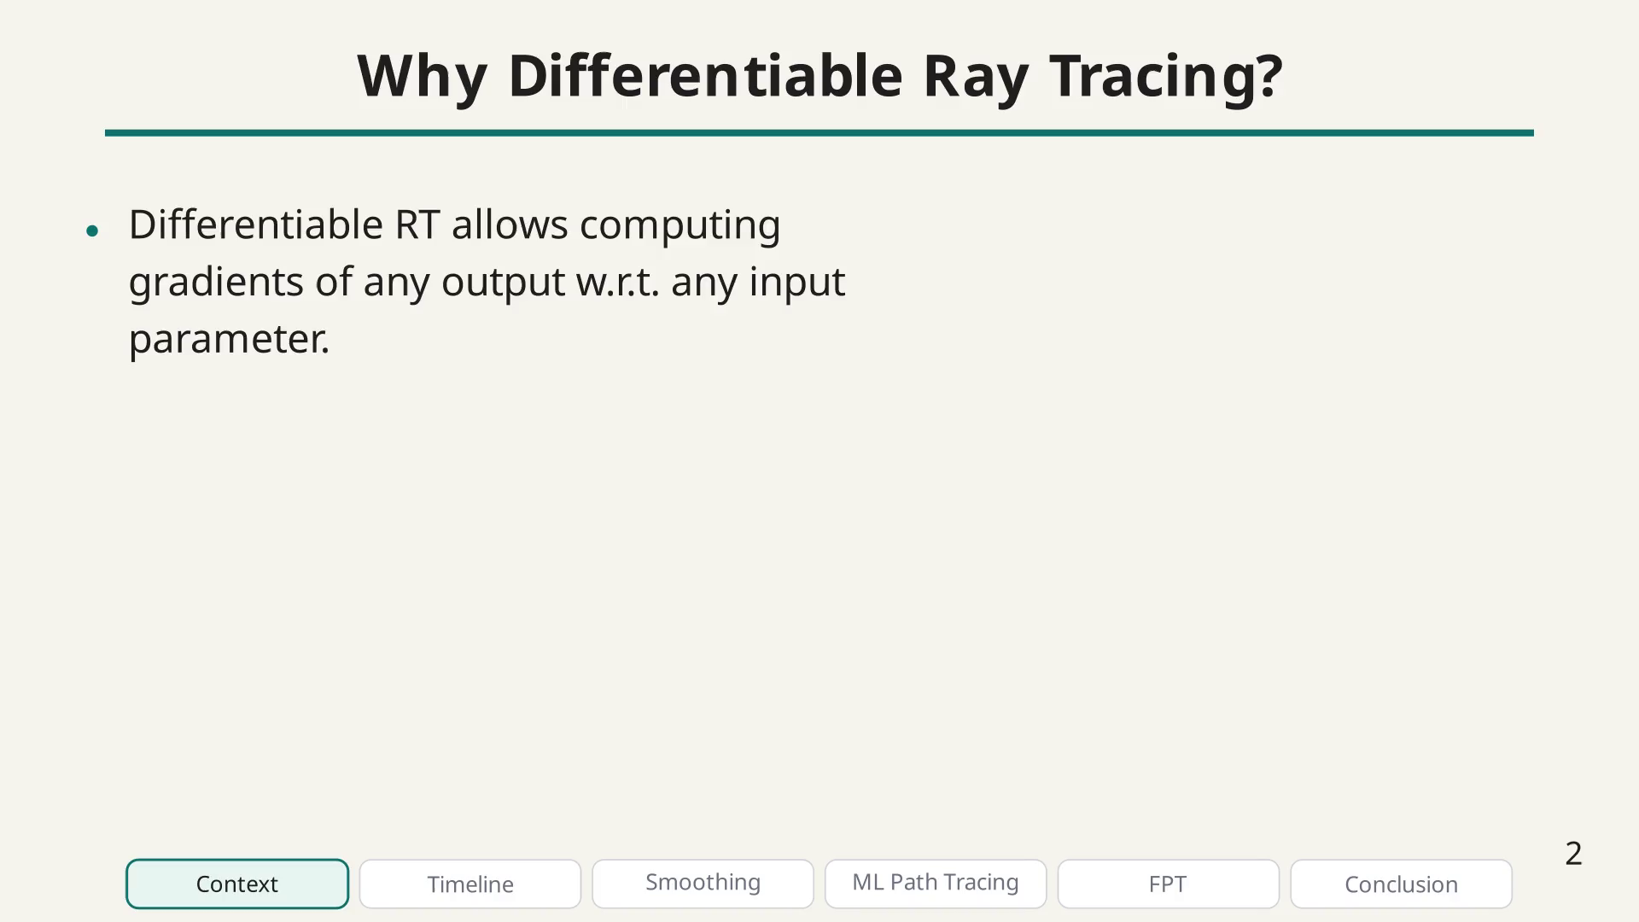
Notes:
Differentiable RT motivation bullet.

Slide 11
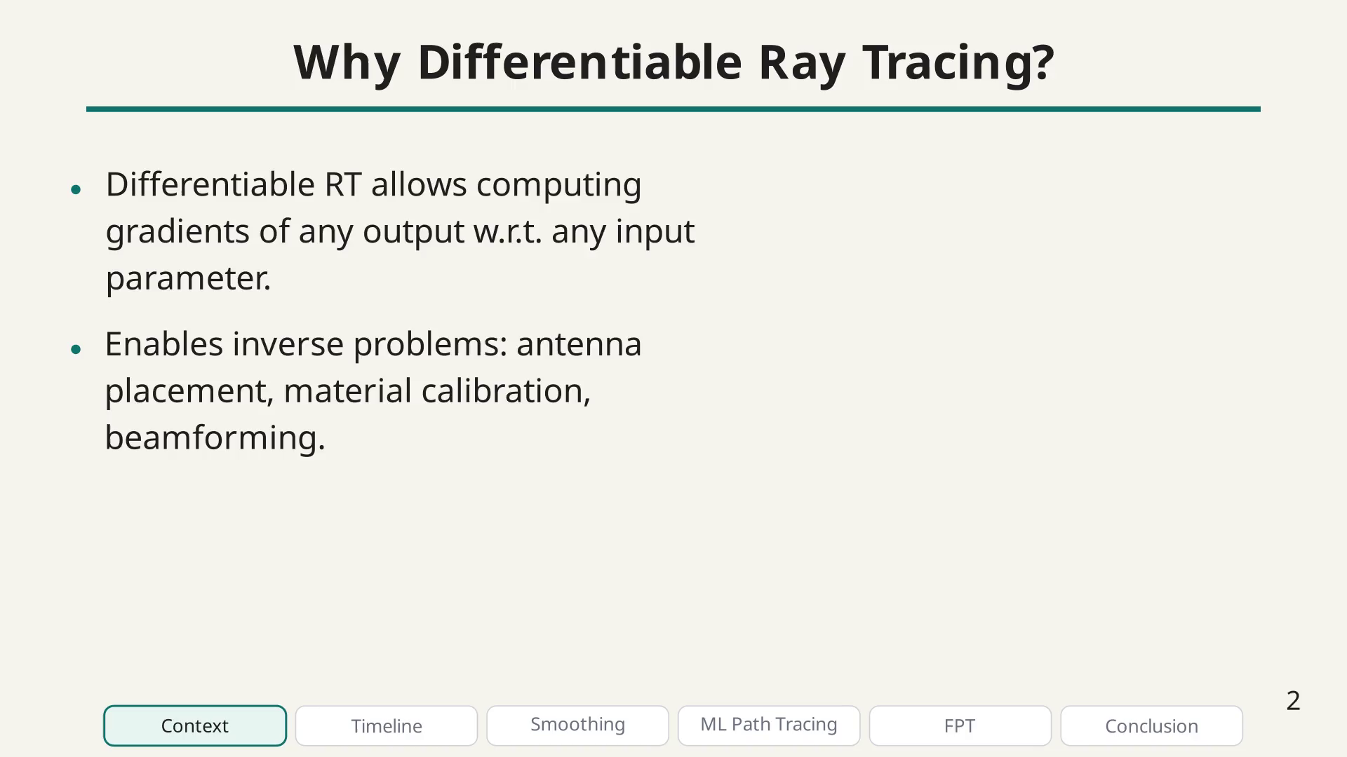
Notes:
Differentiable RT motivation bullet.

Slide 12
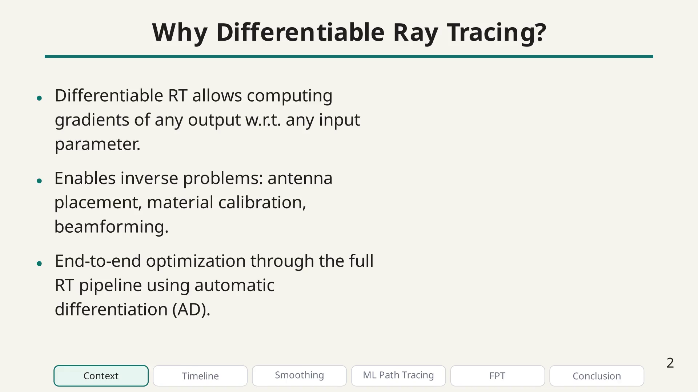
Notes:
Differentiable RT motivation bullet.

Slide 13
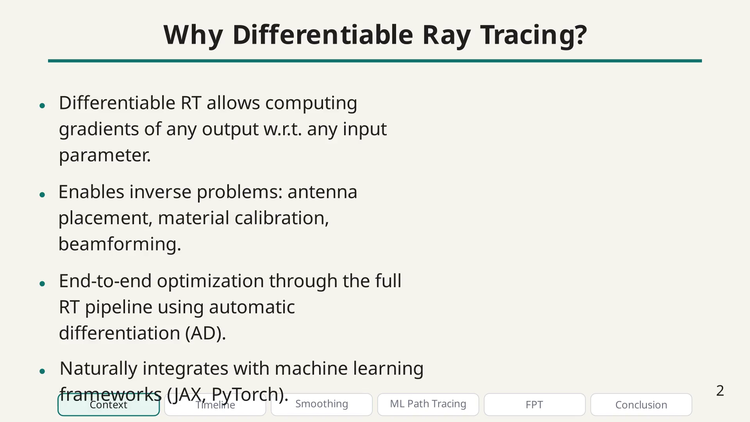
Notes:
This represents a paradigm shift: from traditional CPU-based non-differentiable RT to GPU-enabled, optimization-ready differentiable RT.

Slide 14
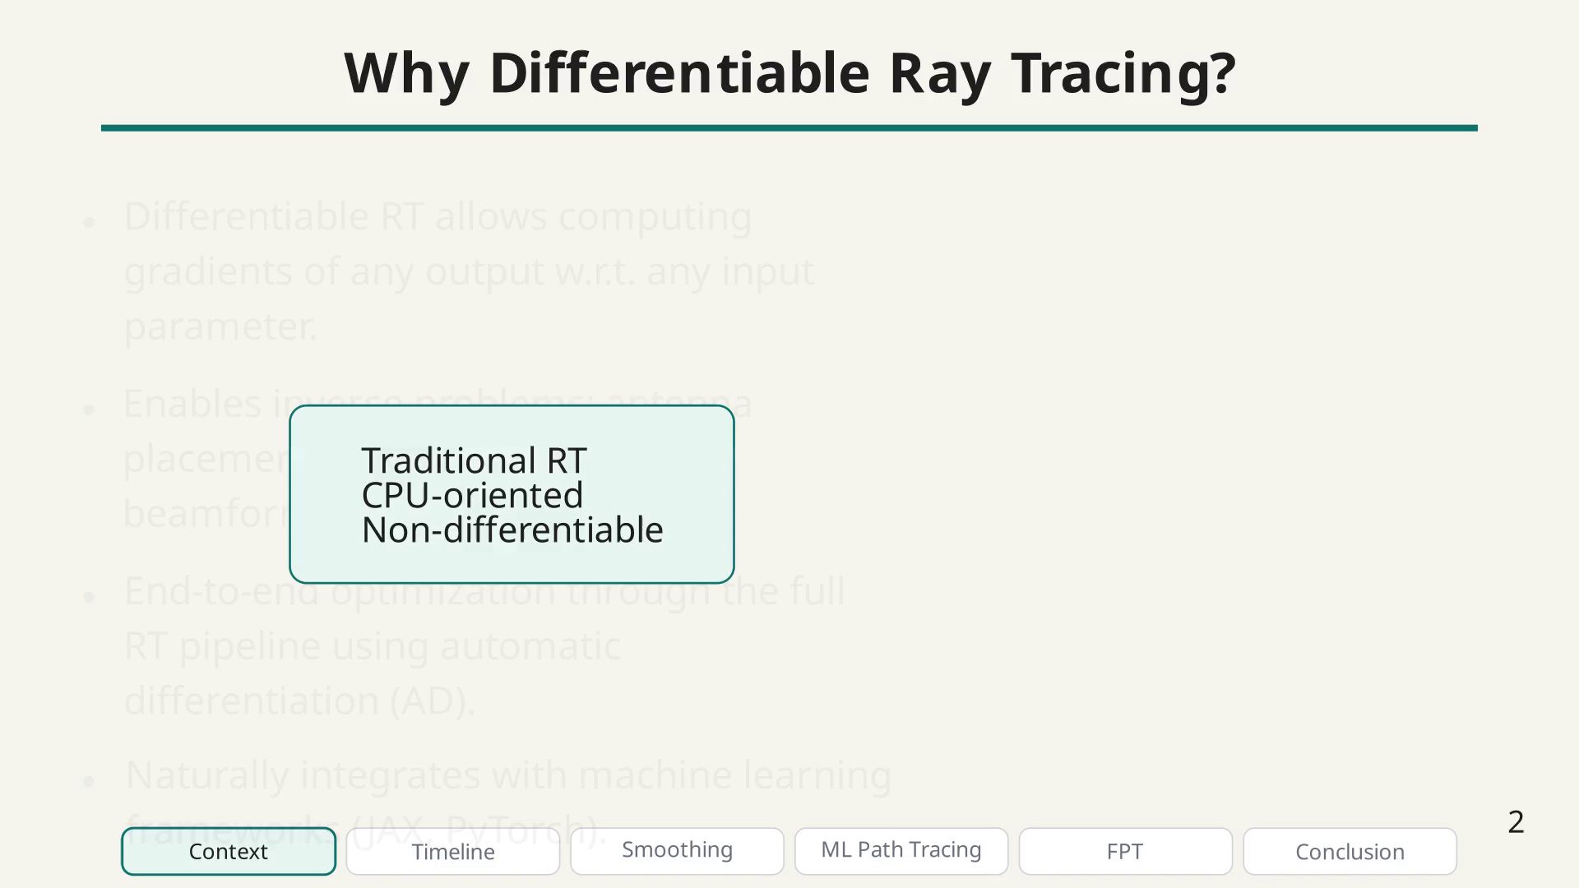
Notes:
To differentiable, GPU-enabled ray tracing.

Slide 15
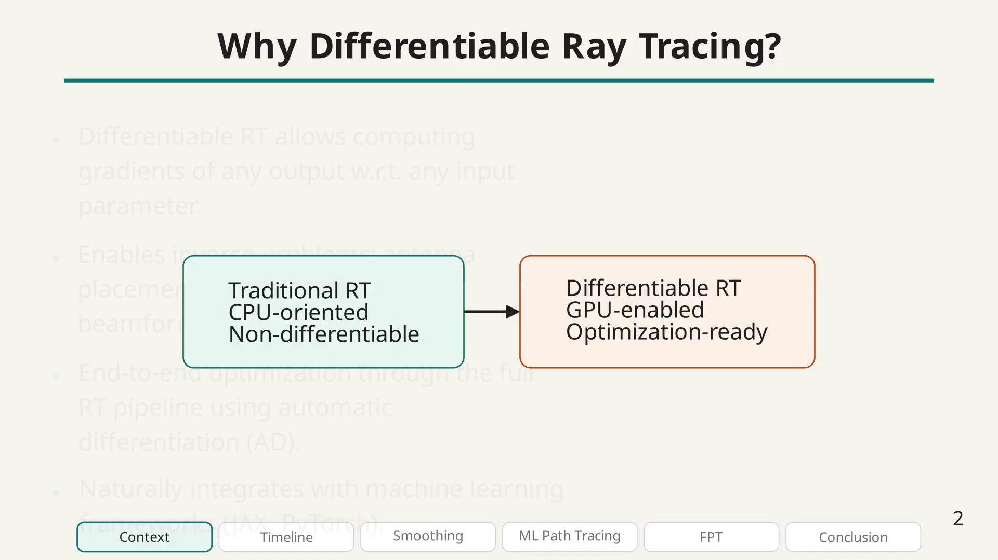
Notes:
These motivations come with several practical challenges, which are the central theme of my thesis.

Slide 16
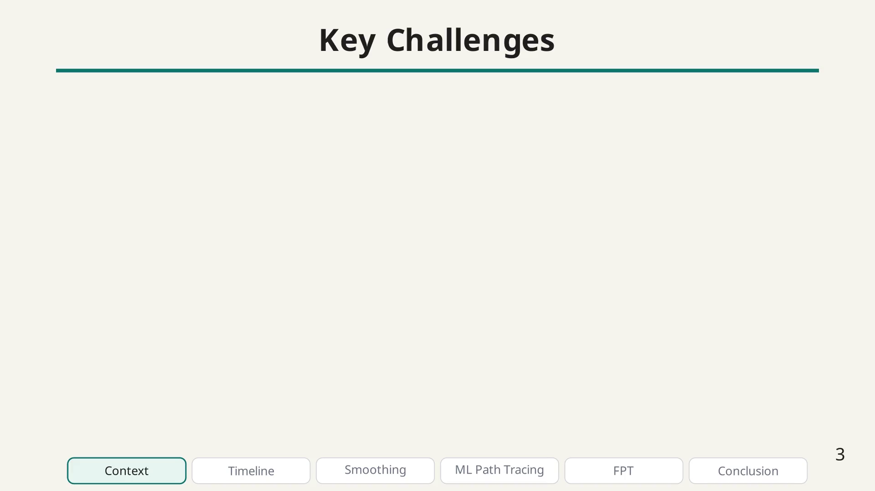
Notes:
Challenge bullet.

Slide 17
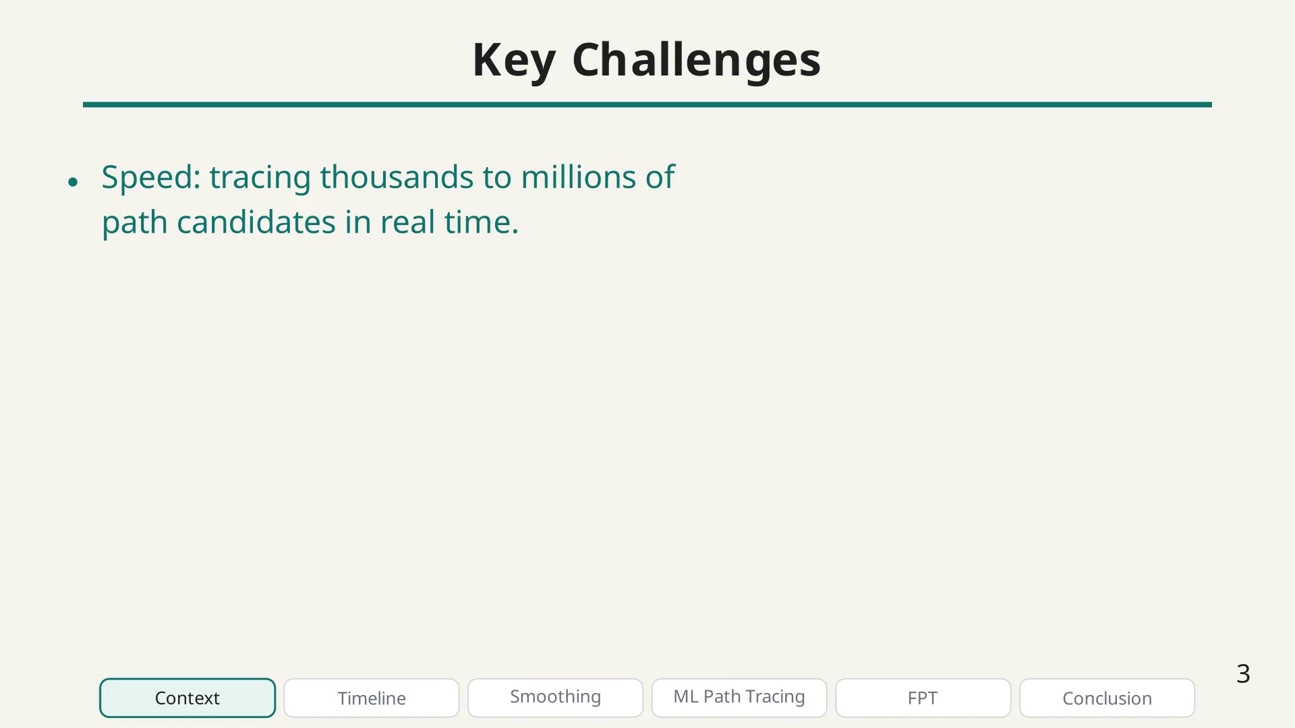
Notes:
Challenge bullet.

Slide 18
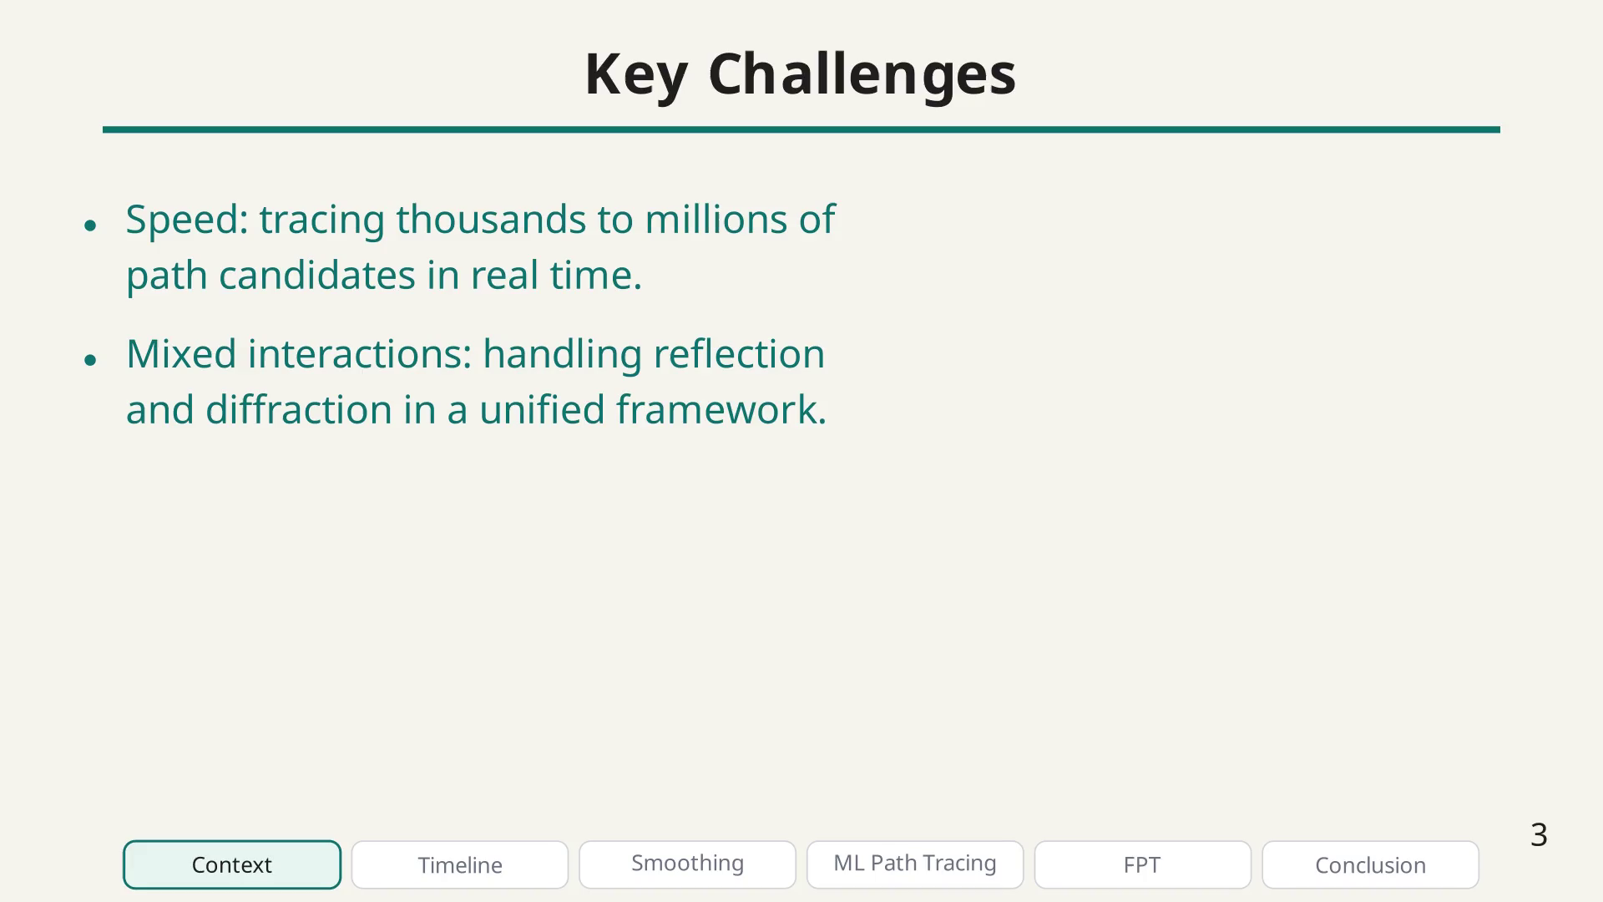
Notes:
Challenge bullet.

Slide 19
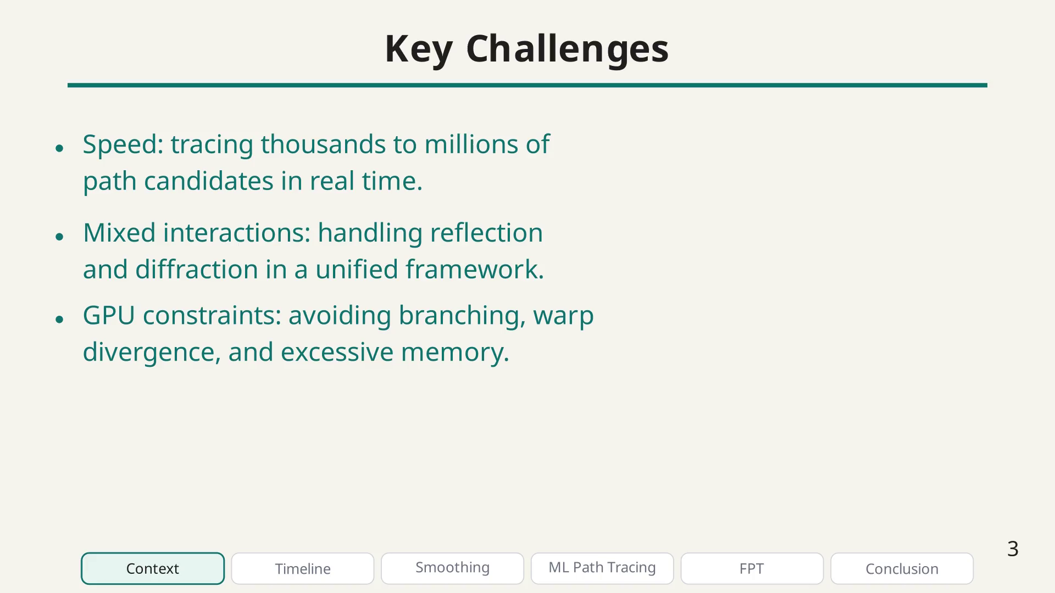
Notes:
Challenge bullet.

Slide 20
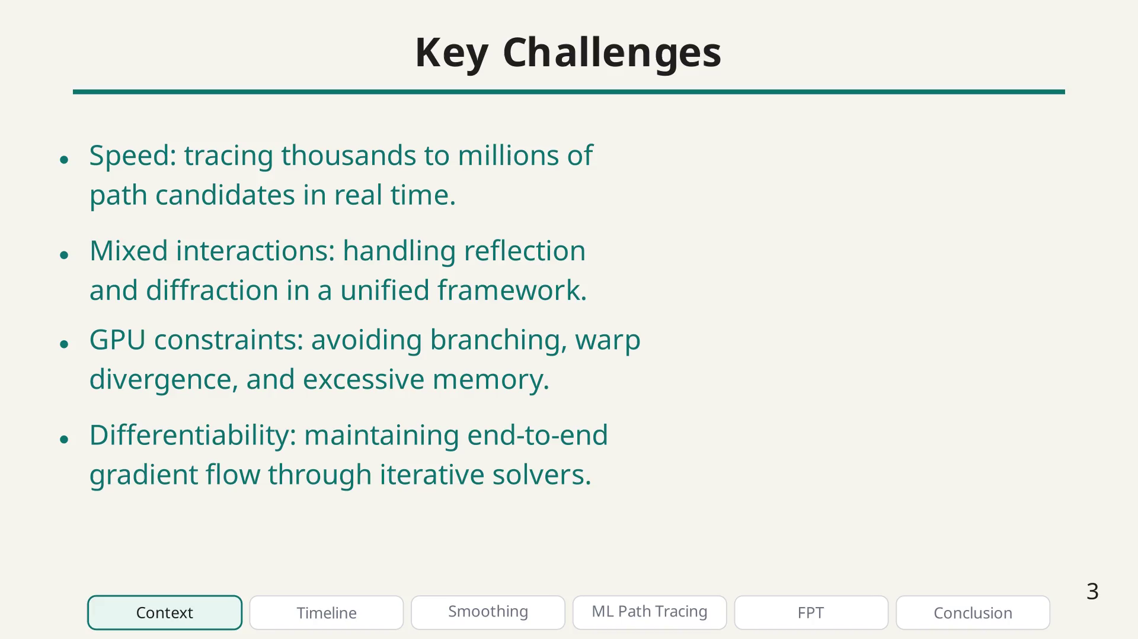
Notes:
My thesis addresses these challenges through three main contributions, which I will now present in chronological order.

Slide 21
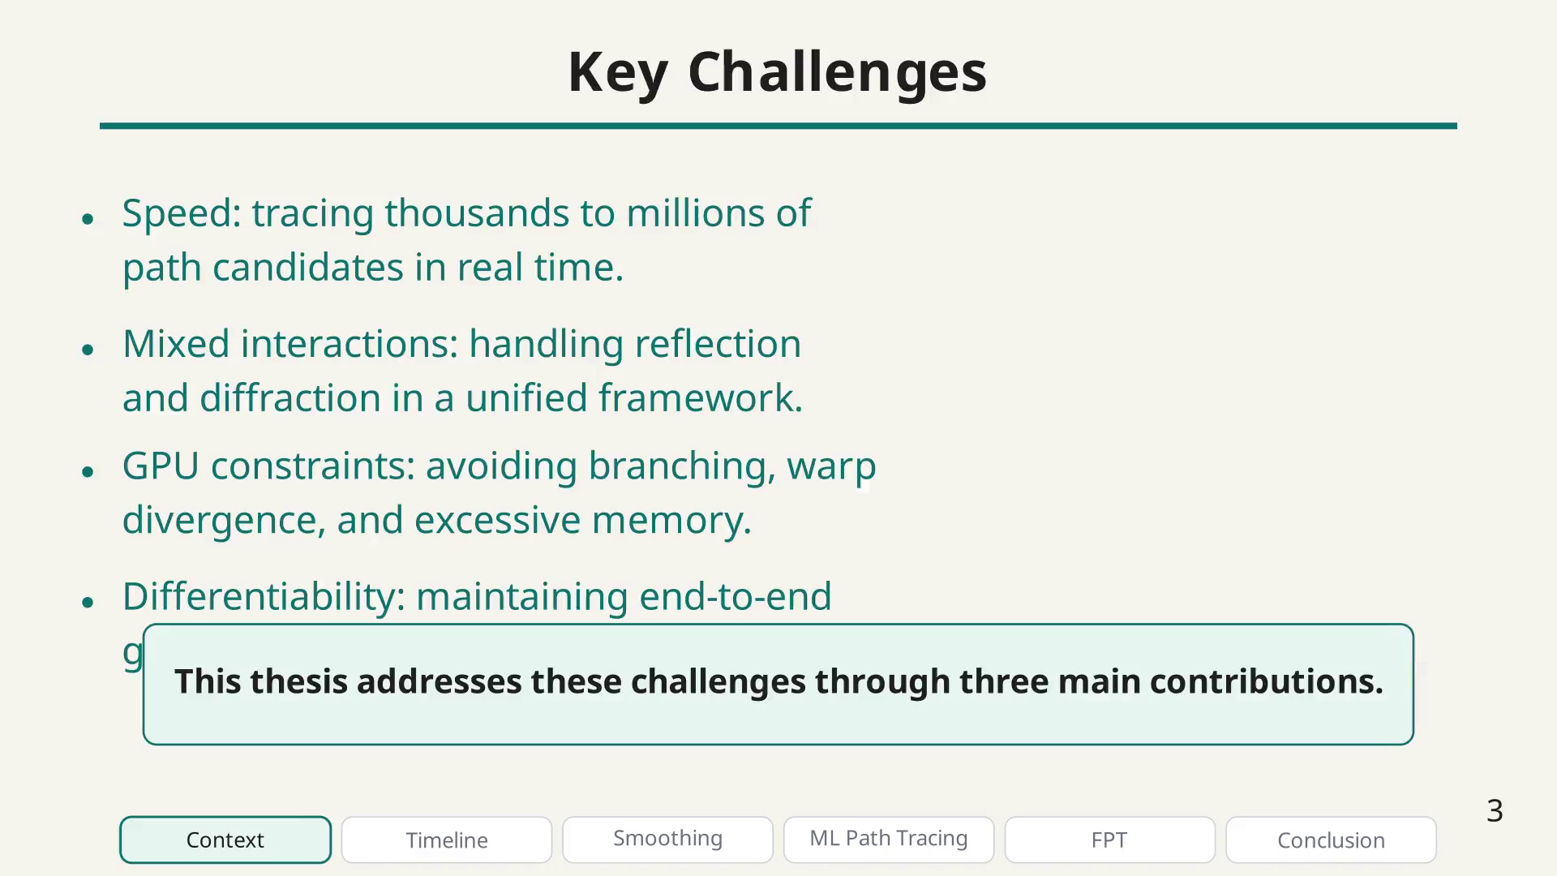
Notes:
Before diving into the contributions, let me give you an overview of my PhD journey. This timeline highlights the key milestones, from my student jobs in 2020 through the start of my PhD in 2021, several conferences and research stays, up to EuCAP 2026 just a few weeks ago.

Slide 22
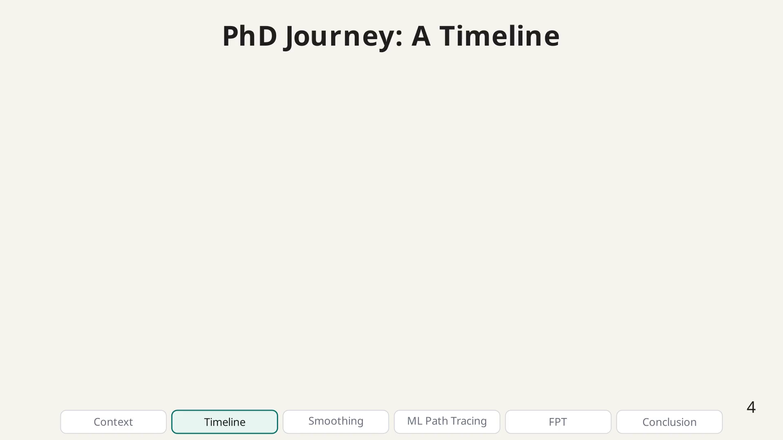
Notes:
The timeline of my PhD journey.

Slide 23
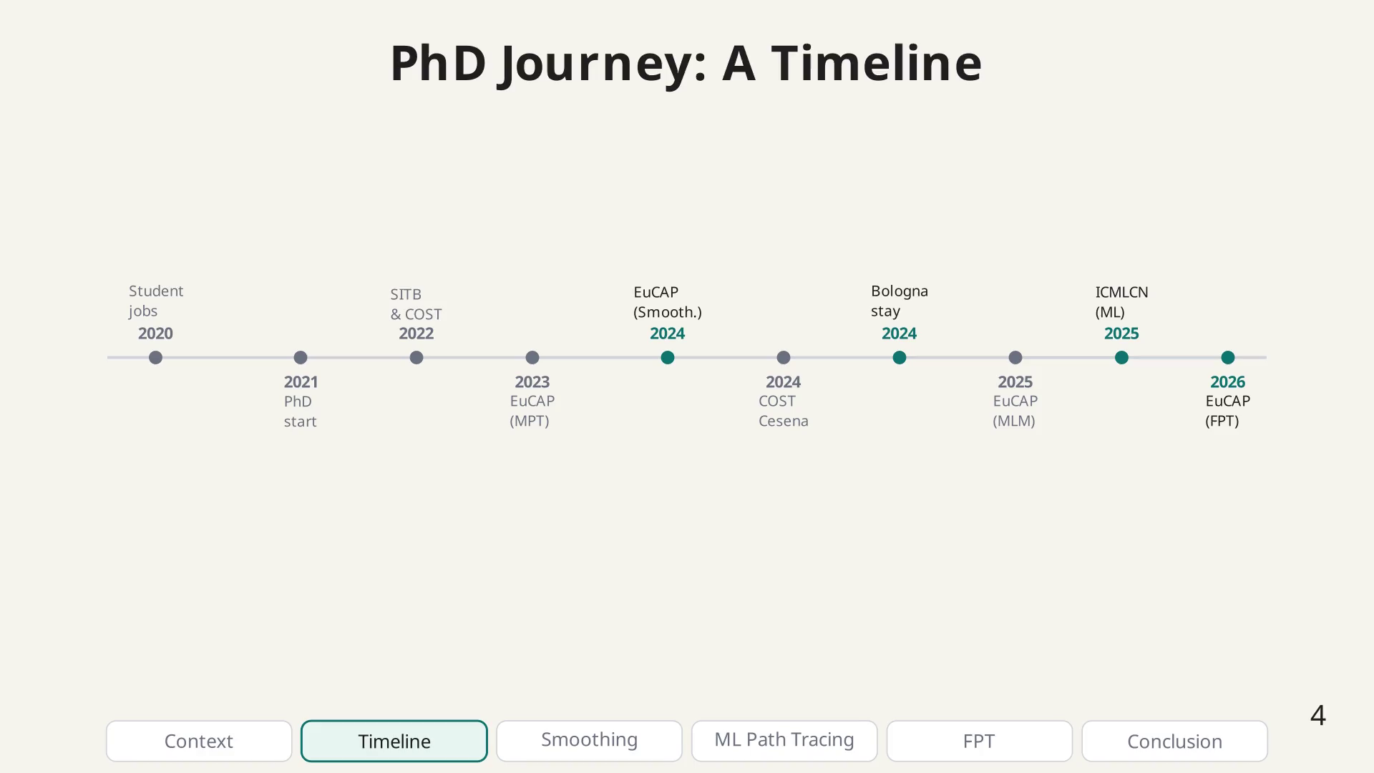
Notes:
I will focus on three main contributions, highlighted here: the smoothing technique, the ML-based path tracing, and the Fermat Path Tracing method.

Slide 24
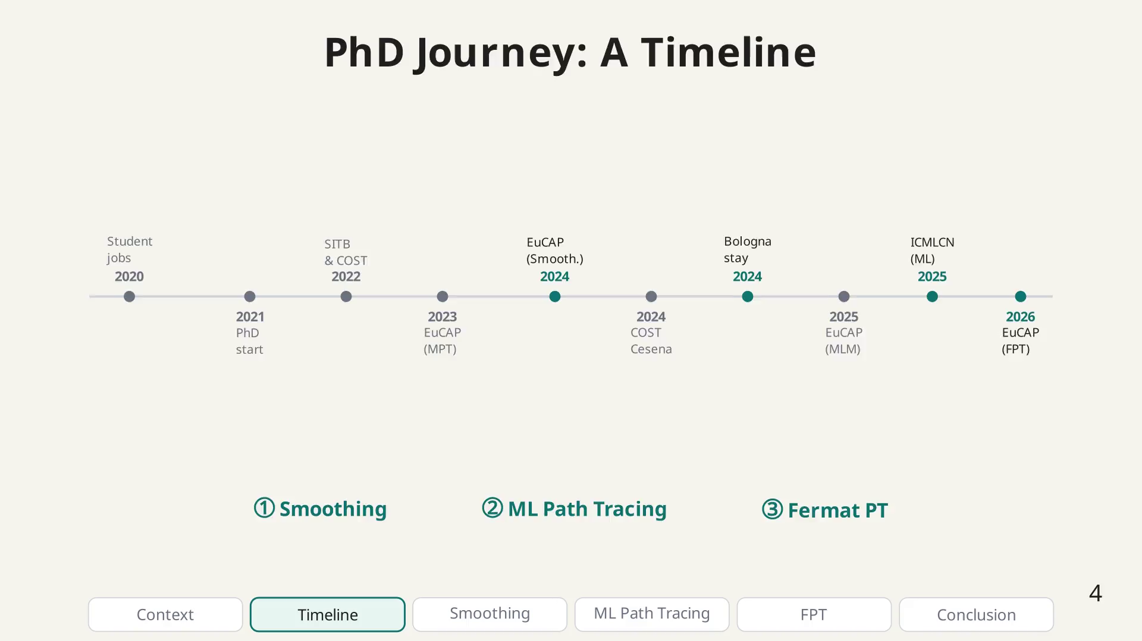
Notes:
Here is the roadmap for this presentation. After the context we just covered, I will present each of my three main contributions in chronological order, followed by a conclusion with future directions.

Slide 25
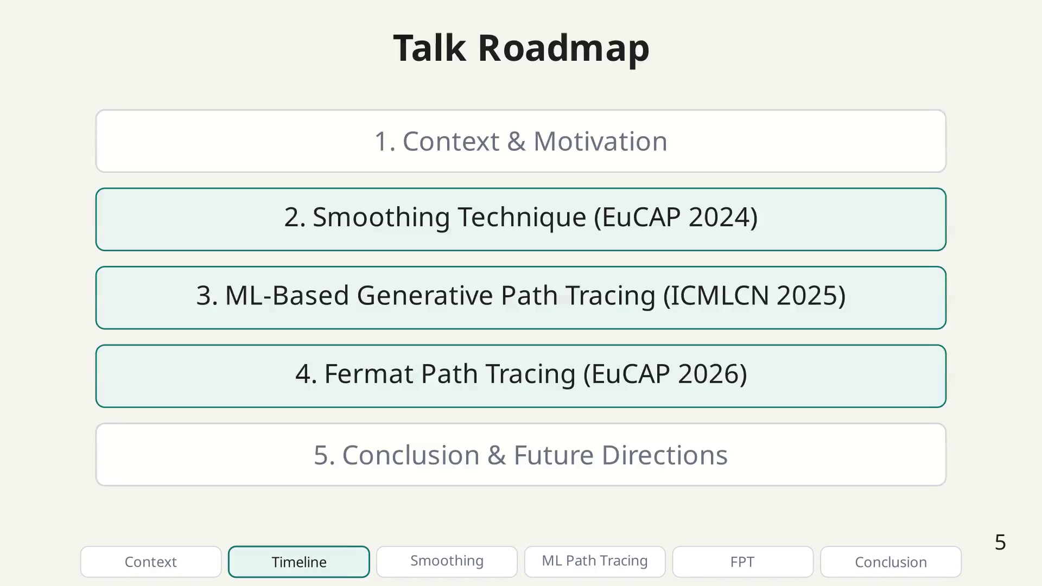
Notes:
Let me now present the first contribution. It all starts with the path tracing problem: given a TX and RX and a sequence of interactions, we want to find the path that minimizes the total optical length, following Fermat's principle.

Slide 26
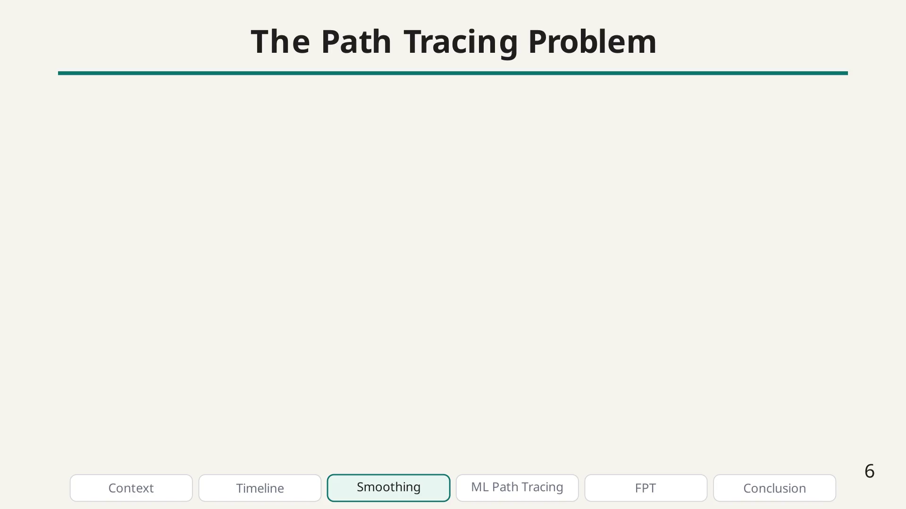
Notes:
The min. path length formulation.

Slide 27
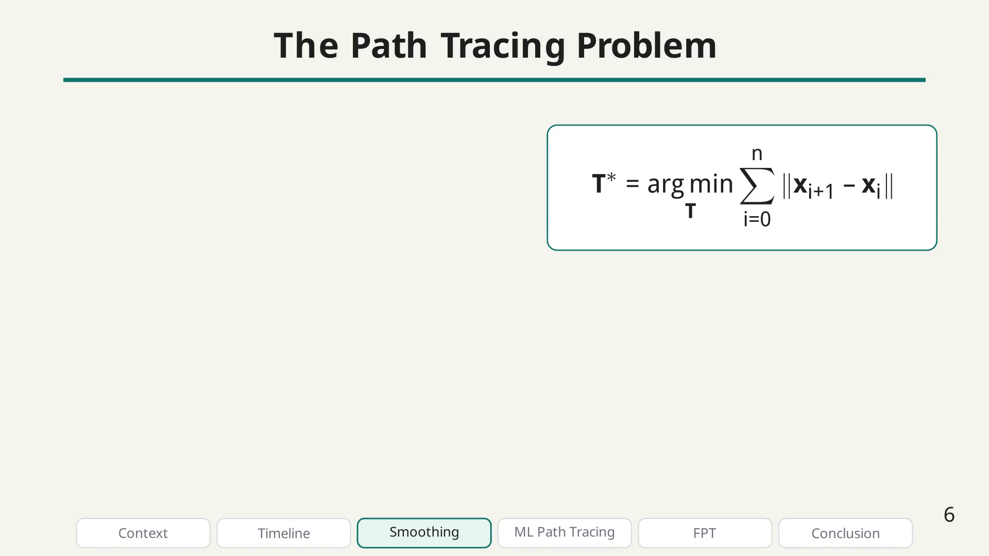
Notes:
Path tracing bullet.

Slide 28
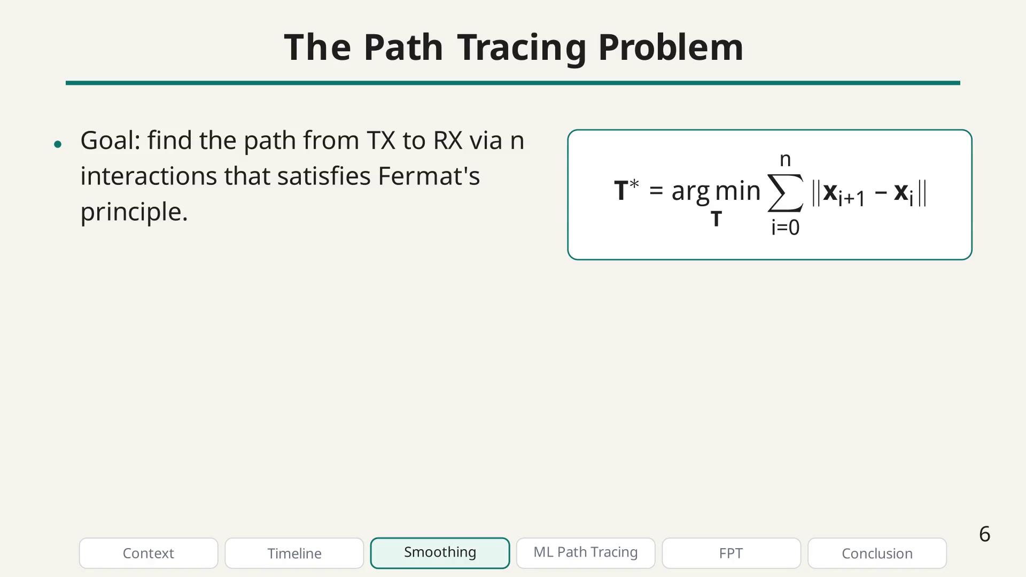
Notes:
Path tracing bullet.

Slide 29
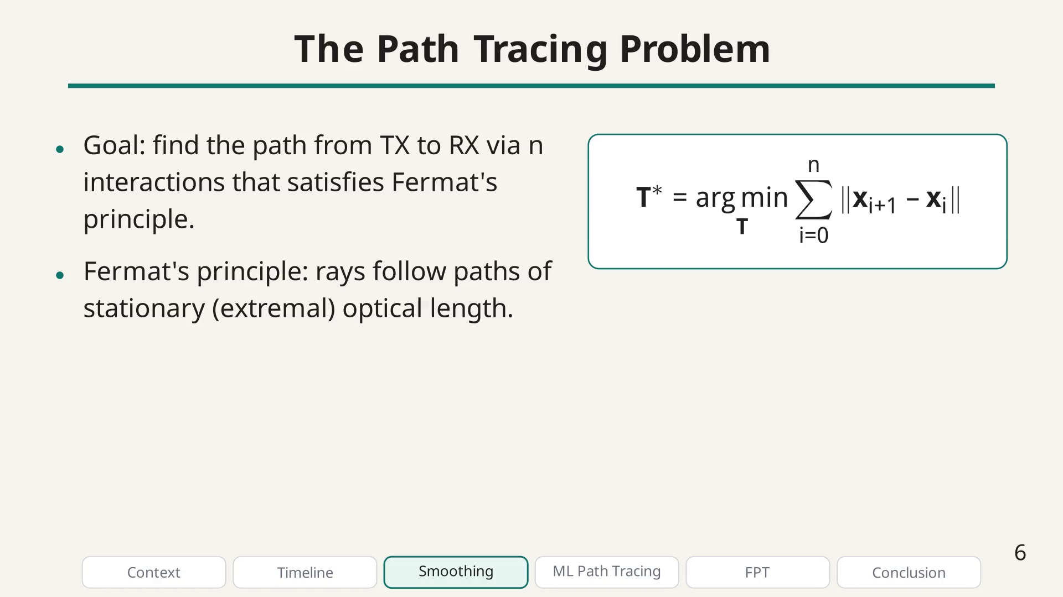
Notes:
Path tracing bullet.

Slide 30
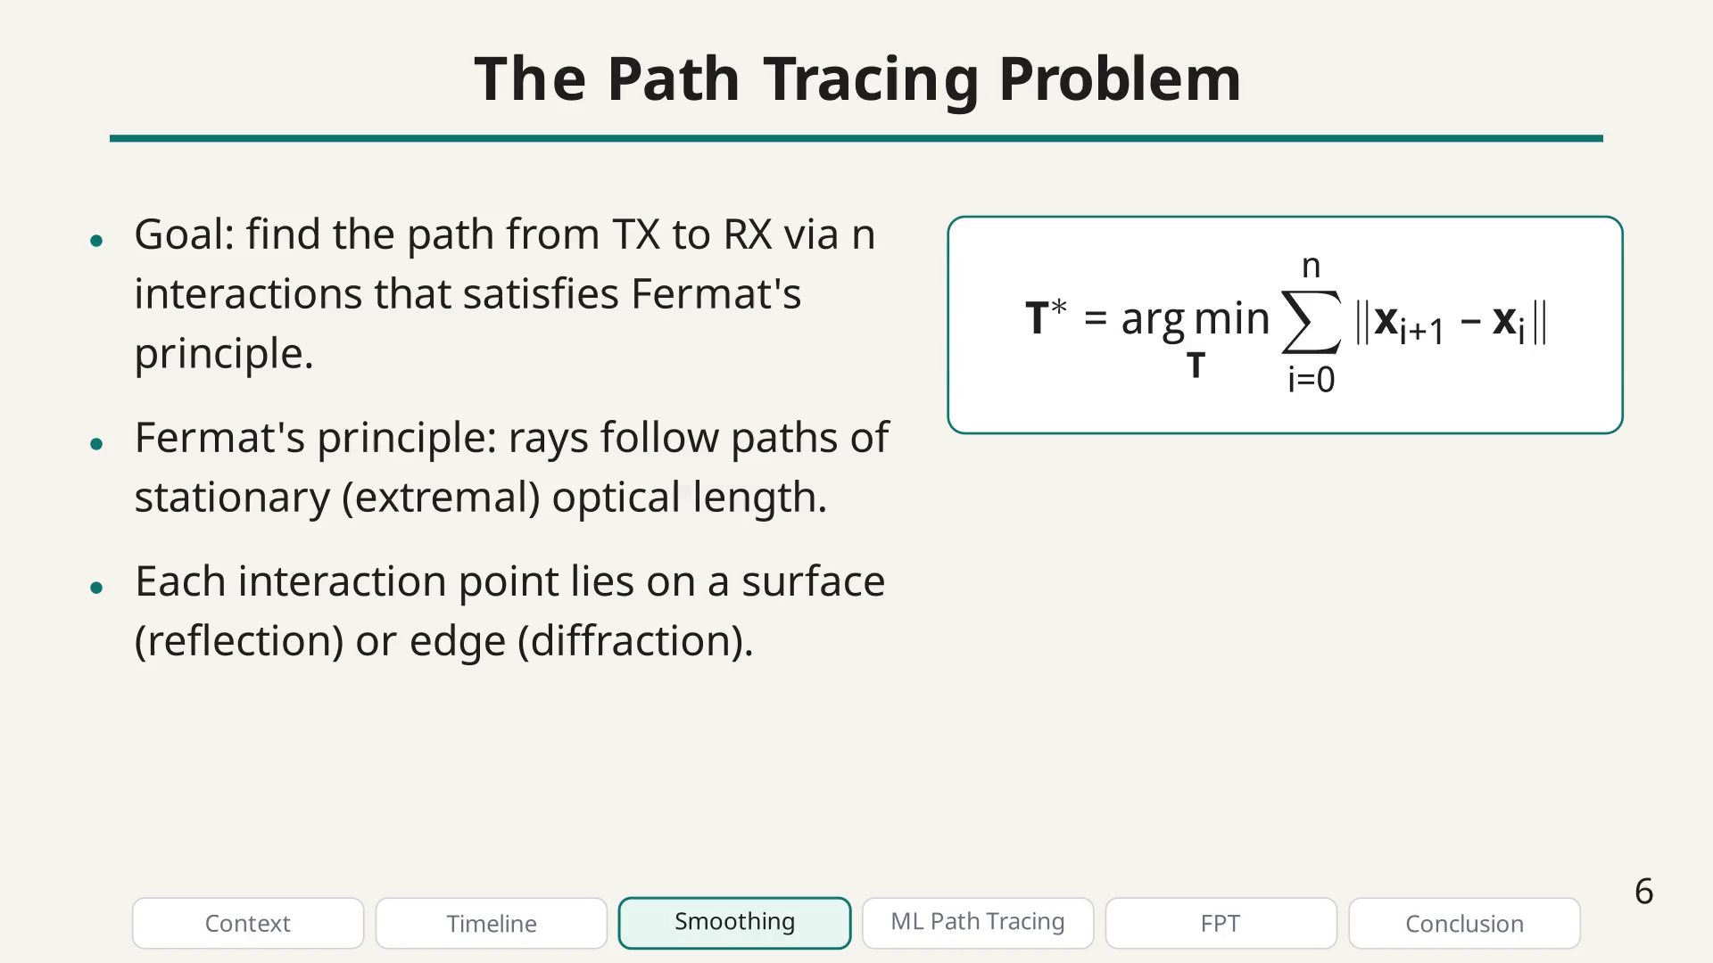
Notes:
Path tracing bullet.

Slide 31
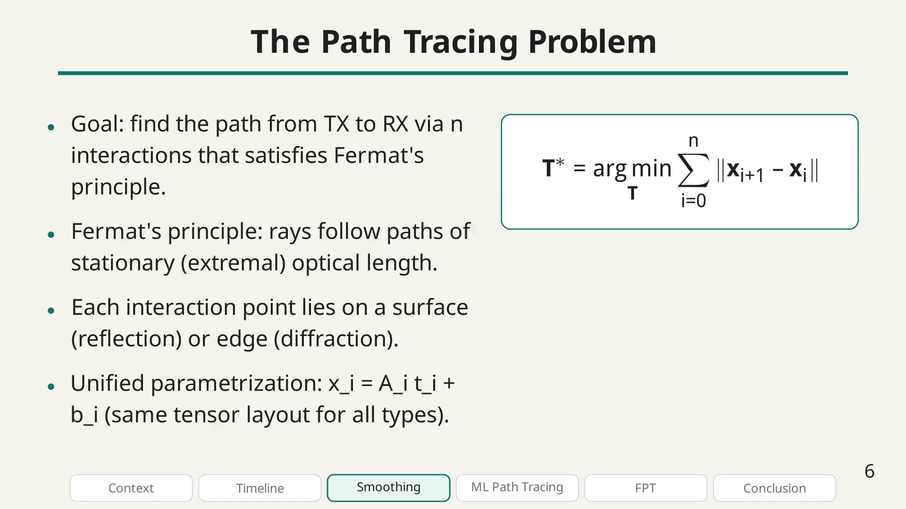
Notes:
The Min-Path-Tracing method is the foundation of my thesis work. Interestingly, I first created this method during a student job in 2020, before my PhD even started, without knowing it was a novel approach.

Slide 32
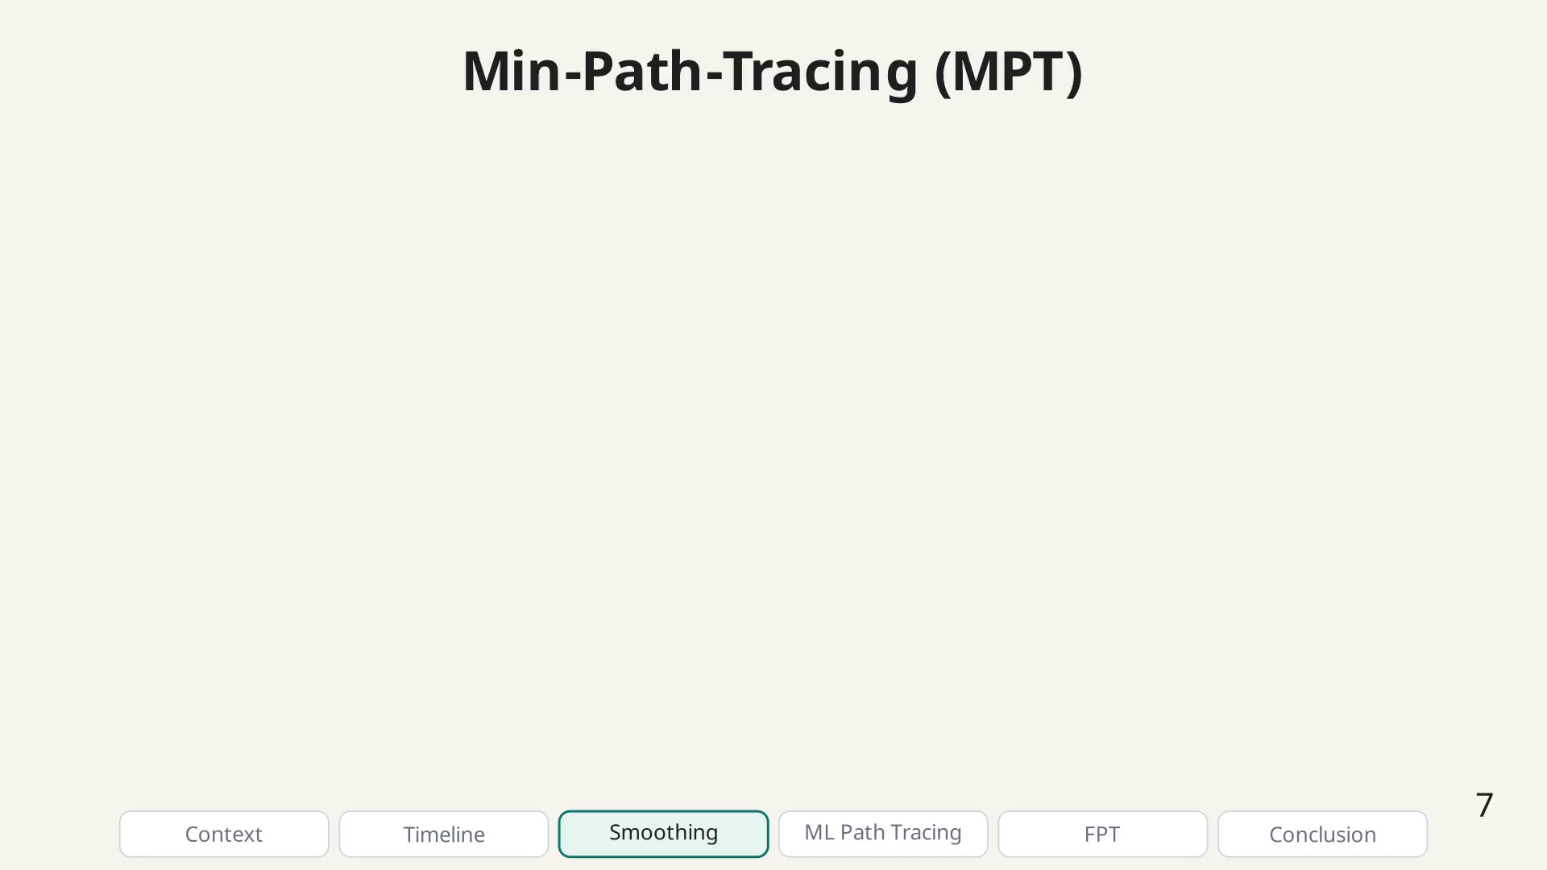
Notes:
The origin story.

Slide 33
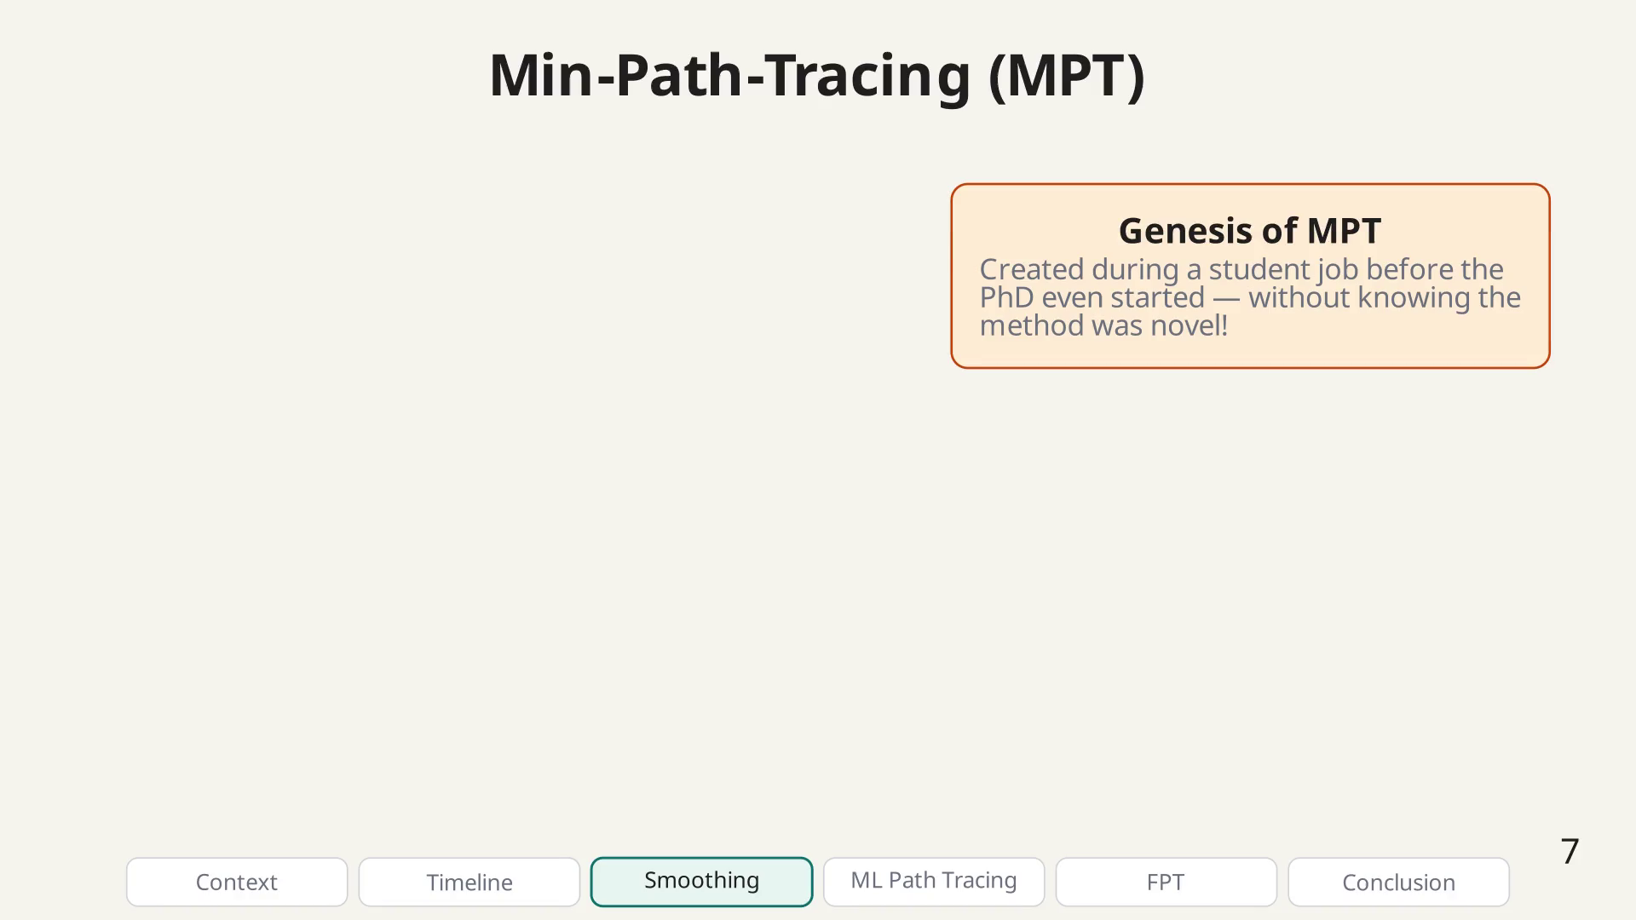
Notes:
MPT bullet.

Slide 34
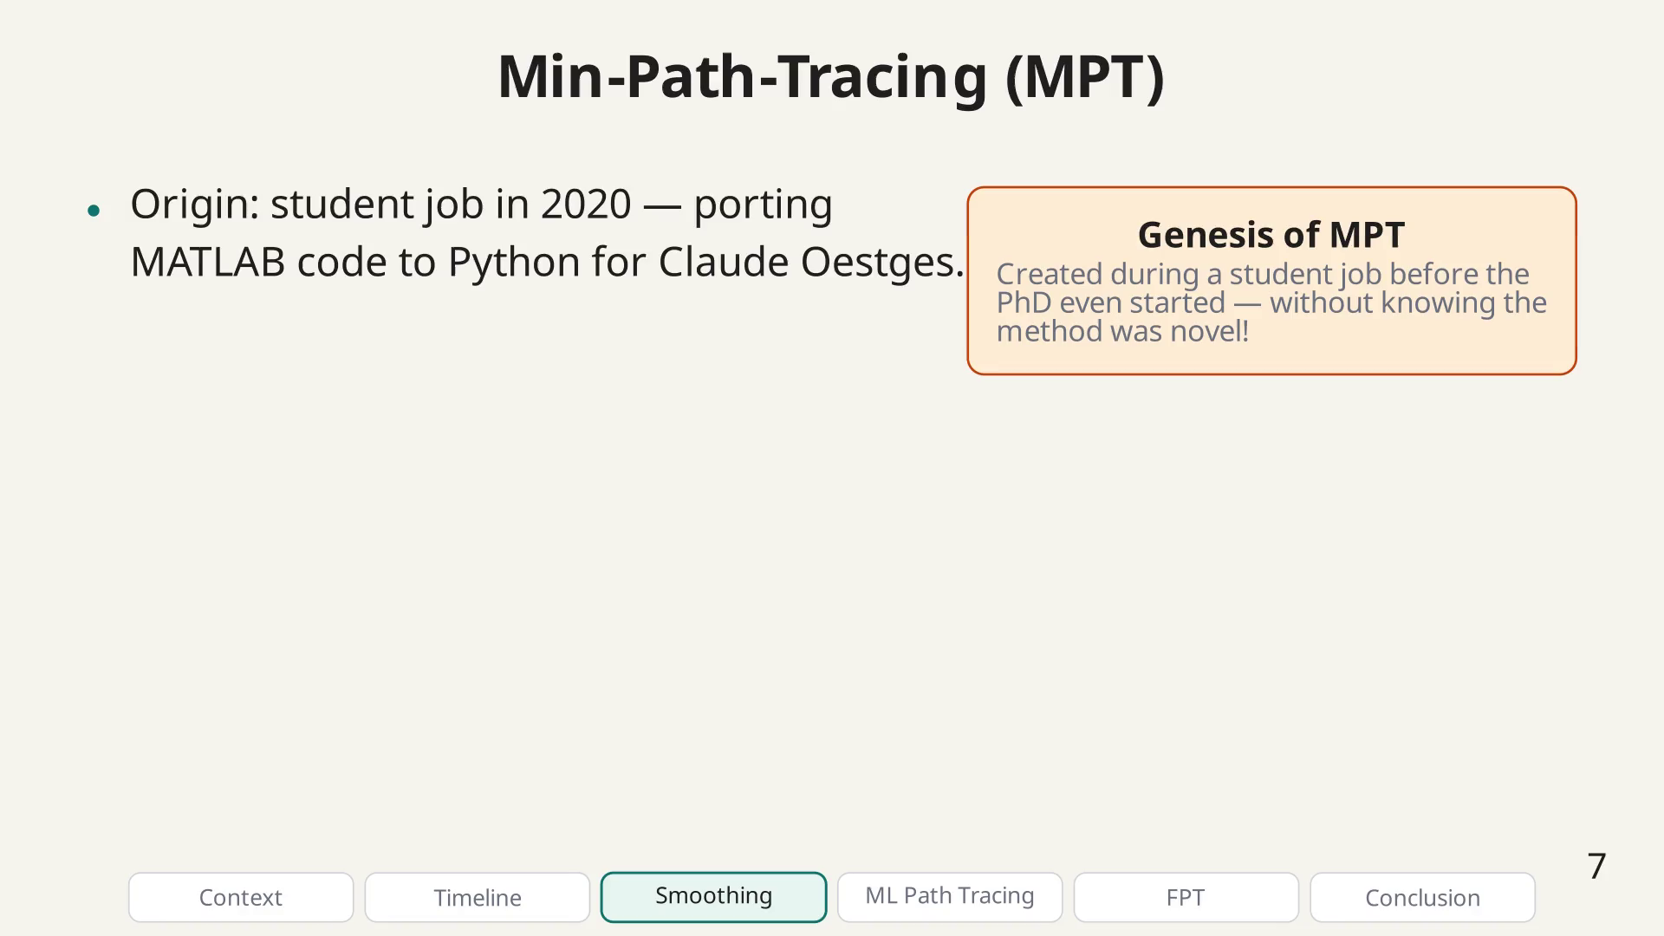
Notes:
MPT bullet.

Slide 35
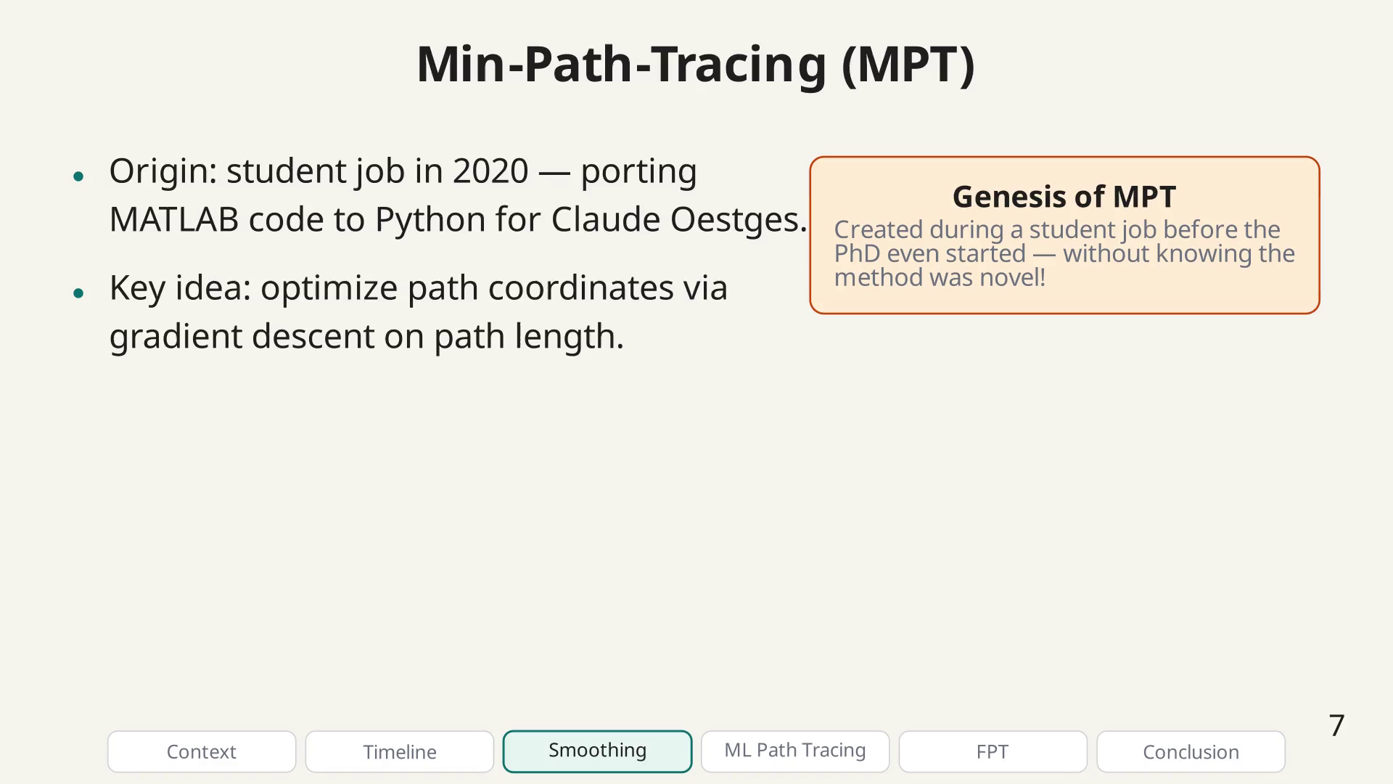
Notes:
MPT bullet.

Slide 36
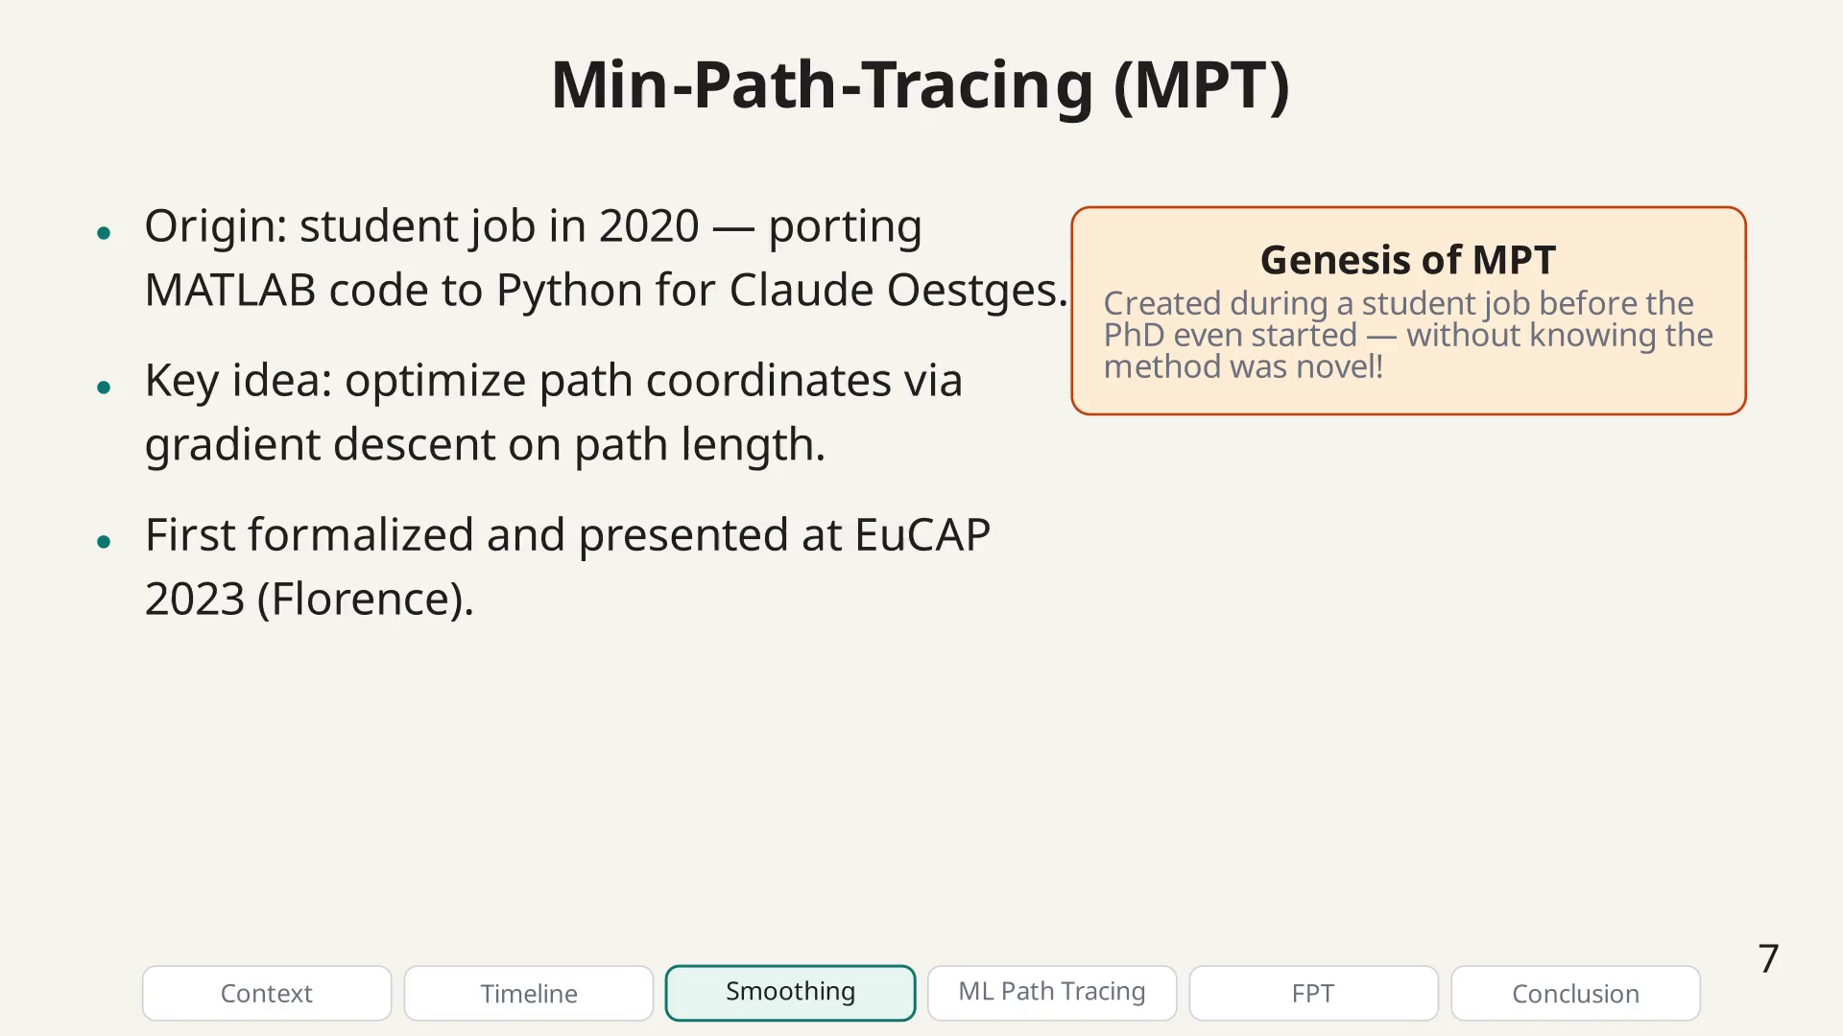
Notes:
MPT bullet.

Slide 37
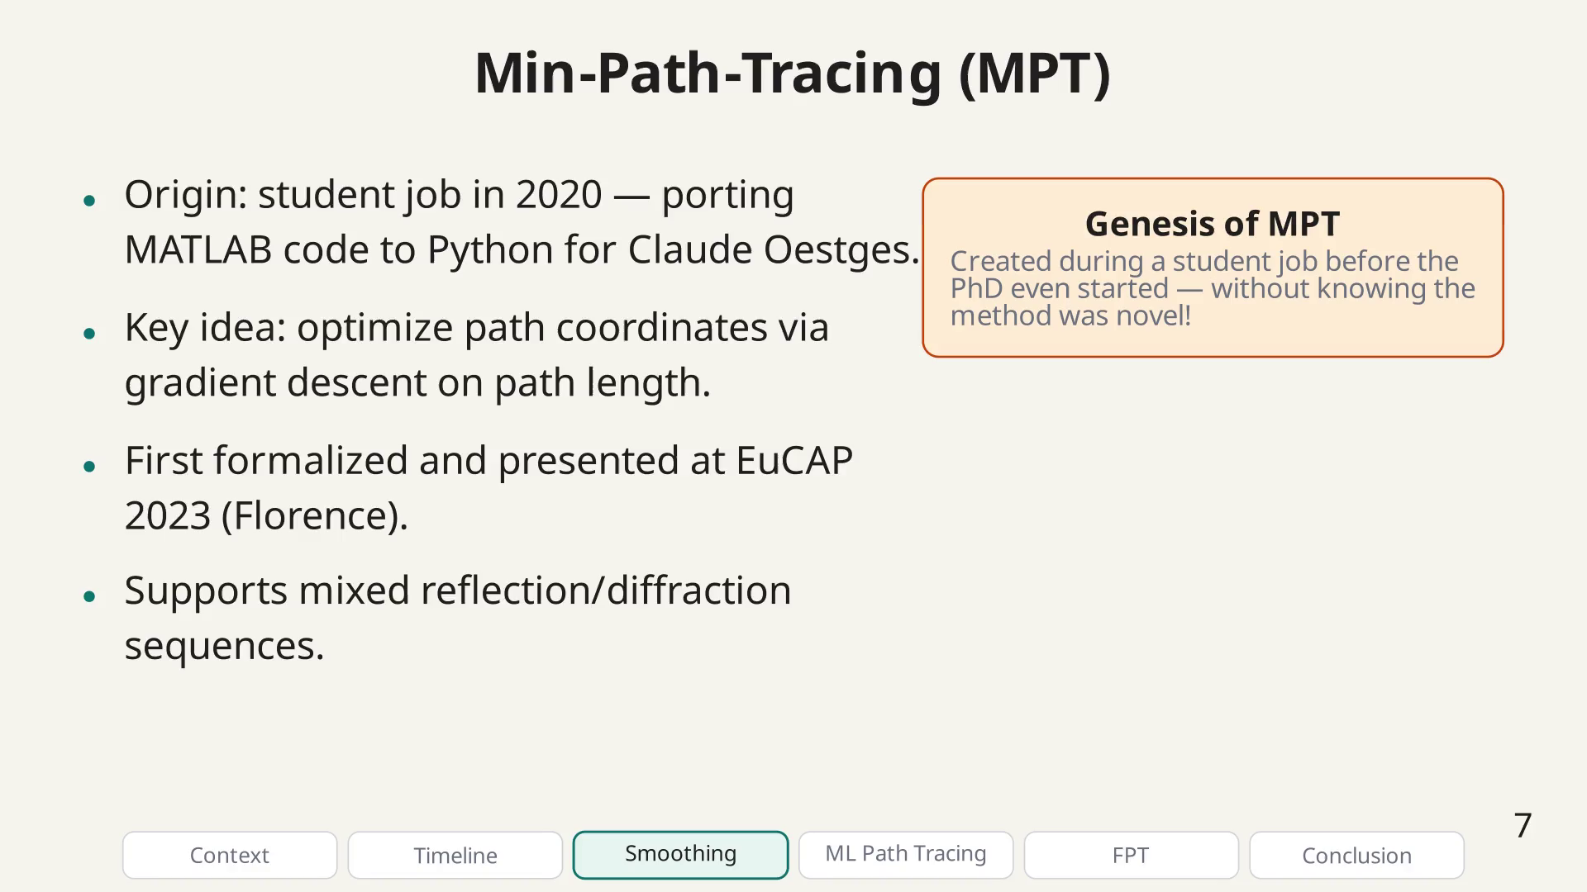
Notes:
MPT bullet.

Slide 38
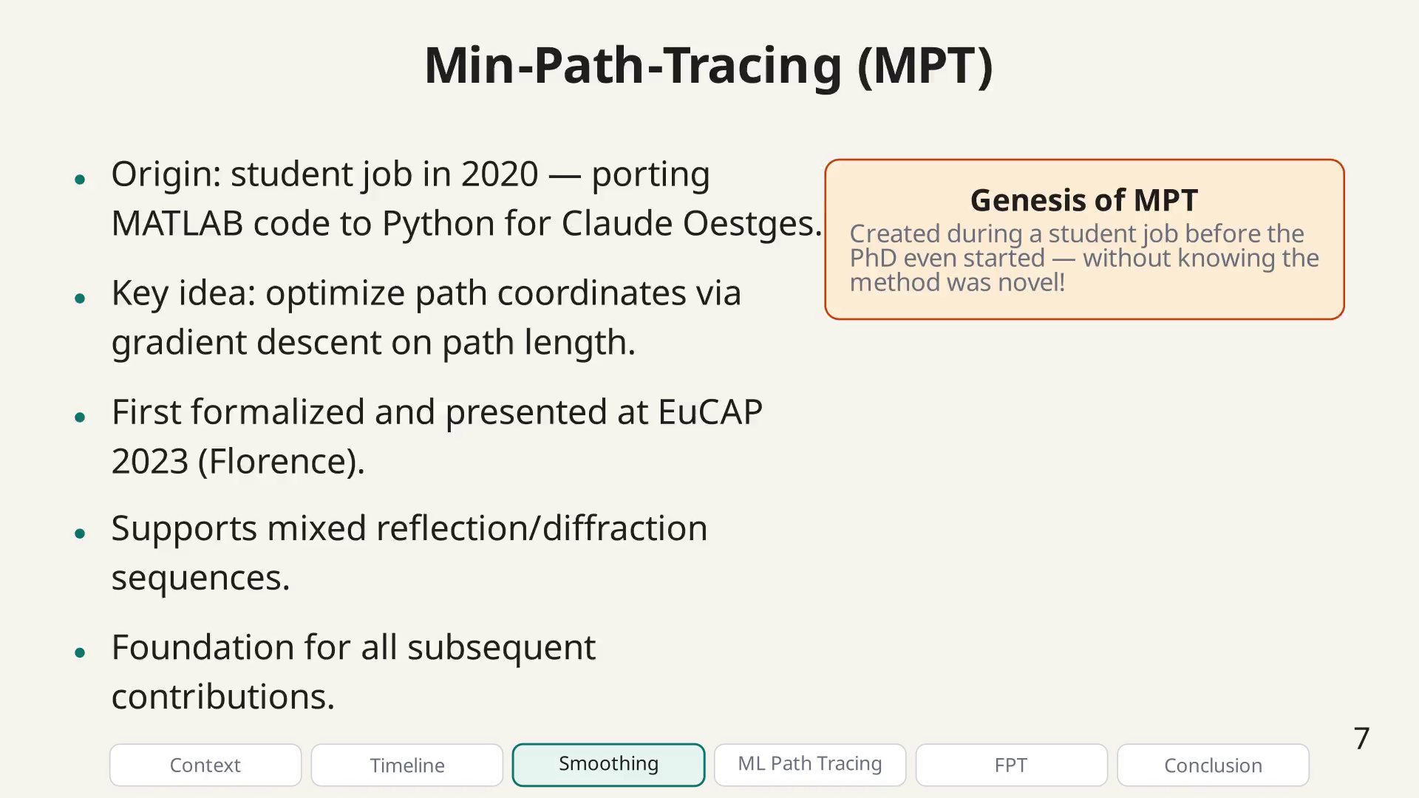
Notes:
The core challenge for differentiable RT is that visibility tests — checking whether a path is blocked — involve hard if-else conditions that break gradient flow. Our smoothing technique replaces these with continuous approximations.

Slide 39
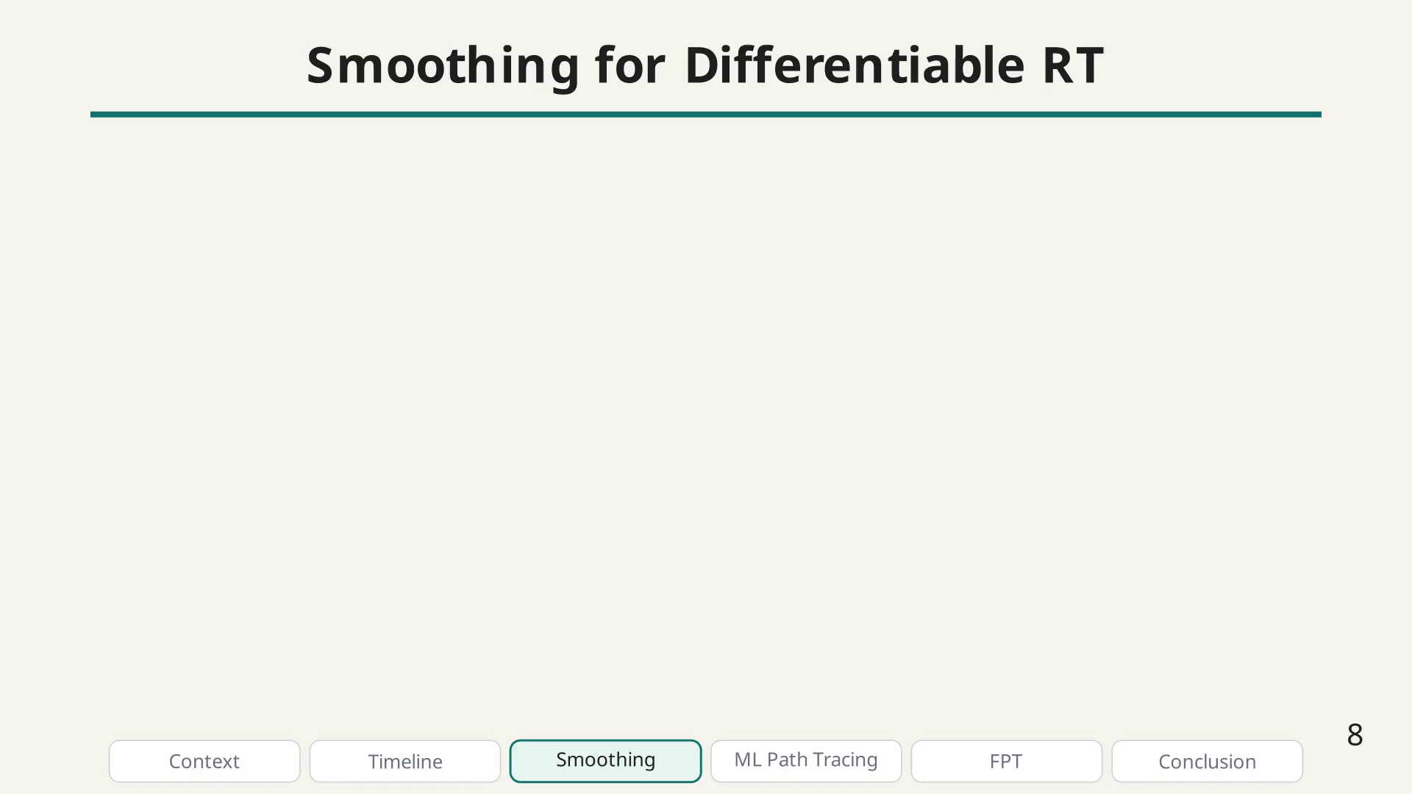
Notes:
Hard → smooth transition.

Slide 40
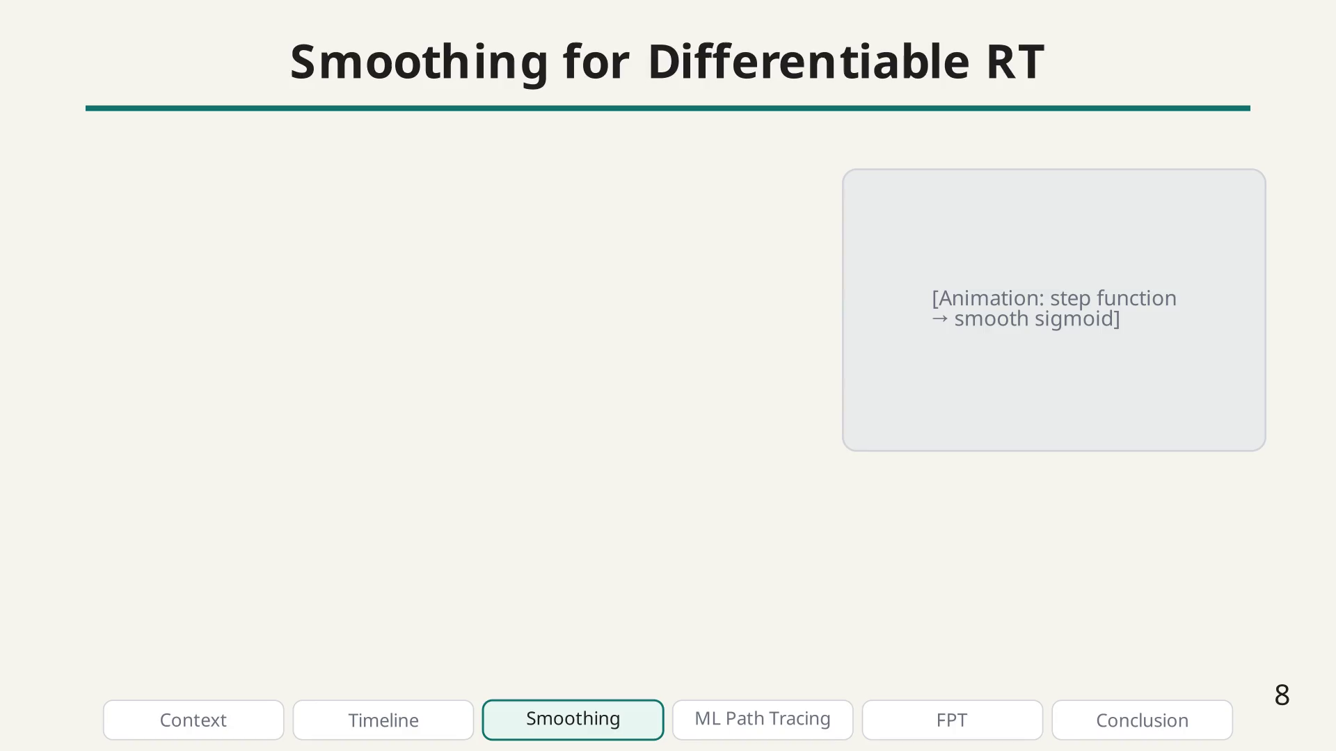
Notes:
Smoothing bullet.

Slide 41
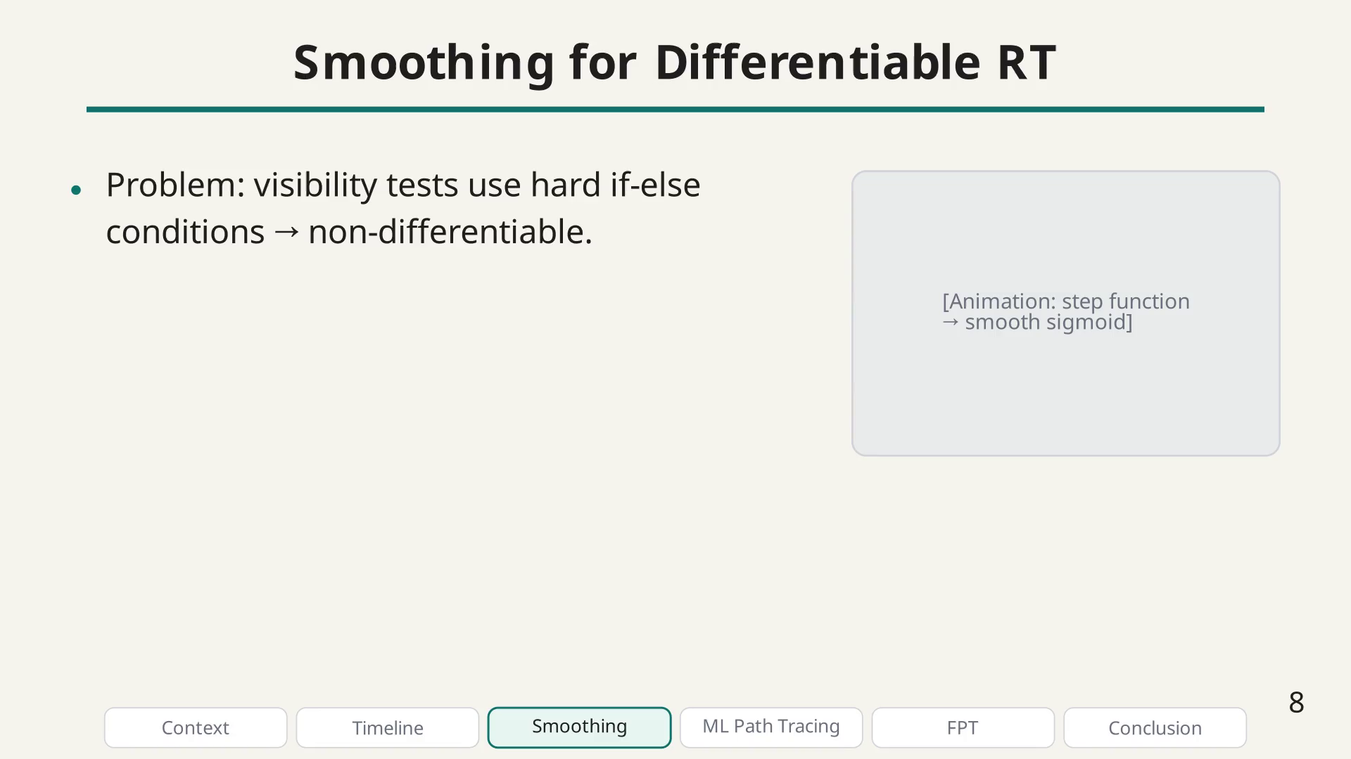
Notes:
Smoothing bullet.

Slide 42
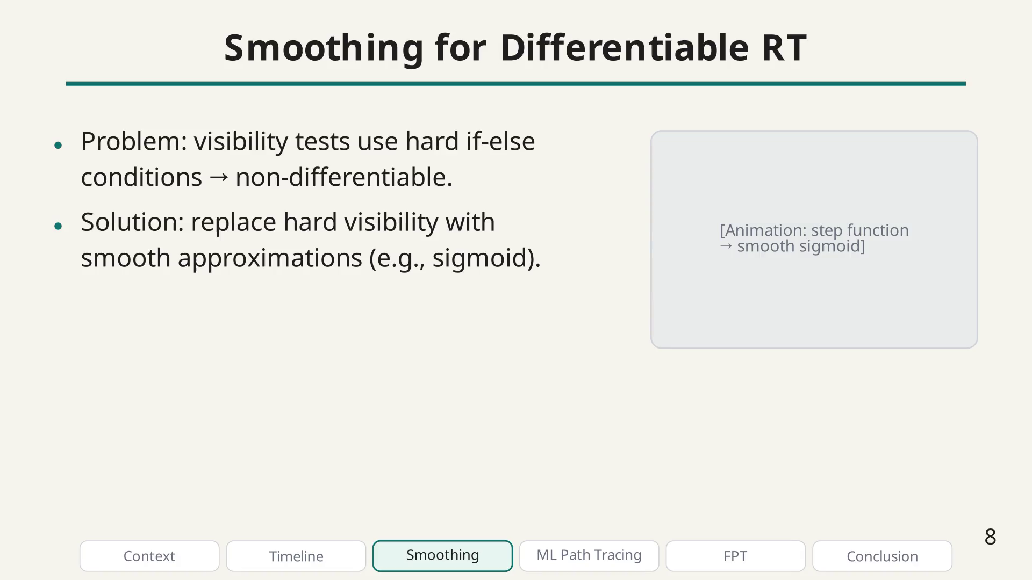
Notes:
Smoothing bullet.

Slide 43
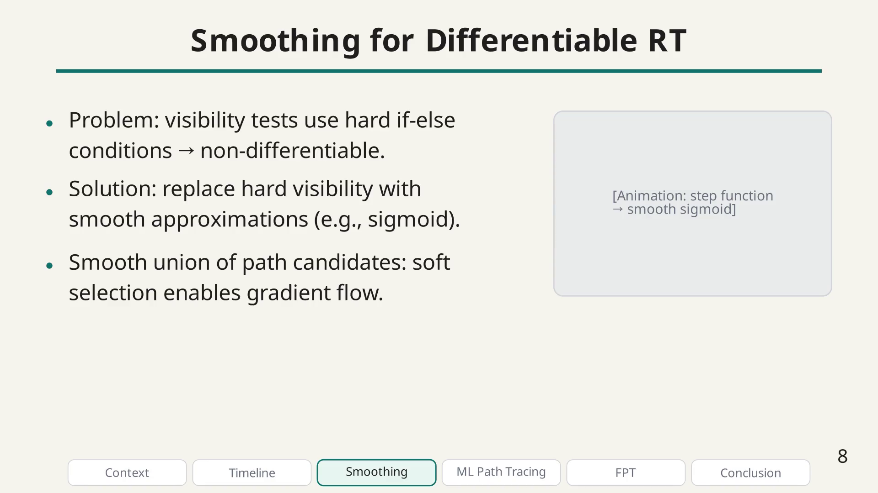
Notes:
Smoothing bullet.

Slide 44
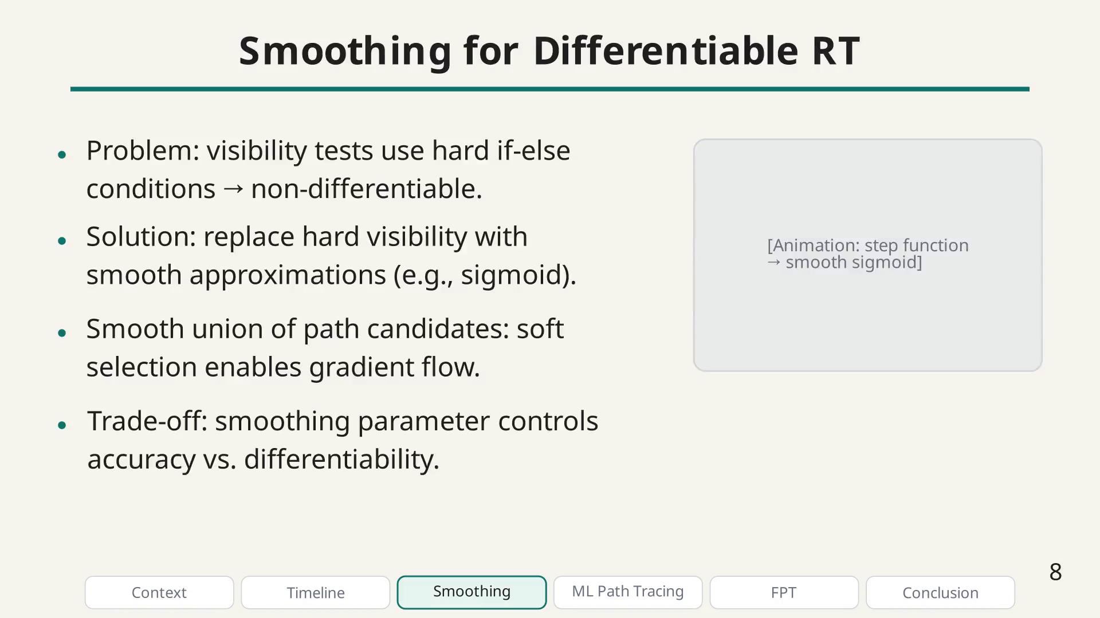
Notes:
The smoothing technique was presented at EuCAP 2024 and has become my most cited work. It enables fully differentiable ray tracing, which we applied to antenna placement and material calibration.

Slide 45
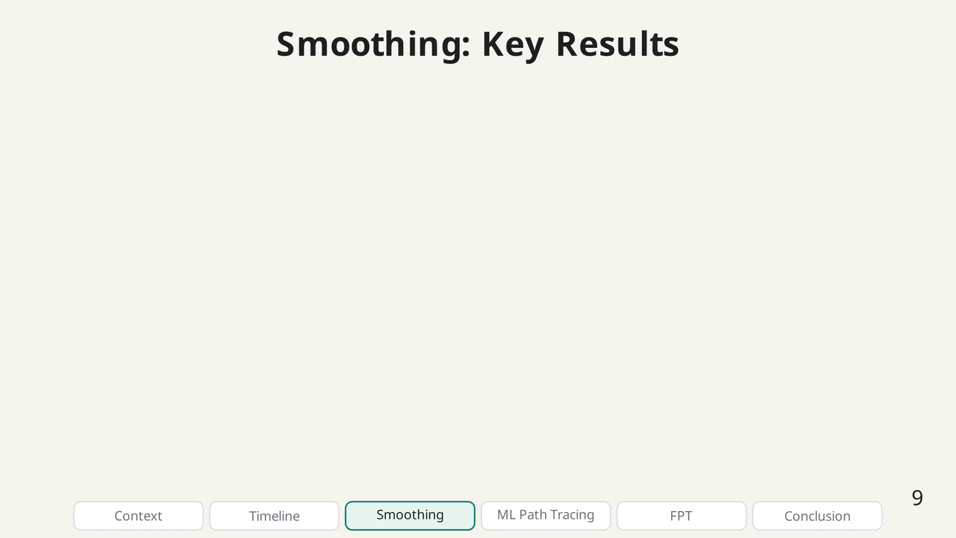
Notes:
Result figure placeholder.

Slide 46
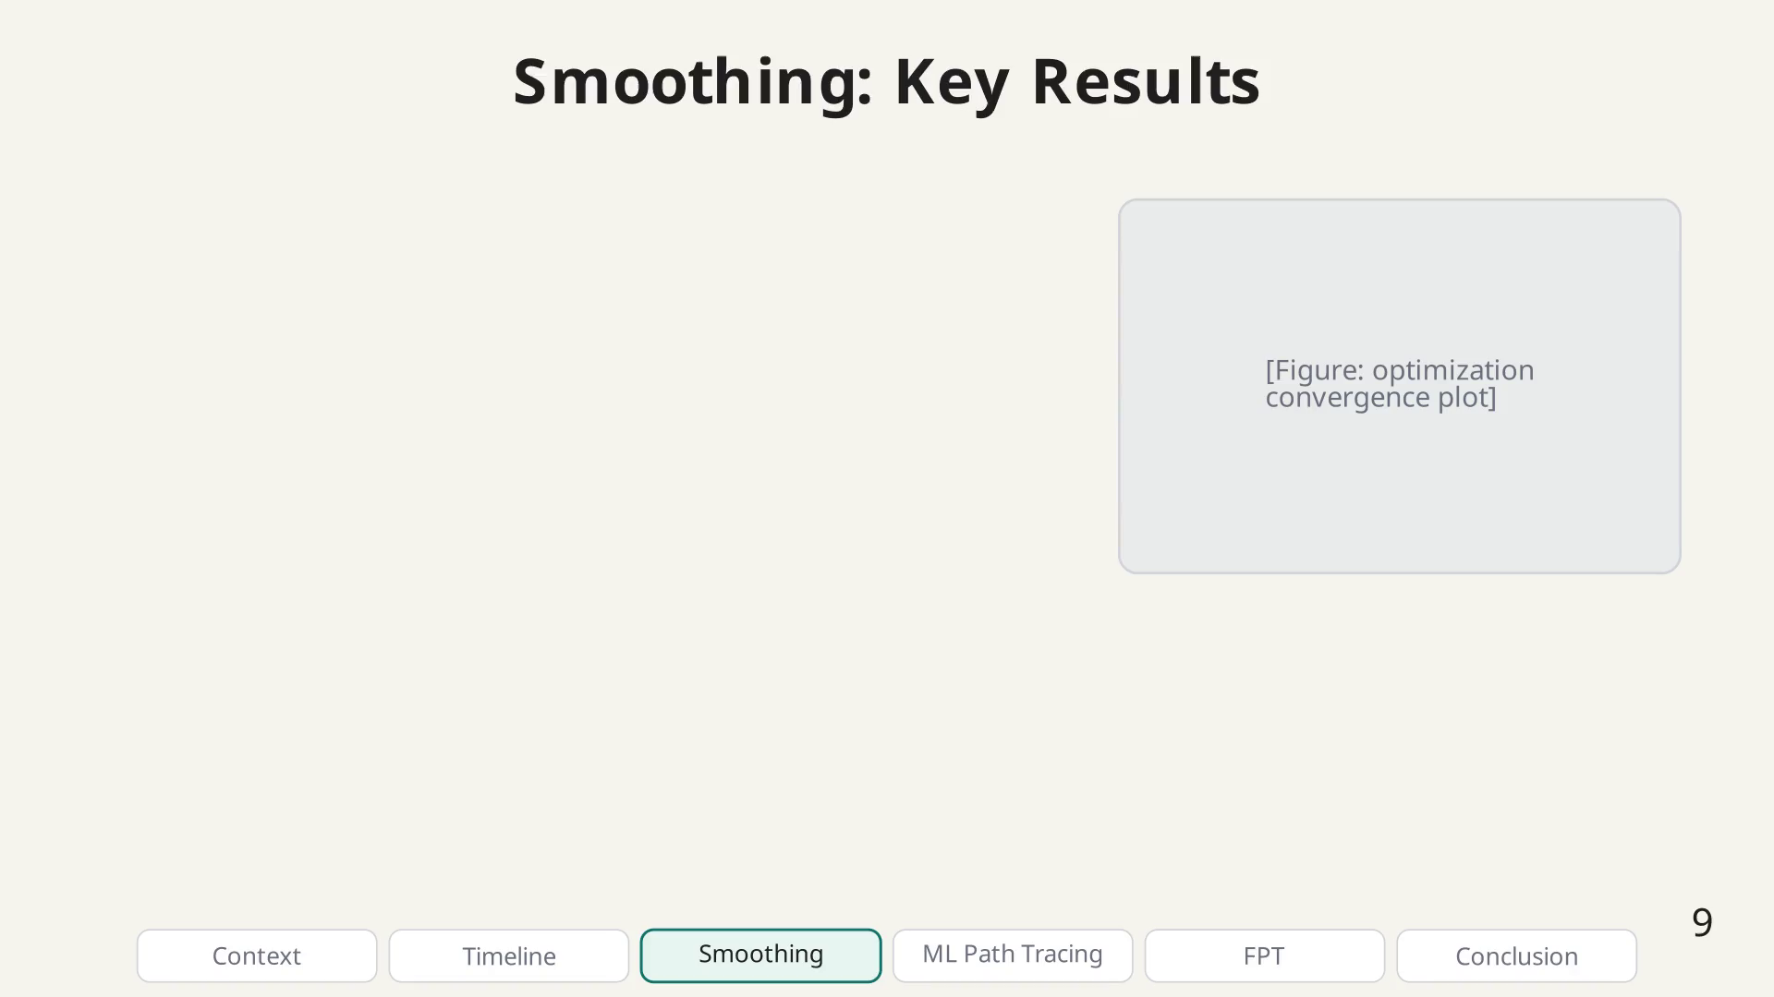
Notes:
Smoothing result bullet.

Slide 47
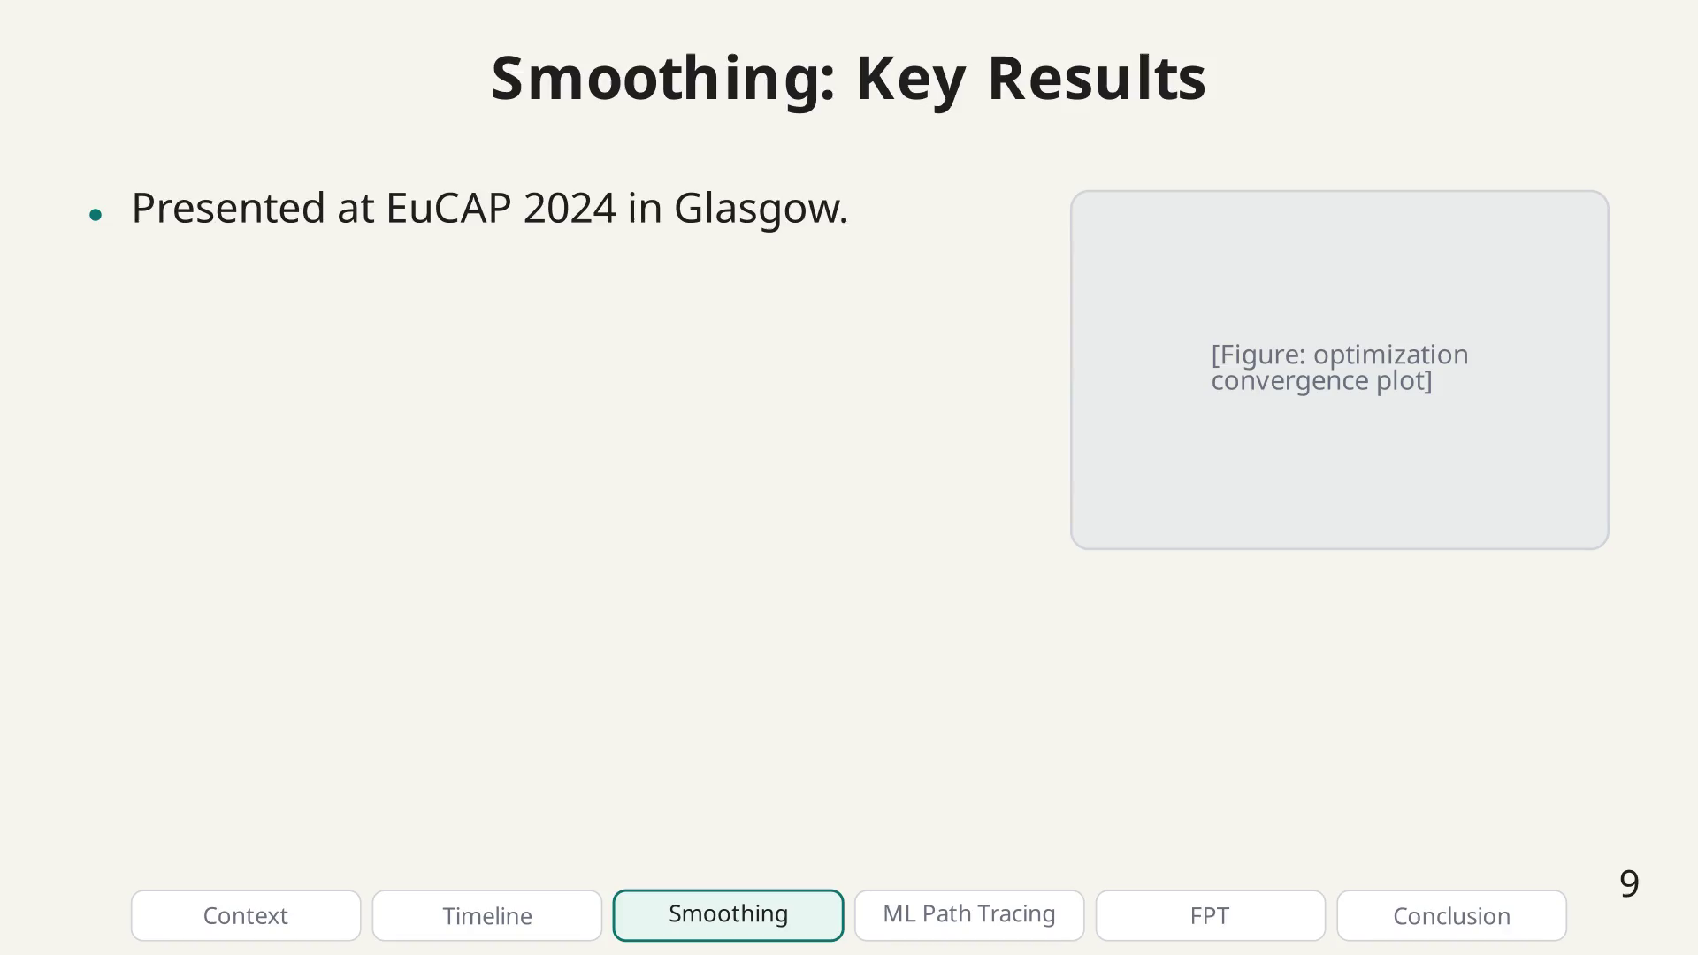
Notes:
Smoothing result bullet.

Slide 48
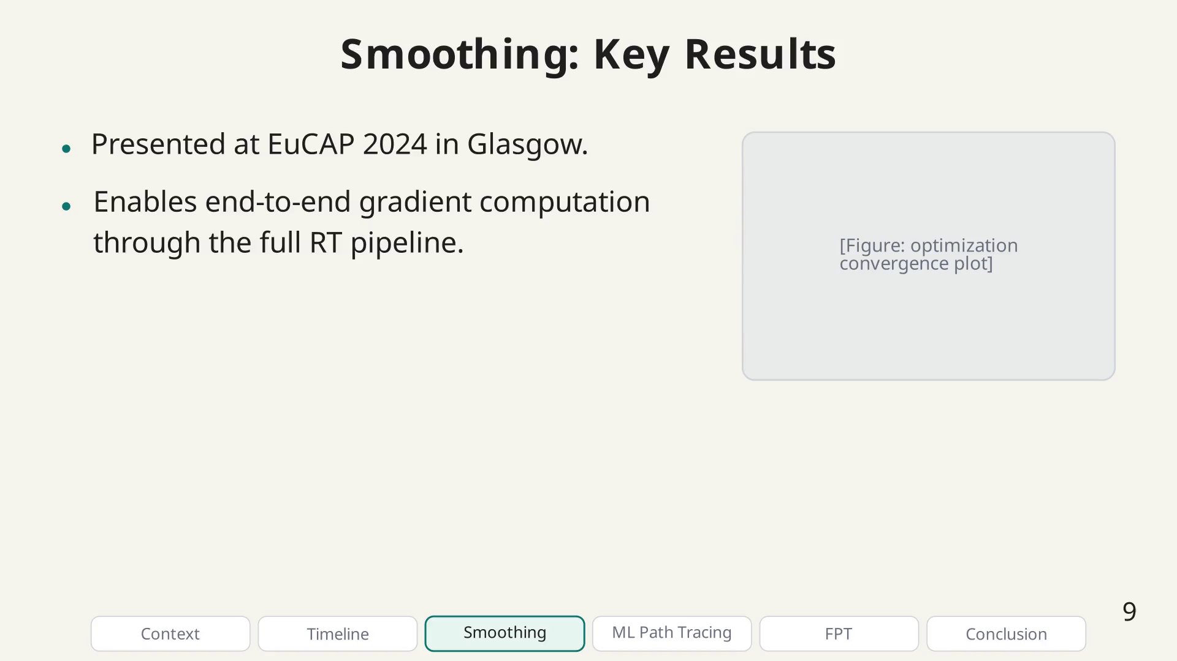
Notes:
Smoothing result bullet.

Slide 49
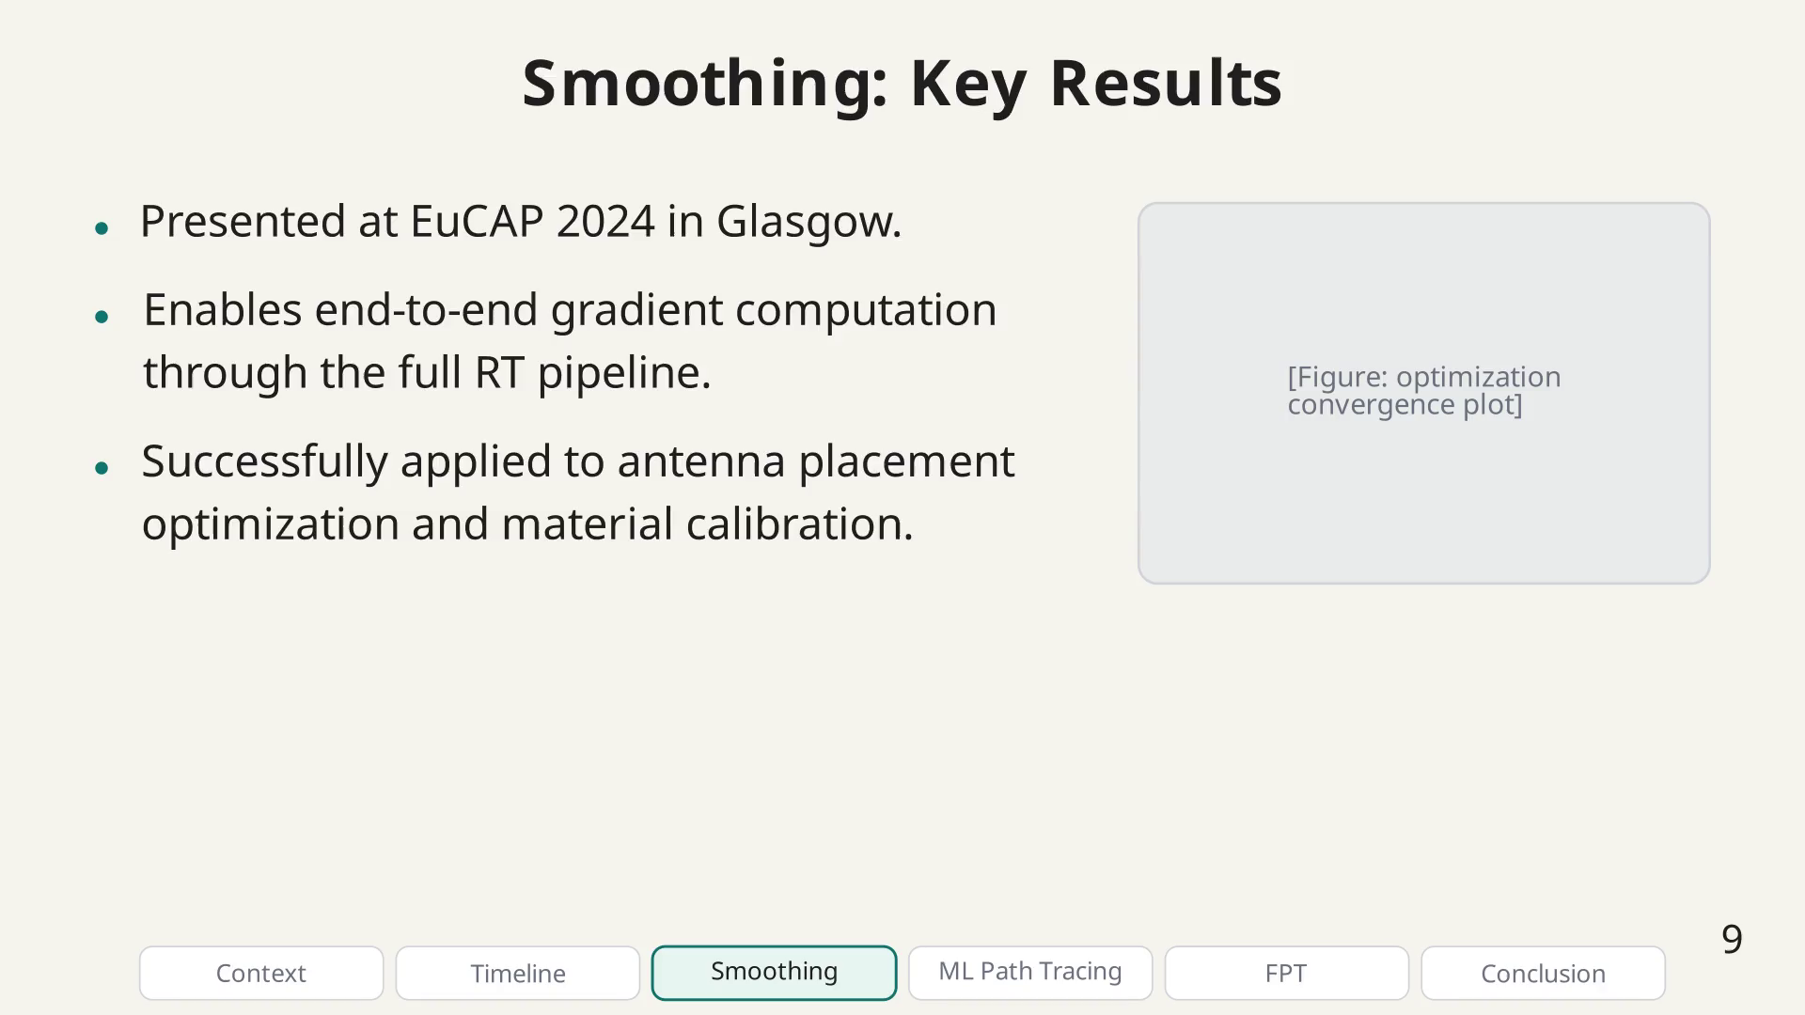
Notes:
Smoothing result bullet.

Slide 50
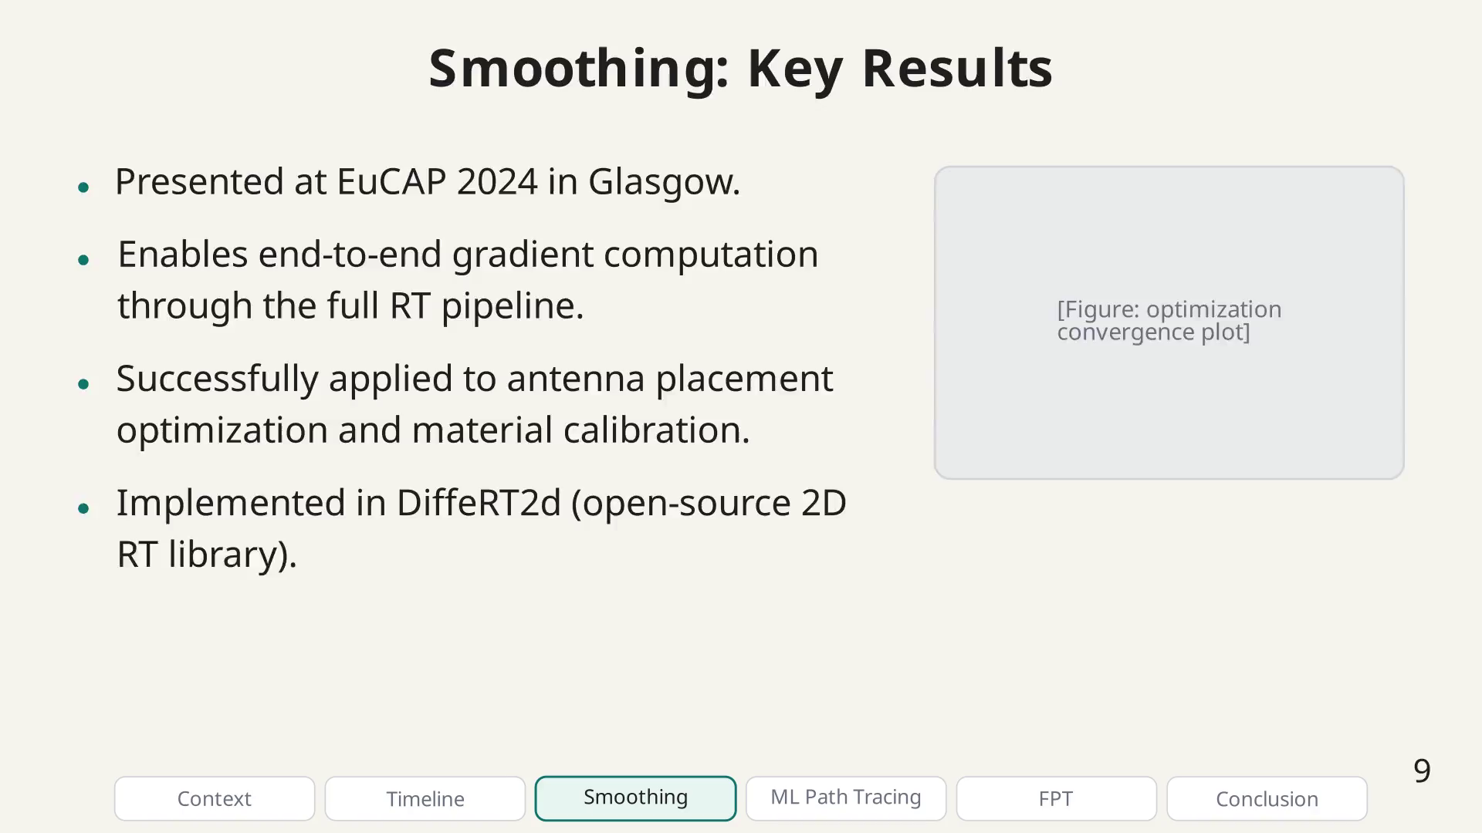
Notes:
The smoothing technique has had a lasting impact: it is my most cited work and has been adopted by other groups. It also led to DiffeRT2d, an open-source library I built for teaching and rapid prototyping of differentiable RT.

Slide 51
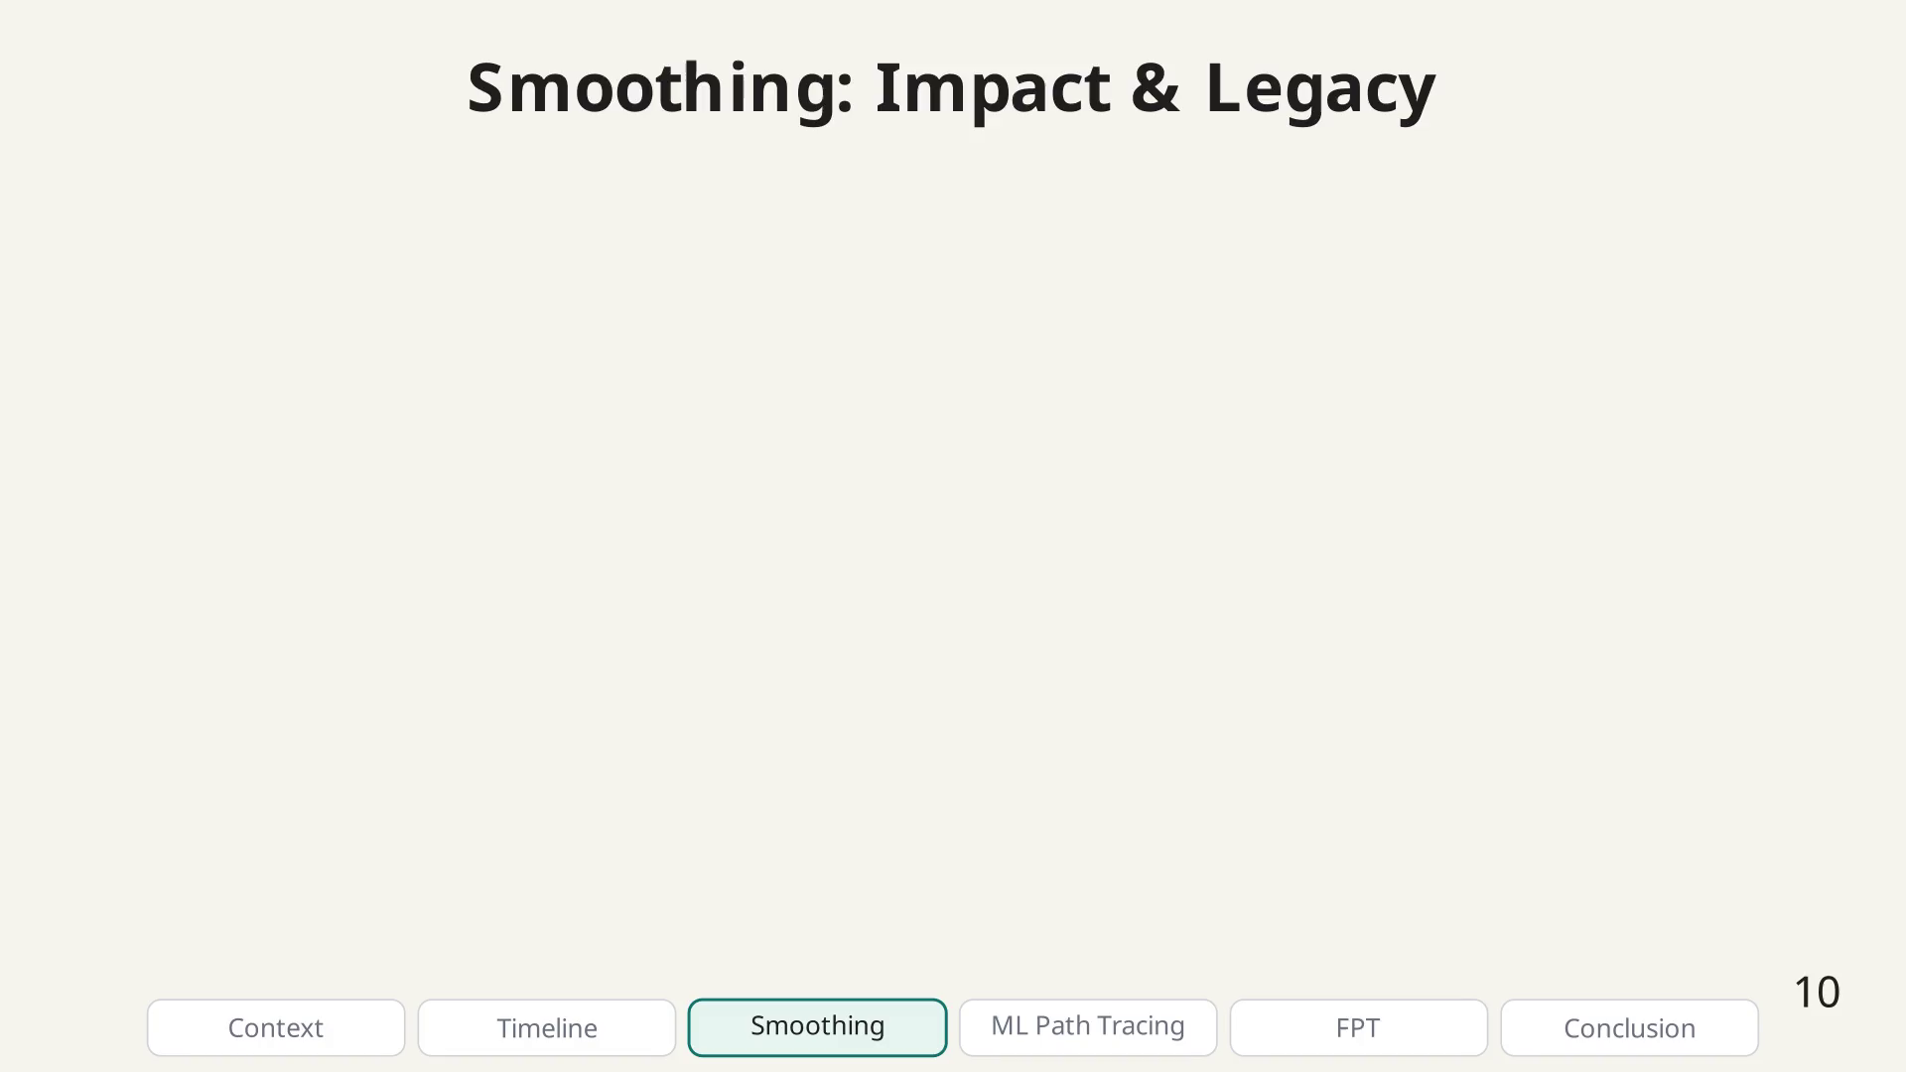
Notes:
DiffeRT2d card.

Slide 52

Notes:
Impact bullet.

Slide 53

Notes:
Impact bullet.

Slide 54

Notes:
Impact bullet.

Slide 55

Notes:
Impact bullet.

Slide 56

Notes:
The second main contribution is about using machine learning for path tracing. While the optimization-based methods work well, they still require iterating for each path candidate. The idea here is to learn a model that directly predicts valid paths.

Slide 57

Notes:
ML motivation bullet.

Slide 58

Notes:
ML motivation bullet.

Slide 59

Notes:
ML motivation bullet.

Slide 60

Notes:
ML motivation bullet.

Slide 61

Notes:
This contribution was born from a collaboration through the COST INTERACT action. I first visited Cesena in April 2024, and then spent four months in Bologna working with Prof. Vitucci and Prof. Degli-Esposti.

Slide 62

Notes:
Collaboration map placeholder.

Slide 63

Notes:
Collaboration bullet.

Slide 64

Notes:
Collaboration bullet.

Slide 65

Notes:
Collaboration bullet.

Slide 66

Notes:
Collaboration bullet.

Slide 67

Notes:
The ML architecture is a generative model: given the scene geometry and TX/RX positions, it predicts the interaction points for each path candidate. The model is trained on data generated from conventional RT.

Slide 68

Notes:
Architecture block 1.

Slide 69

Notes:
Architecture block 2.

Slide 70

Notes:
Architecture block 3.

Slide 71

Notes:
Architecture block 4.

Slide 72

Notes:
Architecture block 5.

Slide 73

Notes:
Architecture description bullet.

Slide 74

Notes:
Architecture description bullet.

Slide 75

Notes:
Architecture description bullet.

Slide 76

Notes:
The model is trained on large-scale simulations. Each training sample consists of a scene configuration, TX/RX positions, and the ground-truth path coordinates computed by conventional RT.

Slide 77

Notes:
Training/validation curves placeholder.

Slide 78

Notes:
Training bullet.

Slide 79

Notes:
Training bullet.

Slide 80

Notes:
Training bullet.

Slide 81

Notes:
Training bullet.

Slide 82

Notes:
The ML-based approach achieves significant speedups while maintaining accuracy comparable to conventional RT. This work was presented at ICMLCN 2025.

Slide 83

Notes:
Results comparison placeholder.

Slide 84

Notes:
ML result bullet.

Slide 85

Notes:
ML result bullet.

Slide 86

Notes:
ML result bullet.

Slide 87

Notes:
ML result bullet.

Slide 88

Notes:
The full journal version of this work was submitted to npj Wireless Technology in March 2026. It is the most comprehensive contribution of my thesis.

Slide 89

Notes:
Journal bullet.

Slide 90

Notes:
Journal bullet.

Slide 91

Notes:
Journal bullet.

Slide 92

Notes:
Journal bullet.

Slide 93

Notes:
Key note about journal status.

Slide 94

Notes:
The third and final contribution is the Fermat Path Tracing method, presented at EuCAP 2026. The key idea is a unified convex formulation that handles both reflection and diffraction using the same parametrization.

Slide 95

Notes:
Annotated geometry / equation.

Slide 96

Notes:
FPT setup bullet.

Slide 97

Notes:
FPT setup bullet.

Slide 98

Notes:
FPT setup bullet.

Slide 99

Notes:
FPT setup bullet.

Slide 100

Notes:
FPT setup bullet.

Slide 101

Notes:
We use a BFGS quasi-Newton solver, which is well-suited for GPU execution because we fix the number of iterations to ensure uniform kernel execution.

Slide 102

Notes:
BFGS bullet.

Slide 103

Notes:
BFGS bullet.

Slide 104

Notes:
BFGS bullet.

Slide 105

Notes:
BFGS bullet.

Slide 106

Notes:
BFGS bullet.

Slide 107

Notes:
Why BFGS?

Slide 108

Notes:
A key insight is the use of implicit differentiation. Instead of unrolling all solver iterations through the backward pass (which costs O(K) memory), we use the implicit function theorem at the converged solution.

Slide 109

Notes:
Implicit diff bullet.

Slide 110

Notes:
Implicit diff bullet.

Slide 111

Notes:
Implicit diff bullet.

Slide 112

Notes:
Implicit diff bullet.

Slide 113

Notes:
The implicit differentiation formula only requires the converged solution, not the full iteration history.

Slide 114

Notes:
The FPT method was benchmarked against existing approaches. Our solver approaches the speed of the image method while supporting both reflections and diffractions in a unified framework.

Slide 115

Notes:
Benchmark figure placeholder.

Slide 116

Notes:
FPT result bullet.

Slide 117

Notes:
FPT result bullet.

Slide 118

Notes:
FPT result bullet.

Slide 119

Notes:
FPT result bullet.

Slide 120

Notes:
All of these contributions are implemented in open-source software. DiffeRT is the full 3D library, while DiffeRT2d is a lightweight 2D version I created for prototyping and teaching.

Slide 121

Notes:
Software cards.

Slide 122

Notes:
Open source bullet.

Slide 123

Notes:
Open source bullet.

Slide 124

Notes:
Open source bullet.

Slide 125

Notes:
Open source bullet.

Slide 126

Notes:
Open source bullet.

Slide 127

Notes:
Let me now summarize the three main contributions: the smoothing technique, the ML-based generative path tracing, and the Fermat Path Tracing method.

Slide 128

Notes:
Plus cross-cutting contributions.

Slide 129

Notes:
Beyond the scientific contributions, I am particularly proud of several achievements: building DiffeRT, the international collaborations, creating Manim Slides (which I am actually using right now to present these slides!), and contributing to the COST book.

Slide 130

Notes:
Proud achievement bullet.

Slide 131

Notes:
Proud achievement bullet.

Slide 132

Notes:
Proud achievement bullet.

Slide 133

Notes:
Proud achievement bullet.

Slide 134

Notes:
Proud achievement bullet.

Slide 135

Notes:
Looking ahead, several exciting research directions remain open. The main bottleneck remains the availability of efficient open GPU solvers.

Slide 136

Notes:
Future direction bullet.

Slide 137

Notes:
Future direction bullet.

Slide 138

Notes:
Future direction bullet.

Slide 139

Notes:
Future direction bullet.

Slide 140

Notes:
Future direction bullet.

Slide 141

Notes:
Key bottleneck warning.

Slide 142

Notes:
Thank you all for your attention. I am happy to take your questions. The code, slides, and all related materials are available on GitHub.

Slide 143

Notes:
Backup slide: other contributions not covered in the main presentation.

Slide 144

Notes:
Other contribution bullet.

Slide 145

Notes:
Other contribution bullet.

Slide 146

Notes:
Other contribution bullet.

Slide 147

Notes:
Other contribution bullet.

Slide 148

Notes:
Other contribution bullet.

Slide 149

Notes:
Backup slide: full list of publications during the PhD.

